Slide 1

AGV for modern Logistics in industrial companies
www.continental-corporation.com

Slide 2
Content
Hardware:
    Smart equipment definition
    AGV selection
    AGV description
    Rack design and Standard alley
Software:
    Advanced Robotics Command Language
    Fleet Management
    Traffic management
    Charge management
    Fleet docking
    Managed Motion Sectors

Slide 3
Content
Hardware:
    Smart equipment
    AGV selection
    AGV description
    Rack design and Standard alley

Slide 4
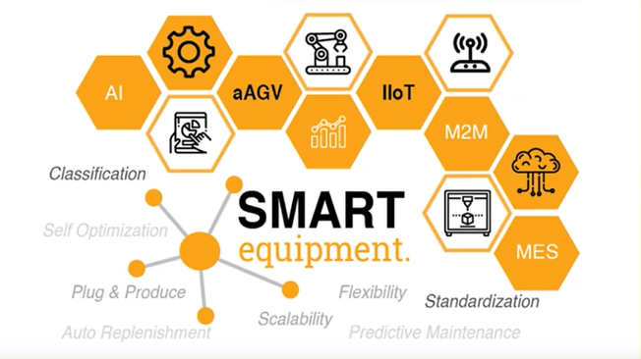
Smart equipment
Smart equipment - equipments that are capable to adapt automatically and modify behavior to fit environment, senses things with technology sensors, this providing data to analyze and infer from, drawing conclusions from rules, capable of learning that is using experience to improve performance.
Technologies that allow sensors, databases, and wireless access to collaboratively sense, adapt, and provide for users within the environment.
Notes:
De luat notițe și printscreen-uri
pentru AGV lăsăm la final
Aici trebuie vorbit despre AGV-uri în general, cine este ele și ce vrea de la noi. Nu pot vorbi de LD 90 RG încă, pentru că îl aleg doar la capitolul următor. Trebuie căutat de pe net, diverse tipuri, istoric, etc. De ex metode de ghidare: benzi magnetice, lasere, poziționare prin wireless, etc. Și așteptat filmulețul despre AGV-uri de pe Stream.

Slide 5
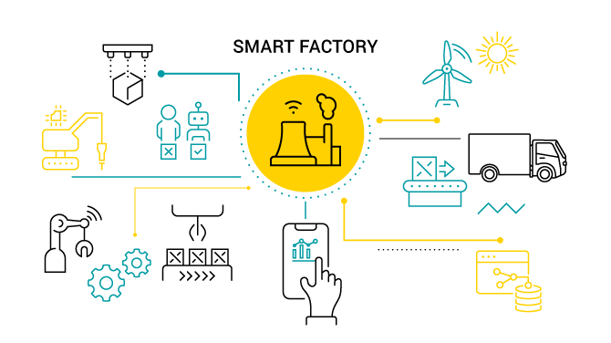
Smart equipment
Smart equipment = intelligent, interconnected and autonomously communicating with the rest of value chain
Smart equpiment can be best defined in terms of characteristics. There are 8 of them:
    Multi-production
    Scalable
    Modularized
    Standardized
    Interconnected
    Intelligent
    Green
Notes:
De luat notițe și printscreen-uri
pentru AGV lăsăm la final
Aici trebuie vorbit despre AGV-uri în general, cine este ele și ce vrea de la noi. Nu pot vorbi de LD 90 RG încă, pentru că îl aleg doar la capitolul următor. Trebuie căutat de pe net, diverse tipuri, istoric, etc. De ex metode de ghidare: benzi magnetice, lasere, poziționare prin wireless, etc. Și așteptat filmulețul despre AGV-uri de pe Stream.

Slide 6
Smart equipment
Smart equpiment can be best defined in terms of characteristics. There are 8 of them:
    Multi-production – is the ability to produce different products which run different process flows in the same production line. It will make our equipment highly utilized and shop floor space more efficiently used.
    Scalable – frequent reconfiguration and easy modifications in terms of size and production volume by ensuring simple hardware mechanisms as well as scalable software. Scalability in production area is the key requirement to optimize future investment.
    Modularized – ensures an easy disassembly by having predefined modules. Moving and reinstallation is possible.
    Standardized – using a standard way of equipment and layout design for hardware, same as using standardized software, programming and communication protocols. It also includes using qualified manufacturing technologies from standard suppliers. At the end of date, standard PMT will leave more flexible production and cost competitiveness on global scale.
Notes:
De luat notițe și printscreen-uri
pentru AGV lăsăm la final
Aici trebuie vorbit despre AGV-uri în general, cine este ele și ce vrea de la noi. Nu pot vorbi de LD 90 RG încă, pentru că îl aleg doar la capitolul următor. Trebuie căutat de pe net, diverse tipuri, istoric, etc. De ex metode de ghidare: benzi magnetice, lasere, poziționare prin wireless, etc. Și așteptat filmulețul despre AGV-uri de pe Stream.

Slide 7
Smart equipment
Smart equpiment can be best defined in terms of characteristics. There are 8 of them:
    Automated – Not only the core process itself, but also product handling between each process and material replenishment is executed by Smart automatic solutions or robotics.
    Interconnected – equipment is horizontally connected with other processes and machines and vertically connected with an upper level control system.
    Intelligent – ability to collect data and analyze it for real time monitoring. So further predictive maintenance and troubleshooting is possible. Also able to change to the right program and adjust parameters automatically whenever required.
    Green – less energy consumption and self energy control in case of idling.
Notes:
De luat notițe și printscreen-uri
pentru AGV lăsăm la final
Aici trebuie vorbit despre AGV-uri în general, cine este ele și ce vrea de la noi. Nu pot vorbi de LD 90 RG încă, pentru că îl aleg doar la capitolul următor. Trebuie căutat de pe net, diverse tipuri, istoric, etc. De ex metode de ghidare: benzi magnetice, lasere, poziționare prin wireless, etc. Și așteptat filmulețul despre AGV-uri de pe Stream.

Slide 8
Smart equipment
AGV’s – automated guided vehicles:
    an example of Smart Equipment.
    are generally used to carry heavy materials in factory buildings or warehouses;
    can be used for taking-over and handing-over defined reusable packaging as well as automatic transport between defined pick-up and drop-off positions;
    the system operates self-guided and recharges automatically when required by means of a fixed-position charging station;
    can be used for taking-over and handing-over defined reusable packaging as well as automatic transport between defined pick-up and drop-off positions.
Notes:
De luat notițe și printscreen-uri
pentru AGV lăsăm la final
Aici trebuie vorbit despre AGV-uri în general, cine este ele și ce vrea de la noi. Nu pot vorbi de LD 90 RG încă, pentru că îl aleg doar la capitolul următor. Trebuie căutat de pe net, diverse tipuri, istoric, etc. De ex metode de ghidare: benzi magnetice, lasere, poziționare prin wireless, etc. Și așteptat filmulețul despre AGV-uri de pe Stream.

Slide 9
Smart equipment
  AGV’s can guide themselves using one or more of the many means of navigation:
    Wired
    Guide tape
    Laser target navigation
    Inertial (Gyroscopic) navigation
    Natural feature (Natural Targeting) navigation
    Vision guidance
    Geoguidance
Notes:
De luat notițe și printscreen-uri
pentru AGV lăsăm la final
Aici trebuie vorbit despre AGV-uri în general, cine este ele și ce vrea de la noi. Nu pot vorbi de LD 90 RG încă, pentru că îl aleg doar la capitolul următor. Trebuie căutat de pe net, diverse tipuri, istoric, etc. De ex metode de ghidare: benzi magnetice, lasere, poziționare prin wireless, etc. Și așteptat filmulețul despre AGV-uri de pe Stream.

Slide 10
Smart equipment
  There are different types of AGV’s depending on their application:
    Towing vehicles (“tugger” vehicles) – first type introduced; used for pulling a multitude of trailer types and have capacities ranging from 1 tone to 75 tonnes.
    AGVS Unit Load Vehicles are equipped with decks, which permit unit load transportation and often automatic load transfer. The decks can either be lift and lower type, powered or non-powered roller, chain or belt decks or custom decks with multiple compartments.
    AGVS Pallet Trucks are designed to transport palletized loads to and from floor level; eliminating the need for fixed load stands.
Notes:
De luat notițe și printscreen-uri
pentru AGV lăsăm la final
Aici trebuie vorbit despre AGV-uri în general, cine este ele și ce vrea de la noi. Nu pot vorbi de LD 90 RG încă, pentru că îl aleg doar la capitolul următor. Trebuie căutat de pe net, diverse tipuri, istoric, etc. De ex metode de ghidare: benzi magnetice, lasere, poziționare prin wireless, etc. Și așteptat filmulețul despre AGV-uri de pe Stream.

Slide 11
Smart equipment
  AGVS Fork Truck can service loads both at floor level and on stands. In some cases, these vehicles can also stack loads in rack. They can sometimes lift to 30' to store or retrieve on high-bay racking.
  AGVS Hybrid Vehicles are adapted from a standard man-aboard truck so that they can run fully automated or be driven by a fork truck driver. These can be used for trailer loading as well as moving materials around warehouses. Most often, they are equipped with forks, but can be customized to accommodate most load types.
  Light Load AGVS are vehicles which have capacities about 500 pounds or less and are used to transport small parts, baskets, or other light loads though a light manufacturing environment. They are designed to operate in areas with limited space.
  AGVS Assembly Line Vehicles are an adaptation of the light load AGVS for applications involving serial assembly processes.
Notes:
De luat notițe și printscreen-uri
pentru AGV lăsăm la final
Aici trebuie vorbit despre AGV-uri în general, cine este ele și ce vrea de la noi. Nu pot vorbi de LD 90 RG încă, pentru că îl aleg doar la capitolul următor. Trebuie căutat de pe net, diverse tipuri, istoric, etc. De ex metode de ghidare: benzi magnetice, lasere, poziționare prin wireless, etc. Și așteptat filmulețul despre AGV-uri de pe Stream.

Slide 12
AGV selection
AGV’s used in Continental Sibiu were chosen based on certain criteria, such as:
  Payload - the LD90 models can transport 90 kilograms (the ones we use in the production area have a conveyor system mounted which weighs 45 kilograms )
  Standad stock unit - the LD90 models can transport the standard KLT, with the dimensions being 600x400 mm.
  ESD - the LD90 model comes with a modified body made especially for Electronical Plants to prevent electrostatic discharge.
Notes:
De vorbit cu Cojoc
poză cu KLT (eventual cu dimensiuni)
90 e sarcina maximă (45 e partea de conveior)
Folosim aceleași KLT-uri (aceleași dimensiuni) ca la Regensburg, adaptate pe Plant Sibiu

Slide 13
Content
AGV Description
      Platform
      Motor
      Control unit & communication unit
      Brakes, sensors, etc.
      Operator panel

Slide 14
AGV Description
The LD Platform OEM is a general-purpose, mobile robot platform, designed to work indoors and around people. It is self-guided and self-charging, with an automated docking station.
The LD Platform OEM is designed to operate in indoor industrial or professional environments. In general, if a wheelchair can safely and easily navigate the environment (open, with gentle slopes), then it is safe for the robot.

Slide 15
AGV Description
The platform includes a navigation laser, front bumper with low front laser, and two rear-facing sonar pairs. Each pair is a transmitter and a receiver.
LD Platform Core, includes an integrated computer, running Advanced Robotics Automation Management (ARAM) and a microcontroller with Mobile Adept Robot Controller (MARC) firmware. It also runs the SetNetGo OS. The core is housed inside the platform.

Slide 16
AGV Description
Motor
  Each platform uses a two-wheel, differential-drive, with spring-loaded passive casters front and rear for balance. The drive-wheels have independent spring-suspension, with solid, foam filled tires. The wheels are at the platform's mid-line, so the platform can turn in place.

Slide 17
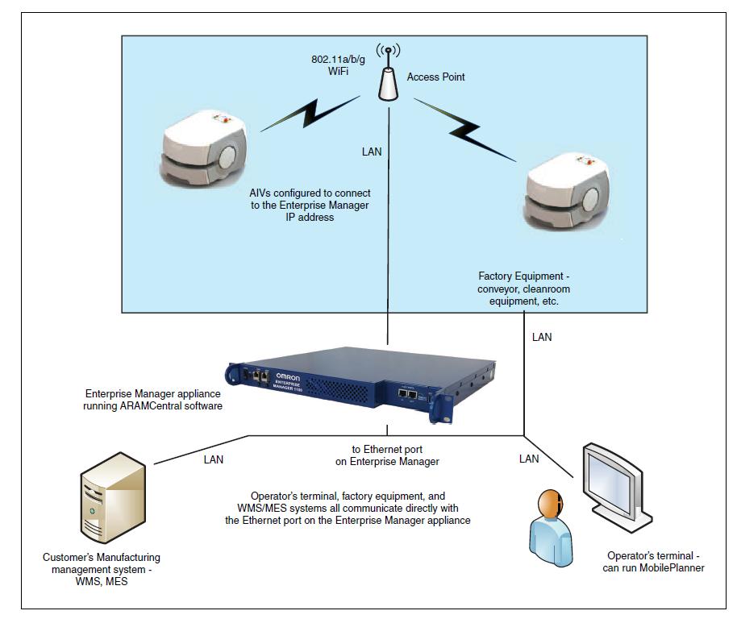
AGV Description
Control unit & communication unit
  The AGVs are connected to
  access points in the production area
  The access points are connected
  to the Fleet Manager, which is the
  “bridge” between the AGVs and them
  operator
  The Fleet Manager is connected
  to multiple pieces of factory equipment,
  a management system and the operator’s
  terminal

Slide 18
AGV Description
Control unit & communication unit
  Enterprise Manager 1100
    is a hardware and software solution that helps you to manage a fleet of AGVs. The Enterprise Manager appliance can communicate with the AGVs in the fleet and perform a variety of fleet-oriented tasks.
    system consists of the Mobile Robot Software Suite running on an Enterprise Manager appliance. It allows you to manage map and configuration updates in a central location, which are then pushed out to each AGV in the fleet. It includes a queuing manager, which ensures that all of the requested tasks get performed by assigning them to appropriate AGVs.

Slide 19
AGV Description
Brakes, sensors, etc.
    The LD Platform OEM uses a Safety Scanning Laser (with a 275-degree radius) as its primary guidance to navigate, comparing the laser readings to a digital map stored in the platform's Core. The platform can detect people moving around it in a 4-meter area
    For navigation, the AGV’s in Continental Sibiu use geolocation and magnetic tape for fine positioning.
    Once it scans its environment, the platform knows where it is within a workspace, and can navigate safely and autonomously to any accessible destination within that workspace, continuously and without human intervention.
Notes:
De făcut idee generală pentru text

Slide 20
AGV Description
Operator panel

Slide 21
AGV Description
Operator panel
The operator panel includes a screen, an E-Stop button, ON and OFF buttons, a brakerelease button, and a keyswitch (which you can lock, in either position, and remove the key).
    When the red E-Stop button has been pressed it removes power from the motors and gives the platform time (1 second delay) to stop safely
    The ON and OFF buttons are used to turn the AGV on or off. The ON button can also be used to restore power after the E-Stop has been pressed; the OFF button can be disabled by the keyswitch
    The brake release button is used when you need to manually move the AGV. Battery power must be used and the E-Stop must be pressed to release the brakes. The button must be held in for the brakes to remain released.

Slide 22
Content
Rack design and standard alley
      Safety requirements related to alley and racks
      1st and 2nd generation racks
      Path and footprints

Slide 23
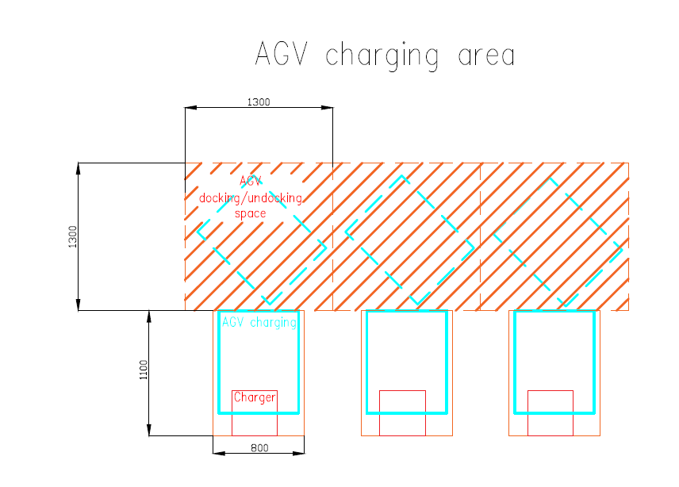
Rack design and standard alley
1-way AGV + people – standard alley is 1600 mm wide.
2-ways AGV + people – standard alley is 2200 mm wide.
In case, width is smaller, the AGV speed is reduced to avoid colisions.

Slide 24
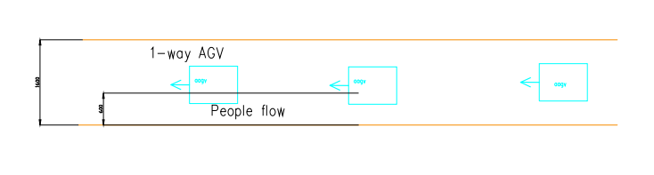
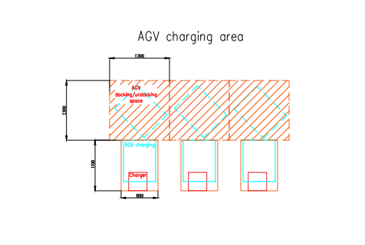
Safety requirements related to alley and racks
Alley for 1-way AGV
Alley for charging station

Slide 25
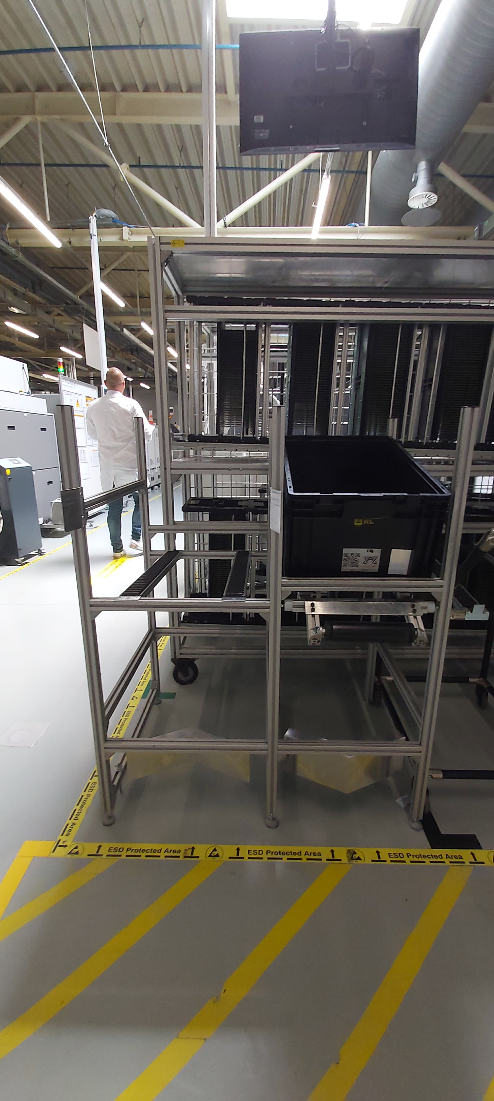
Rack design and standard alley
Single rack – only one purpose, loading or unloading
  It is used only for picking and delivering one KLT at the time on the lines. In this case it uses a two-slot rack.
  The position near the rack for the aAGV is a two-step involvement. First the aAGV delivers the full KLT, then it repositions and picks up the empty KLT.
  This increases the delivery time and the space on the production lines

Slide 26
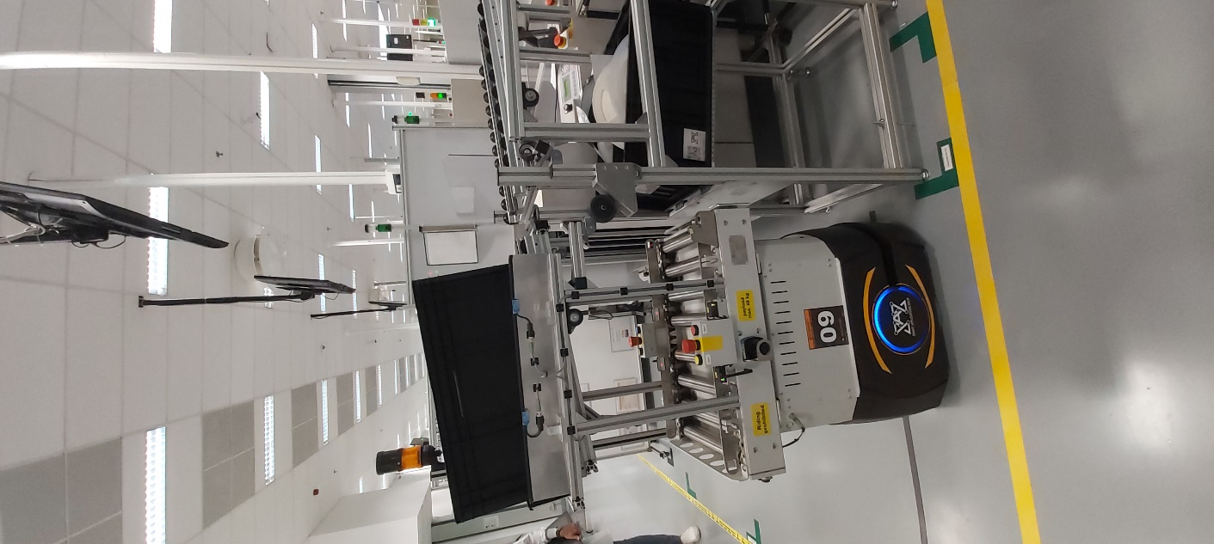
Rack design and standard alley
2nd Generation rack
  With the improvement added by the Smart Application Shop team, the aAGV can deliver the KLT and pick up the empty one at the same time, thus saving production time.
  With the new double rack that is required with this aAGV, the production space required for the rack to be implement is reduced by half.

Slide 27
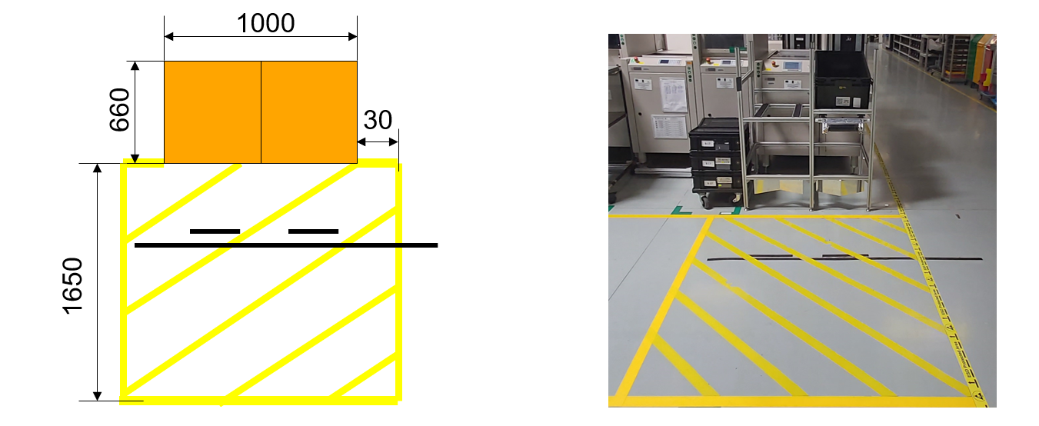
Rack design and standard alley
The required dimensions for a one-way path is 1700 mm.
Footprint of the double-sided rack & floor marking
Rack space
AGV maneuver space
Magnetic tape for AGV positioning

Slide 28
Rack design and standard alley
AGV approaches racks
AGV

Slide 29
Rack design and standard alley
!
AGV detects second magnetic band
AGV

Slide 30
Rack design and standard alley
AGV proceeds to turn 90 degrees upon detection of second magnetic band
AGV

Slide 31
Rack design and standard alley
After picking up materials, the AGV rotates back to its original position and will move towards the next magnetic band
AGV

Slide 32
Rack design and standard alley
AGV detects the third magnetic band and will repeat the previous movement, after which it will leave
!
AGV

Slide 33
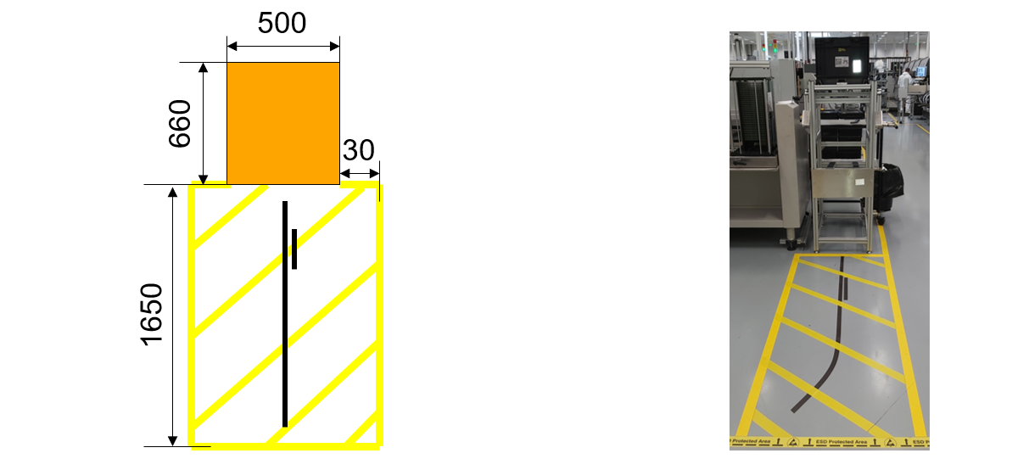
Rack design and standard alley
Footprint of the vertical rack & floor marking

Slide 34
Rack design and standard alley
AGV moves towards the rack
AGV

Slide 35
Rack design and standard alley
AGV moves on the first magnetic band and detects the second one
!
AGV

Slide 36
Rack design and standard alley
AGV proceeds to pick up the materials, after which it exits back on the alley
AGV

Slide 37
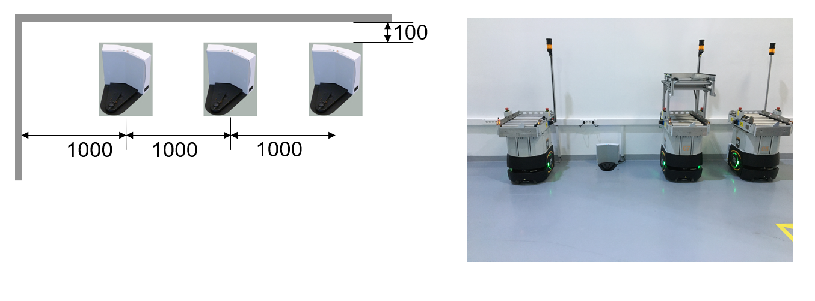
Rack design and standard alley
Footprint of docking station

Slide 38
Content
Software:
    Advanced Robotics Command Language
    Fleet Management
    Traffic management
    Charge management
    Fleet docking
    Managed Motion Sectors

Slide 39
Advanced Robotics Command Language
Introduction to ARCL
  The Advanced Robotics Command Language (ARCL) is a simple, text-based, command-and-response operating language for integrating a fleet of mobile robots with an external automation system.
  ARCL allows you to operate and monitor the mobile robot, its accessories and its payload devices over the network; it is intended for automating your mobile robots.
  The Enterprise Manager (EM) version of ARCL is for use with the Enterprise Manager software and appliance. This hardware and software combination has been specially designed and configured to manage a fleet of robots operating in a facility. Therefore, it uses a minimal ARCL command set, because all of the critical work is being handled directly by the appliance and Enterprise Manager software.

Slide 40
Advanced Robotics Command Language

Slide 41
Advanced Robotics Command Language
Connect to ARCL Using a Telnet Client
  Setting the Connection Parameters:
    Open the MobilePlanner software, version 4.0 or later, and connect to the mobile robot. Refer to the Mobile Robots Software Suite User's Guide for details on installing and starting MobilePlanner.
    From the Configuration tab, select the Robot Interface tab.
    Select ARCL Server Setup from the Sections column. The ARCL Server Setup parameters are shown in the following figure.
    Enter a password for the Telnet client for the Password parameter. If a password already exists, make a note of it so that you can open the ARCL server from the Telnet connection.

Slide 42
Advanced Robotics Command Language

Slide 43
Fleet Management
Description
  What’s an Enterprise Manager?
    An Enterprise Manager (EM) is a network appliance that makes it possible to use a fleet of mobile robots. It runs the same operating system image and Mobile Software suite as the LD, and would typically be installed in the customer’s server room (i.e. OFF the factory floor).
  What does it do?
    It provides one central place to manage the map and configuration, automatically propagating data to the fleet.
    It provides a queuing manager which matches up jobs with the most appropriate robot in the fleet.
    It provides one central point of communication for integration with robots in the fleet.
    It reduces traffic jams by serving as traffic-cop and by sharing location and trajectory information among neighboring robots in the fleet.
  When should you use one?
    If you have more than one LD and the workspaces are overlapped, then you MUST have an EM.
    If you want to queue jobs across multiple robots, then you MUST have an EM.
    In almost all cases, if you have more than one LD then you will need an EM.

Slide 44
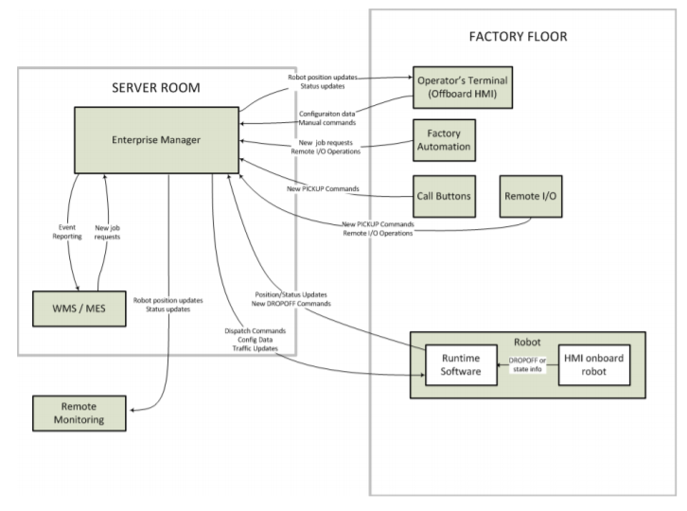
Fleet Management
Information Flow through the Fleet

Slide 45
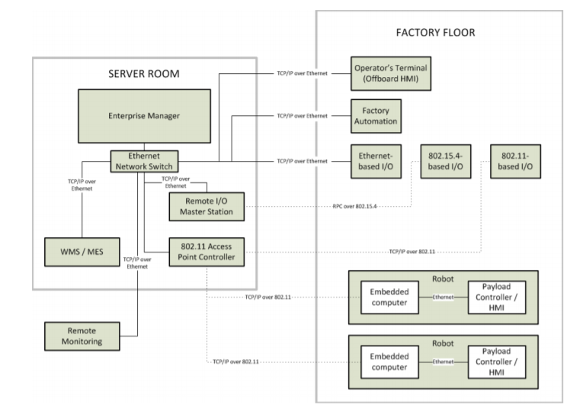
Fleet Management
Network Connections in the Fleet

Slide 46
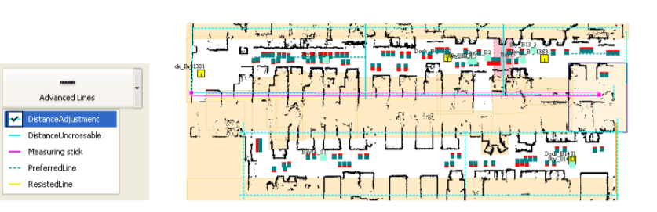
Fleet Management
EM Initial Map & Config
  If you were using a LD in the environment prior to installing the EM, then you can export the map and configuration data from the LD and import it to the EM.
  Make sure to do this BEFORE connecting the LD to the EM, otherwise you might lose the data!
  The first step to make is to ”draw” the initial map so the AGV’s know how and where to move.

Slide 47
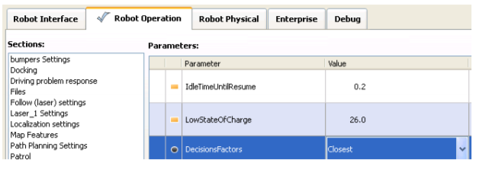
Fleet Management
Robot Selection
  The FM works in FIFO or non-FIFO order, by priority. For the next job in the list it will attempt to find a suitable robot.
  It will only consider robots that are in the Available state, regardless of substate.
  If enabled, the EM will only consider robots that have the required Custom Tasks.
  Lastly, the EM will use a final decision criteria to decide. This will be the distance from the robot to the goal.
  The default decision criteria is distance. (Note: this is geometric distance, NOT true-path distance).
  Only one of these factors can be selected.

Slide 48
Traffic Management
Standby Goals
  Standby goals serve two purposes:
  Buffering
    If a robot is trying to drive to a goal or sector which is already occupied, then it can drive to a Standby goal to wait. This is referred to as “buffering”. The robot can use either Standby-parking or Standbybuffer goals for this purpose.
    The robot will select an available Standby-buffer OR Standby-parking goal which is closest to the target goal or sector.
  Parking
    If a robot is Available and there are no more jobs to perform, then the robot can drive to a Standbyparking goal to wait. This is beneficial because it will get the robot out of the way of traffic and regions of interest (i.e. goals, tools).
    The robot will select an available Standby-parking goal which is nearest its current location.

Slide 49
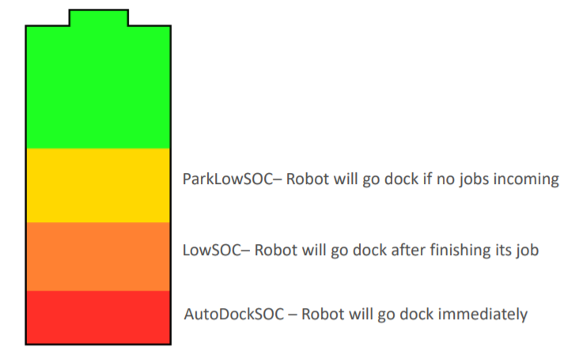
Charge Management
The EM seamlessly coordinates charging with the job assignments. The charging logic is controlled in two methods:
  Low State of Charge Docking
  AutoDockStateOfCharge
  ParkLowStateOfCharge
  LowStateOfCharge
  Fleet Docking
  Explicit Number
  PercentOfFleet

Slide 50
Charge Management
AutoDockStateOfCharge is the lowest threshold and will cause the robot to immediately dock if the threshold is crossed. This value should be set very low (10-20%)
LowStateOfCharge is the threshold below which the EM will no longer assign new jobs to the robot. The robot will complete any existing dropoff jobs befors driving back to the dock, as long as the SOC remains above AutoDockStateOfCharge.
ParkLowStateOfCharge is the highest threshold and is the point at which a robot will drive to a dock to charge rather than driving to a parking goal. This takes place only while the robot is idle, and the robot will remain Available the entire time. This can allow the robots to opportunity charge when idle, but without taking the robot out of service.

Slide 51
Charge Management
Low State of Charge Visual
  When a robot needs to charge, it will use the nearest, unoccupied dock When using this default method, it is important that there are at least as many docks as there are robots. This is because the EM will NOT cause a docked robot to vacate a dock in order to allow another to charge.

Slide 52
Fleet Docking
Fleet Docking
  Fleet Docking allows us to tell the fleet that we consistently want some robots to be docked. This makes it so there is always a steady stream of robots performing jobs. It is still recommended to have half the number of docks as there are robots.
  Fleet Docking Strategies
    There are two different strategies for Fleet Docking
    ExplicitNumber • Specify a number of robots that should always be docked in “FleetNumberToDock”
    PercentofFleet • Specify a percentage of robots connected to the EM that should always be docked in “FleetPercentToDock”
    Both strategies will use “MaxForcableSoC” which tells the EM to ignore docking a robot if they have a state of charge above this value.

Slide 53
Managed Motion Sectors
Certain applications might require that multiple robots drive in very narrow aisles. If all the robots could freely drive in the narrow pace, then it could result in traffic deadlocks.
Managed Motion sectors provide a means for the EM to serve as ‘traffic cop’ and decide when each robot can drive. Only one robot can autonomously drive within a MM sector at a time. This provides a very deterministic traffic flow, but at the expense of cycle time. The robots are still allowed to perform tasks (such as pick/place) simultaneously, without requesting permission from the EM.
Robots entering a MM sector will wait at standby goals to request permission to enter MM sectors can effectively allow multiple robots to operate in narrow spaces if all goal positions are placed such that they do not obstruct traffic flow. If traffic flow will be obstructed, then a managed motion override sector might be required.

Slide 54
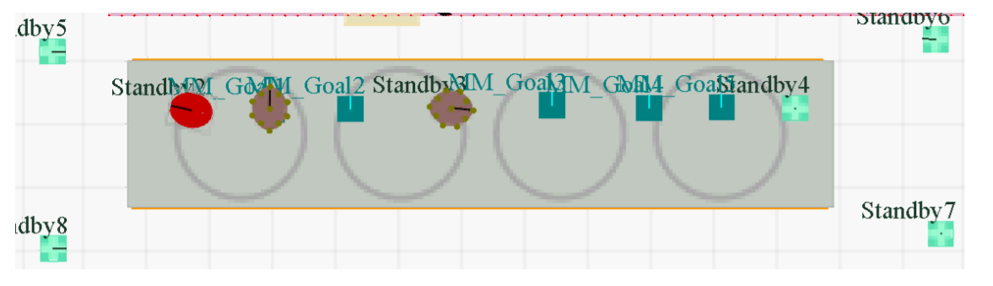
Managed Motion Sectors
Narrow Aisle with MM Sector
  Very orderly movements
  Very low risk of deadlock
  Main downside is the increased cycle time

Slide 55
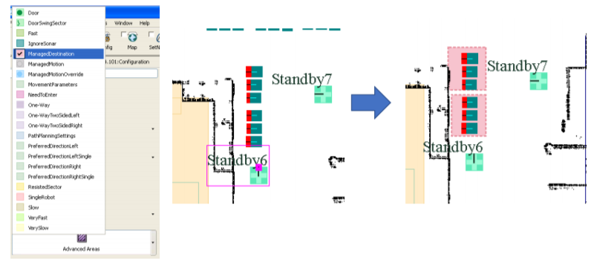
Managed Motion Sectors
Managed Destination
  In some cases, there might be tools that are so close together that they can’t be serviced simultaneously because the neighboring robots would hit each other.
  A Managed Destination sector can be placed around these goals so that they’re treated as a single goal from the perspective of buffering. Thus, if a robot wants to drive to one of the goals within the managed destination sector, then it will buffer if ANY of the goals within the sector are occupied

Slide 56
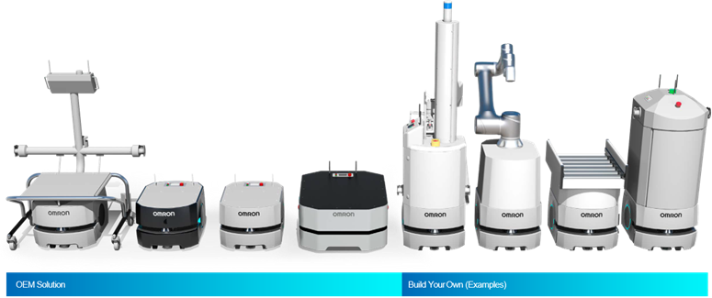
Thank you for your attention!
Questions?

