Slide 1
EMSE_02 Product-Service-System Design Pr. Xavier Boucher

Slide 2
Module 3 : Discover several distinct PSS applicative fields
Pr. Xavier Boucher

Slide 3
3 examples of PSS application fields
Domain : Industrial Manufacturing
– Case Study EUROPRESS.
Domain : Agroalimentary Production
– Case study EUROFARM
Domain : Sanitary Systems for Healthcare Institutions
– Case Study ECOBEL.

Slide 4
Your objectives and deliverable (75mn of team work)
(3 persons, 2 questions : 1 paperboard + 1 responsible for each question)
1/ You are a customer group of the case study company.
As a first result, you have to produce a synthetic map of needs, requirements & potential usages concerning a future PSS offer by the company.
This expression of the needs & requirements is derived from the key user-stakes provided.
2/ You are a strategic design team, within the case study company.
As second result, you have to provide a catalog of services, designed to answer the usages identified before (please consider the potential PSS typology)
Final Report : Argument the coherence between three elements :
1 – The strategic vision for the future that you highlight for your company
2 – The vision of the usage needs (expressed in a structure map of needs/requirements)
3 – The vision of the various PSS offers and service packages you propose to put on the market in the future
Synthetic Oral Presentation and Debate: 15 mn for each group

Slide 5
3 examples of PSS application fields
PRESENTATION OF THE CASE STUDY EUROPRESS

Slide 6
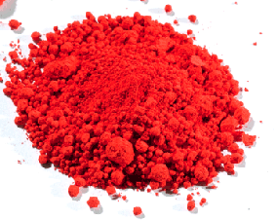
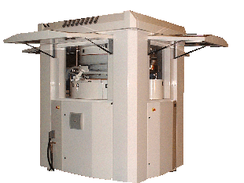
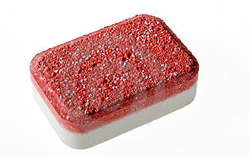
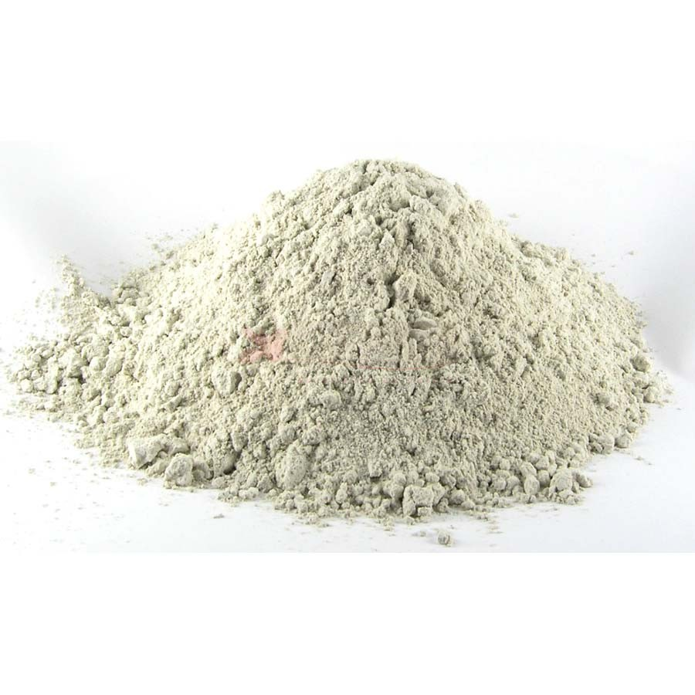
EUROPRESS Technology CASE STUDY
EUROPRESS = SME, 200 persons on an international market
EUROPRESSTechnology = Business Unit with 30 personnes
Key Activity = Design and Manufacturing of powder compression machines, with maintenance service
Only BtoB activity.
2-3 meters
7 Customisable Machines

Slide 7
EUROPRESS CASE STUDY
→Objective to try and balance the fluctuations of sales :
Prospection of new markets
Development of service offers
2/ 3 Main Clients : Cleaning powder (leadership), Chlore, Salt
3/ Distribution of the sales among products and services :
Global Turnover (volume of sales) |  | ~ 6 M€
Sale of Machines |  | ~ 3 M€
Service Department | Spare Parts for maintenance | ~ 900 k€
 | Pure service delivery | ~ 350 k€
Royalties (brevet) |  | ~ 650 k€
Re-engineering of ‘in use’ machines |  | ~1,2M€

Slide 8
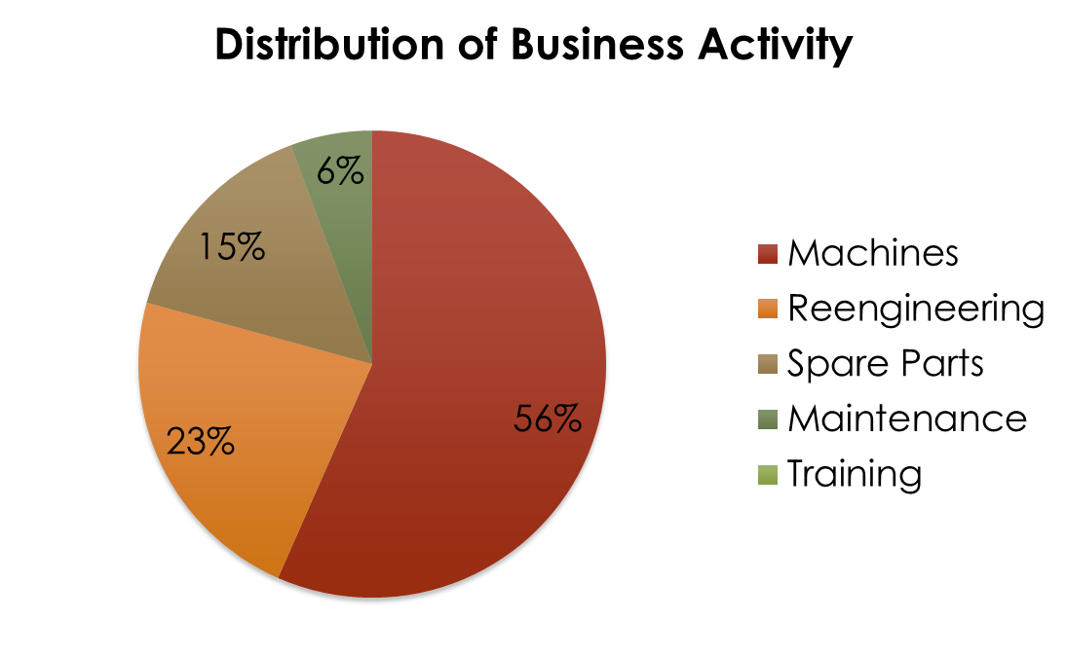
Current service-oriented activity
Current ‘Service Department’ = spare parts + maintenance + formation

Slide 9
Current service-oriented offer
+ : Some clients without maintenance resources
- : Clients with internal maintenance
Clients all over the world
Service
Offer
Maintenance
Retro-engineering
Spare parts
Training
+ : New clients
- : Risk of new machine loss of sale
+ : EUROPRESS Expertise
- : Language
+ : Specific parts designed par EUROPRESS
- : Lots of comon parts, avalaible on the market

Slide 10
Machine Life-Cycle
Life span for the compression machine : 10-20 years
Customer contact and demand
Design
(Bureau d’étude)
Production
Delivery /Training
Usage
Mainte-nance
Re-engineering

Slide 11
KEY STAKES FOR EUROPRESS CUSTOMERS
Which needs to change EUROPRESS’s offer through more services ??
I have integrated EUROPRES Technology in my production plant : I look for performance improvement of ‘Powder compression’ but also for all my manufacturing processes. Today, ‘performance’ should answer to recent constraints on societal & environmental responsability
I’m SME manager. The amount of investment for EUROPRESS Technology is a great difficulty for me. To be abble to invest, I would need partnerships and solutions involving the fundings themselves.
I need to manage a permanent evolution of the products manufactured by Powder Compression. My need is not at all a fixed investment for the 15 coming years, but a capacity of permanent change management for my production capability.
Considering the technological specificities of ‘Powder Compression’ I do not have all internal maintenance skills required. Beyond the maintenance, the performance of using the technology also depends a lot of my employees competencies.

Slide 12
3 examples of PSS application fields
PRESENTATION OF THE CASE STUDY ECOBEL

Slide 13
ECOBEL Case study
Company | ECOBEL
site | www.ecobel.fr
Manager | Jean-Pierre BOSLE
Activity | Manufacturing, sale and delivery of Shower-Heads with technical added-value : water consumption reduction + sanitary protection (legionellosis)
Current customers and markets | Health : Private clinical or retirements homes Tourism : Chaîne thermale du Soleil, Campings Health : potential market with Public Hospitals
Size | Very Small Enterprise
Historical elements | Created in 1983, innovation and patent concerning water consumption reduction (dispositif Venturi) Lack of innovation : sold in 2004 par JPBosle, with a new strategy linked to sanitary purposes
Activities | Key activity : innovation, design, and sale of the Offer Current service activities : stock, delivery, commercial relationship Manufacturing : fully subcontracted to local manufacturing firms

Slide 14
ECOBEL Vision
A real opportunity : reduction of sanytary risks, with new european standards imposing a high level of quality control on sanitary devices.
A strong market : public hospitals. This market is really difficult to get : currently chinese shower heads are dominating ! The competition on price only is not possible.
A sustainable strategy by the company manager : the business should not only make possible to develop the company, but to maintain local employment, to be based on territorial collaborations, and to provide life-cycle management solutions for the shower-head technology.
Constant Innovation required : on the shower head + on the economic model (functional economy ?)
Current offer
Step 1
Step 2
Product oriented strategy
Service
Oriented
Strategy
Current Product Sale
PSS1 ?
PSS2 ?

Slide 15
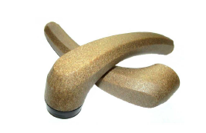
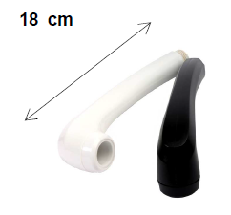
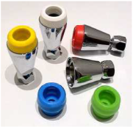
ECOBEL : technological components
Product
Special materials : patent and certification for reduction of sanitary impacts
Venturi Technology
- Water consumtion reduction up to 75%
Protection against legionellosis
Possibility of traceability when changing the key compoent of the shower head (venturi filter) when chaning the material every 6 months or every year (traceability by a system of colours)
Special lock, against risk of robbery by the user….

Slide 16
KEY STAKES FOR ECOBEL CUSTOMERS
Which needs to change ECOBEL’s offer through more services ??
I’m a tourism company. Concerning showers or other sanitarian devices, I’m particularly sensible to the design of the device. We also currently develop a company-image oriented on Ecology and Sustainability.
Public Hospitals: already applied quality standards imposing sanitary propocols against legionellosis and similar risks (Change of shower heads every 6 months, temperature of water, etc…). Even more strict standards are planned in the 2 coming years. However the cost reduction issue is a major topic in any Deparmtent of the Hospital. The sanitary quality is a responsibility of Health-Care department in the Hospital, when the maintenance is in charge of Maintenance Department with its own cost reduction objectives.
All customers: sensible to ecological actions (Life cycle management) to improve their image…when it is not contradictory with economical objectives.

Slide 17
3 examples of PSS application fields
PRESENTATION OF THE CASE STUDY EUROFARM

Slide 18
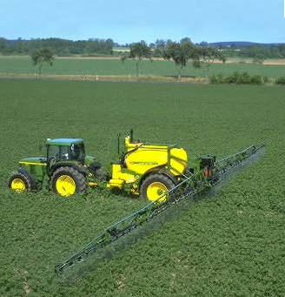
Eurofarm CASE STUDY
Eurofarm = SME, ~300 people, farming equipment sector
Turnover ~ € 70 millions, over 40% from export (to more than 30 countries)
Key Activity = Design and Manufacturing of crop sprayers (fertilizer and phyto-treatment)
Row crops
(65% of the turnover)
Vines and fruit bushes
(20%)
Parts and accessories
(15%)

Slide 19
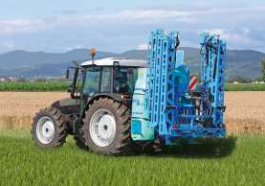
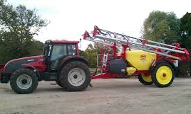
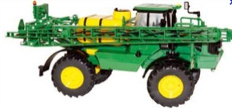
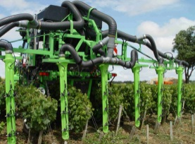
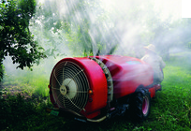
Eurofarm products and services
Row crops
Small or large mounted
Trailed
Self-propelled
Vines and fruit bushes
Pneumatic
Air-assisted
Dusters
Mounted or trailed
Equipment is marketed through a local distribution network close to farmers in around 30 countries
Services
Spare parts
Hotline & after-sale services
Learning center
Customer support in the handling and use of the sprayers

Slide 20
PESTEL Analysis
Farming equipment
Political
Support to organic/sustainable farming
Lobbies
Economic
Productivity
Risk reduction (crop losses)
Social
Environmental and health concerns and lobbies (consumers and farm workers)
Technological
Remote monitoring, onboard electronics, GPS
Efficiency of plant-health products, GMO
Environmental
Norms
Organic and sustainable farming
Legal
Phyto-sanitary regulations
Food safety
Notes:
Big trends on the market
Decrease in the volume and scope of chemical products used (fertilizer, plant-health products), optimization of their use, increase of organic and sustainable farming
Bordering residents are more and more worried about the use of chemical plant-health products and their consequences on environment and people health

Slide 21
SWOT Analysis of Eurofarm
Strengths
Spraying specialist, leader on several market segments
Capacity for Innovation
Premium products
International presence
Existing services
Weaknesses
High dependency on French and similar markets
Dependency on dealers
Seasonality of sales
A more than 100 years old company
Opportunities
Emergence and development of new marketplaces (China, …)
Partnership with agrochemical companies (Bayer, Monsanto …)
Threats
Large and strong competitors, able to provide a complete range of products

Slide 22
Needs and constraints all along the distribution chain
Eurofarm
Local dealers
Farmers
Final consumers
Competitors
e.g. differentiate from competitors, ensure dealers loyalty, anticipate and meet farmers’ and final consumers’ needs, …
e.g. meet farmers’ needs …
e.g. compliance to norms and regulations, efficiency …
e.g. health and environment concerns …

Slide 23
KEY STAKES FOR Eurofarm’s CUSTOMERS
Which needs to change Eurofarm’s offer through more services ??
Farmers
I am not a specialist on phytosanitary products; what I need is just to get a good harvest
I want to protect myself and my employees, and minimize the handling of phytosanitary products
I do not need a sprayer all the time but only on specific periods, depending on my crops
Local residents are very concerned with health and environment issues ; how can I convince them that I am not polluting? How can Eurofarm help me to minimize risks?
Dealers
What can Eurofarm provide me and farmers that its competitors cannot?
Why would I choose to sell a Eurofarm equipment instead of another one?
If a farmer needs not only a sprayer but also other equipment, how can I convince him to buy a Eurofarm sprayer even though?
How can I collaborate with Eurofarm to provide farmers with a more global offer?

