Slide 1
EMSE_02 Product-Service-System Design Pr. Xavier Boucher

Slide 2
Module 1 : Introduction to Product-Service-Systems (PSS) industrial strategies
Pr. Xavier Boucher

Slide 3
AGENDA
Product Service Systems (PSS) Concept & Applications
PSS typologies
Servitization of the industry : which problematic issues ?

Slide 4
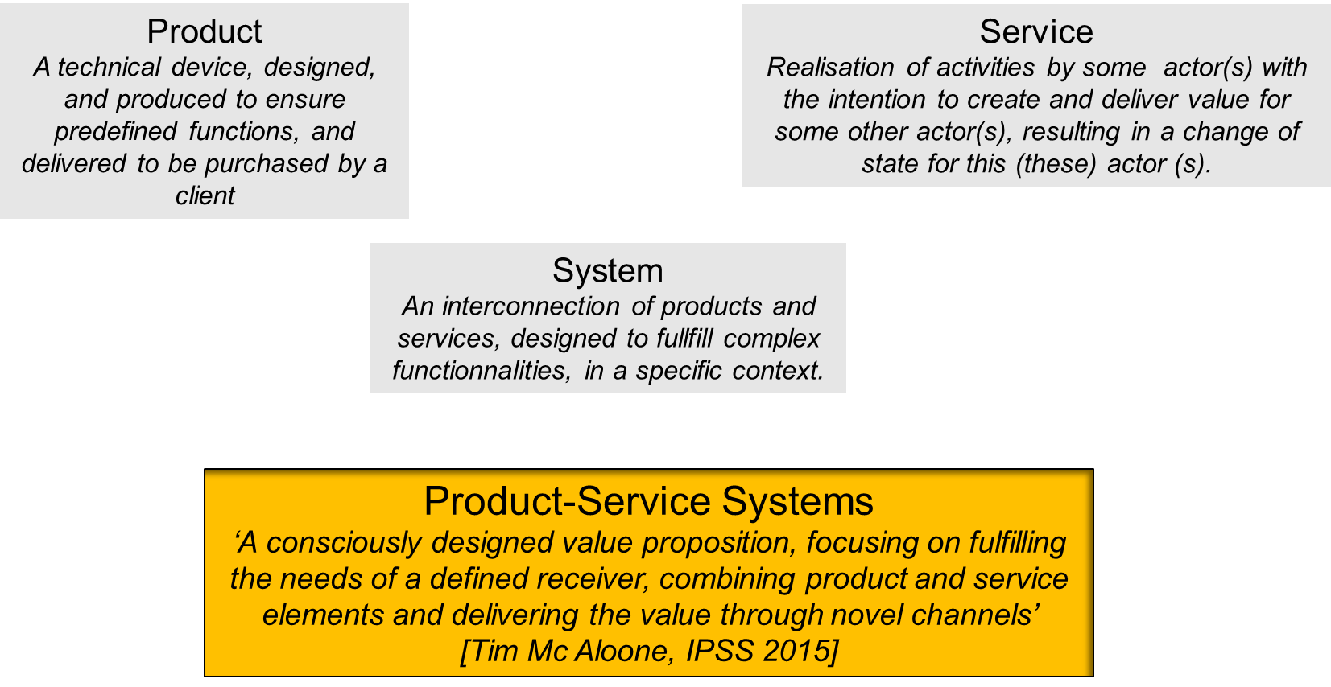
Notion of Product-Service Systems
Notes:
INSISTER SUR LE FAIT QUE l’intégration PSS : c’est comment appréhender les usages du client et construire une réponses à ses problèmes spécifiques, c’est-à-dire une offre de valeur customisée, et comment faire vivre cette offre durant tout son cycle de vie.

Slide 5
DéfinitionS
Sustainable Development
Mont 2002: A system of products, services, supporting networks and infrastructure that is designed to be: competitive, satisfy customer needs and have a lower environmental impact than traditional business models.
Evans et al.,2007 : An attempt to use existing industrial and commercial structures to create radically environmentally improved products by treating them as services.
Boehm, Thomas,2013 : A Product-Service System (PSS) is an integrated bundle of products and services which aims at creating customer utility and generating value
Marketing
Manzini, Vezzoli, 2003 : A product service system (PSS) can be defined as "an innovation strategy, shifting the business focus from designing (and selling) physical products only, to designing (and selling) a system of products and services which are jointly capable of fulfilling specific client demands
Baines et al.,2007: A market proposition that extends the traditional functionality of a product by incorporating additional services.
Value creation and engineering, Change of business Model, Industrial shift, Complex integrated offer,….
Industrial Transformation
Meier 2012: An Industrial Product-Service System is characterized by the integrated and mutually determined planning, development, provision and use of product and service shares including its immanent software components in Business-to-Business applications and represents a knowledge-intensive socio-technical system

Slide 6
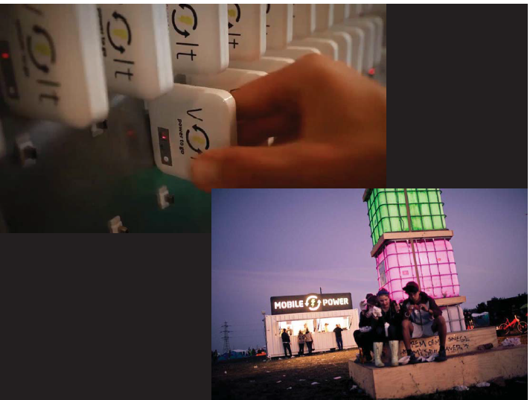
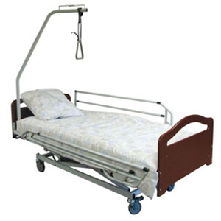
Examples : PSS in B to C
Car Sharing
Solution
Mobile power
solution
Common Points ?
Offer a solution
Purchase the usage
Share the product functionnalities among multiple users
Medical support
Solution
6

Slide 7
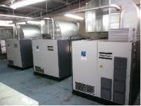
Examples : PSS in B to B
Mobility Solution
Automobile
Industry
Machinery
Change of Business model ?
Understand the processes of your customers
Take in charge a full & optimized function
Transform the economic model….but also all the process of value creation
Air Compression
Systems

Slide 8
PSS Deployment in Big Companies
A high maturity level in big companies…
XEROX printing solutions (and today all printing competitors). Connected object for remote control of usage (and payment).
ROLLS ROYCE for motorization in the aeronautical industry (sale of flying hours). Improvement of component life-span.
MICHELIN neumatical industry and the economic model balancing. Enlarged strategy to become a mobility provider.

Slide 9
Change of Business Model: is it pertinent for our manufacturing SMEs ?
It is always a progressive path !
Nearly all industrial companies are already in the path towards service offers
Different level of maturity on services in the same company, depending on the business
The industrial transition has to be very customized …
But this customization process is well managed today
It requires the involvement of the key decision-makers in the company
For SMEs it requires collaboration and some strategic guidance.
But methods are mature and supporting expertise is available
This transition appears…necessary : many example are available today, with a transition spreading throughout all levels of the supply chain.
>>>Discussion on 2 local French examples
PCI-SCEMM : Machinery industry
Desgranges Outillage : Cutting tool industry

Slide 10
Example 1 : PCI-SCEMM
Saint Etienne, 150 employees
PSA Group…till 2015, with the integration of the TongTai Group (Taïwan).
Market : Automobile and Aeronautical industries
Products and services : machinery integrated systems for industrial processes
Machining Centers
Flexible lines
Transfer machines
Special machines

Slide 11
PCI-SCEMM : Progressive development and risk management …
Progressive development of service offer along the years
Intervention in case of technical failure (curative maintenance)
Development of full maintenance offers : spare part inventories, maintenance service contracts
Development of renovation offer on a special component : motorspindle
Creation (2007) of a full service department
Maintenance contract and risk management
Spare part stocks : obsolescence risks reporter on the manufacturer, cash flow impacts and financial risks
Necessity to manage a knowledge learning loop : maintain a strong interaction and know-how transfer between maintenance and design teams
PSS ‘availability offer’ : high level of risks !
Offer = the manufacturer sales the availability (or even performance !) of its technology for the final business user. The technology itself is not sold. The manufacturer is responsible to maintain the performance of the system
Risks : how to manage the working conditions by the customer ?
Risk Management : Contractualisation is crucial and based on risk anticipation / Treaceability for production parameters supervision and failure detection / Economic based share of risks
Notes:
MotorSpindle = Electo-broche

Slide 12
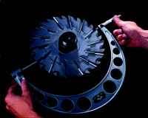
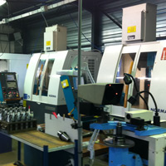
Example 2 : Desgranges Outillage
Saint Etienne, 50 employees
Sub-contractors for aeronautics industry
Products : cutting tools for industrial processes
Services : tool sharpening and adaptation
Final
product
Aeronautic
industry
Cutting tools

Slide 13
Desgranges Outillage : which industrial transition ?
Manuf. & sale of tools
Sale of use of the tools
Fonction ’design and purchase of new cutting tools’
Creation of value by better adaptation of the tools to the client needs
Fonction ‘Inventory management’
Creation of value by stock
optimisation
Fonction ‘tool re-sharpening’
Fonction ‘tool preparation and delivery on production line’
Creation of value by life cycle management
Creation of value by improvement of client’s industrial processes
Completely new revenue models, with mutiple opportunities of value offers
A full innovation on the product itself (durability, traceability, service support…)
Profound change of definition of the internal business, and processes of the firm
Deep change on what means « innovate » and « develop new offer »
Deep change of culture for the firm

Slide 14
Synthesis 1/2
Functionality sales….can appear on the whole value creation chain
‘Cutting’
Functionnality
Production
Functionnality
Mobility
Functionnality
Economic model : Sale of use

Slide 15
Synthesis 2/2
C. du Tertre (2008) : Functional Economy (sale of ‘functionalities’ and no more of products)
« … Dynamics of co-production by producers together with consumers, of overall solutions integrating products and services in order to answer needs of people (B2B) or enterprises (B2B), taking into account new environmental and societal requirements »
Characteristic of the economic model
Economic model with ‘no possession transaction’, but with a sale of service making possible to sale the use of goods ; thus, economic based on use-value and no more on transaction-value of the goods.
Mutualisation of the use of goods, by putting forth service offers which tend to answer ’collective functional needs’ : territorialisation of needs.
Transformation de ‘focus’ of the production processes : New ‘object of production’ based on the integration of product and services over the whole life cycle (Design, Production, End of Life, Evolution of the offer,…).
Dynamics of co-production (customer/user contribution, collaborative production networks, multiple stakeholders), generating new forms of value creation process & value creation factors.
An intentionality which should be oriented on environnemental and societal requirements

Slide 16
AGENDA
Product Service Systems (PSS) Concept & Applications
PSS typologies
Servitization of the industry : which problematic issues ?

Slide 17
Basic PSS Typology
Product Service System (PSS) : Product-Service is a value proposition that consists of a mix of tangible product and intangible service designed and combined so that they jointly are capable of fulfilling final customers’ needs (Tukker et al., 2006).
PSS Typology: Hokkerts (1999), Tukker (2004)…Baines et al. (2007)
Product focus
Et a
Service focus
Product-oriented PSS
Addition of services to ensure functionality and durability along the lifecycle of a product, sold with a usual transactional model
Use-oriented PSS
Only the availability or the use of the product is sold to the customer. Relational value creation model.
Result-oriented PSS
No more product sale, but sale of a well specified result or capability specified by the customer (contract on the ability to guarantee a performance)
FUNCTIONAL ECONOMY

Slide 18
Characteristics of PSS Types
 | PSS PROVIDER |  |  | PSS USER
 | Cost | Revenue | Risks | Cost | Revenue | Risks
Product-oriented | Design; Manufacturing; Service staff; | Sale product Sale service | Loss of serv. revenue; | Product & service purchase ; | Revenue derived from product usage; | Product fiability; Maintenance cost; Lack of usage;
Use-oriented | Increased maintenance cost; Maintenance stocks; Innovation costs; Customer management costs; | Usage sale, along the whole life cycle; Long term service contract; Client loyalty; | Usage risks; Obsolescence : full solution + parts; Image impact; Service workload; | Usage; Quality of service; |  | Lack of reactivity and quality of service; Dependency;
 | Contractualisation elements
Product-oriented | Quality of service, for punctual service deliveries.
Use-oriented | Level of availability of the solution ; Level of availability of parts for maintenance; Reactivity & quality of services all along life-cycle ; Usage Behaviours ;

Slide 19
Characteristics of PSS Types
 | PSS PROVIDER |  |  | PSS USER
 | Cost | Revenue | Risks | Cost | Revenue | Risks
Result-oriented | Design; Manufacturing; Client process understanding & adaptation; Service staff; User production staff; Maintenance costs & stocks; Traceability & customer management; | Performance sale, along the whole life cycle; Strong customer dependency; Client loyalty; | Adaptation to client processes; Usage risks; Obsolescence : full solution + parts; High staff cost and heavy HR management ; Service workload; | Payment of the perf. achieved; Payment of risk sharing; | Revenue derived from final production; | Strong performance dependency; Full loss of knowledge on production processes; Risk of higher costs;
 | Contractualisation elements
Result-oriented | Levels of performance of the solution ; Level of reactivity and quality to ‘maintain the solution on operational condititions’; Interoperability with the reste of the customer process; Competence levels;

Slide 20
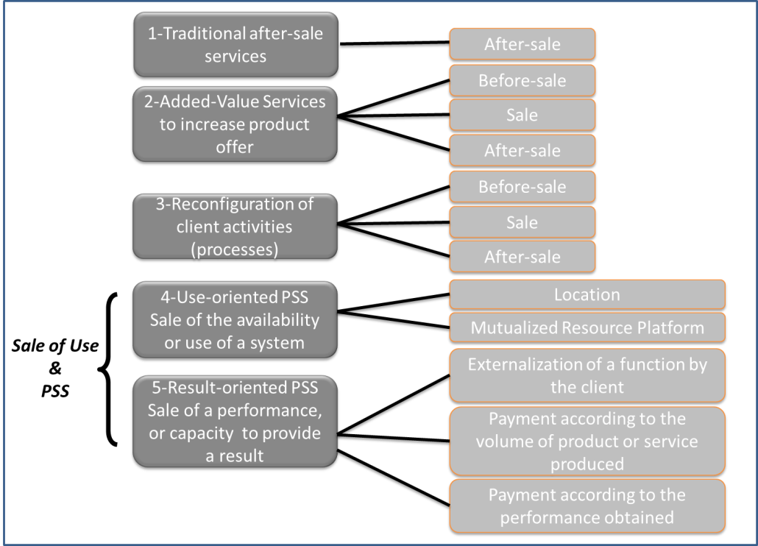
Extended Typology for progressive servicisation
Product
Oriented
PSS

Slide 21
Extended Typology : some examples
BtoC : usual examples in day-to-day life !
BtoB : VALBOM and waste-treatment technology
Location
BtoC : repair you car by yourself
BtoB : CETIM with a strategy of high technology platforms
Mutualized Resource Platform
Externalization of a function by the client
BtoB : IT functions, Commercial functions (SME, ex: Ledin)
Payment according to the volume of product or service produced
BtoB : ‘Fabless’ orientation, enlarged with 3D printing perspectives. Fabless for ‘ARCHIDUCHESSE’ and textile production
Payment according to the performance obtained
BtoB: Manufacturing functionallity with performance contract. Ex EUROTAB ensuring the performance of Powder Compression, but risky contracts !

Slide 22
AGENDA
Product Service Systems (PSS) Concept & Applications
PSS typologies
Servitization of the industry : which problematic issues ?

Slide 23
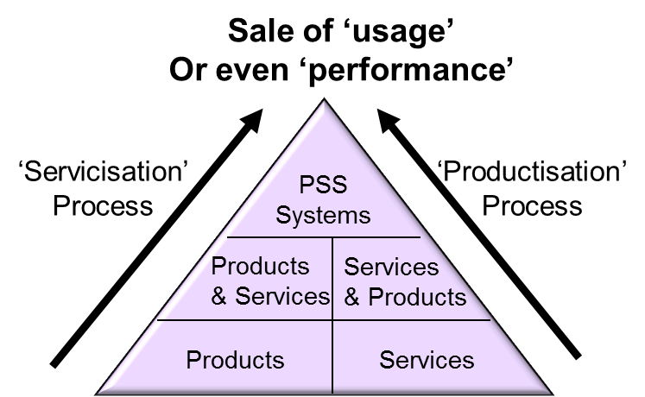
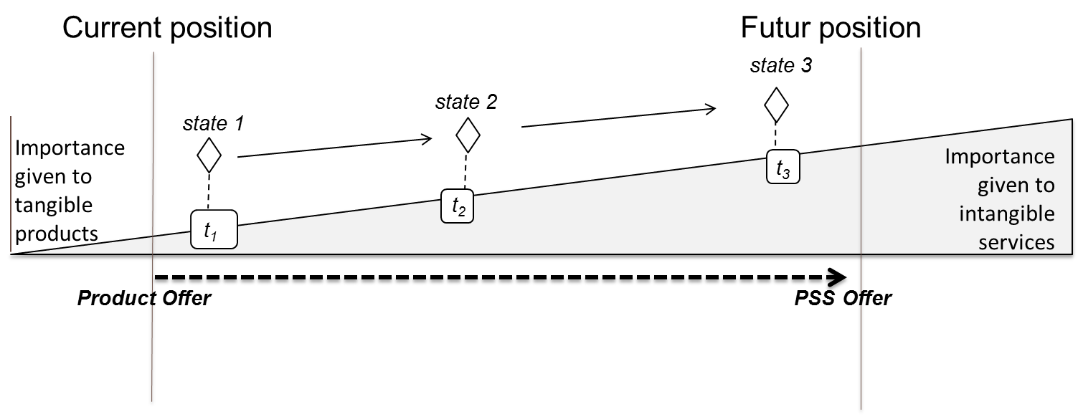
Servitization requires in-depth change of Business model for the industry …
What BM dimensions can be affected ?
(Baines et al., 2007)
Change of innovation and managerial paradigm
Transition of client-relationship model
Transformation of economic model & impacting factors
Transition through Digital Technologies
Change of sustainability management
Organisational and process changes
Cultural transformation
(Oliva & Kallenberg, 2003)
Notes:
PROCESSUS / EXEMPLE VERDOT , Chromatographie. 1er contact 2011 avec analyse stratégique : 6 ans pour mettre en œuvre apeuprès les orientations clés et engager une nouvelle phase pour aller plus loin.

Slide 24
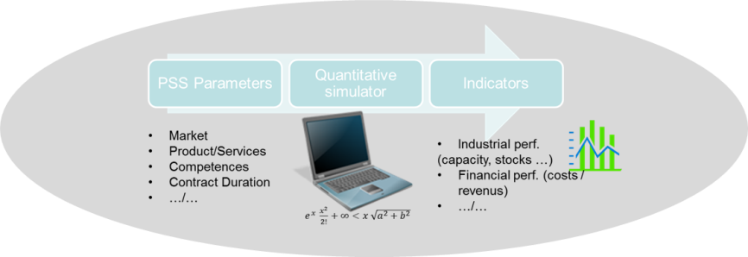
Servitization Strong impact on the economic model
Necessity to organize progressively the economic model transition and to provide risk anticipation solutions
Engineering of the transition of economic model
Market Dynamics
Simulation of the sensibility to customer behaviors, analysis of market penetration scenarios and strategies
Value creation network
Configuration of value creation network, determination of value sharing contracts, specification of collaborative regulation mechanisms
Risk Management
Short term and long term impacts of change of economic model
on cash flow, turnover, internal accounting results

Slide 25
Servitization : strong impact on design methods and tools
Shift the focus from mere product design to the design of an integrated product service system offer along with the value network (Medini et al., 2014, 2015; Hery et al. 2016)
PSS
Analyse the context
Analyse usage modes
Design the PSS offer
Design organisational scenario
Build evaluation model
Collect data
Evaluate the scenarios
Integrated Design of
Products
Services
Value Network
Economic models

Slide 26
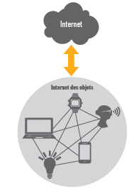
Information technologies : impact of IoT, and intelligent objects
Innovation through
Product Service Systems
Change of business model
Change of life cycle Management
Change of actor networking environment
Mediated by new technological context
Value extracted from information
Web-services and SAAS
Intelligent Objects
Social Networks
Etc….
Internet of Things
Albert Shum, Partner Director of UX Design at Microsoft, notes:
“Business models are about creating experiences of value.
And with the IoT, you can really look at how the customer looks at an experience—from when I’m walking through a store, buying a product, and using it—and ultimately figure out what more can I do with it and what service can renew the experience and give it new life.”

Slide 27
Servitization: Strong impact of cultural aspects
Cultural and managerial aspects
What does servitization change ?
Service Culture
Service Awareness
Long-term orientation
Service innovation
Service-oriented incentive system
Value network management
Awareness on the strategic importance of the network.
Risk and value sharing management is necessary
Develop internal abilities to co-innovate and internalize new knowledge
Customer relationships
Long-term relational logic
Interactions mediated by information and knowledge management
Life-cycle management

