Slide 1
EMSE_02 Product-Service-System Design Pr. Xavier Boucher

Slide 2
Module 4 : Experimentation of PSS design with a Case Study
Pr. Xavier Boucher
Notes:
Product-Service System (PSS) Modelling Procedure Application, based on a real case study and a practical exercise.
By studying the present set of slides, future modellers and designers are going to be immersed in the application of the current and available PSS Modelling Method to a real case study in the industrial context, carried out in the FAYOL Institute.

Slide 3
Presentation of the case study
GENERAL INFORMATION
Automaton agent
- It is a PSS design industrial project.
- It is framed in the economic sector/activity of the meat transformation industry.
- It is mainly composed of an autonomous cleaning robot and services deployed during its PSS lifecycle.
- It focuses on the qualitative design stage of both the robot and the services opportunities, for characterizing the PSS offer specifications.
3
Notes:
Subsection 1.2: A Case Study. In order to validate the present modelling procedure, this is implemented on a case study which is called “Automaton Agent”. But, what is “Automaton Agent”?
It is a PSS design industrial project.
It is framed in the economic sector of the meat transformation industry.
It is mainly composed of an autonomous cleaning robot and services deployed during its PSS lifecycle.
It focuses on the qualitative design stage of both the robot and the services opportunities, for characterizing the PSS offer specifications.

Slide 4
Get access to the Case Study initial data
Open PS3M Software
Download on your PC, the initial case study data
Upload data into PS3M
Select ‘import’ function

Slide 5
Presentation of the case study
CONTEXT DESCRIPTION
INDUSTRIAL AND TECHNOLOGICAL:
- Automation of cleaning processes and hygiene functionalities.
- Hygiene and quality are two key objectives.
- Potential of high-added value solutions coupling robotics with service.
ENVIRONMENTAL:
- Benefits from innovative solutions to increase the efficiency of cleaning process.
- Optimization of resources (water and energy) and responsible use of chemical substances.
LEGAL:
- Hygiene standards are evolving, requiring innovative methods and technologies to keep up with new requisites.
- Overcome with sanitary controls.
- Compliance with safety and occupational health laws.
SOCIAL AND HUMAN:
- Food safety is one of the main concerns of consumers in this field.
- Preserve the quality of life of the work force through the improvement of its work places.
Requirements and needs
5
Notes:
We continue in the subsection 1.2, A Case Study, in order to describe its requirements, needs and context…
From a LEGAL point of view:
Hygiene standards are evolving, requiring innovative methods and technologies to keep up with new requisites.
Overcome with sanitary controls; and
Compliance with safety and occupational health laws.
From a SOCIAL AND HUMAN point of view:
Food safety is one of the main concerns of consumers in this field; and
Preserve the quality of life of the work-force through the improvement of its work places.
From an INDUSTRIAL AND TECHNOLOGICAL point of view:
Automation of cleaning processes and hygiene functionalities.
Hygiene and quality are two key objectives; and
Potential of high-added value solutions coupling robotics with service.
From an ENVIRONMENTAL point of view:
Benefits from innovative solutions to increase the efficiency of cleaning process; and
Optimization of resources, water and energy, and responsible use of chemical substances.

Slide 6
Presentation of the case study
KEY ACTORS AND THEIR EXPECTATIONS
“PROVIDER”: a small-sized company manufacturing batteries (E1) who has a key role in and impact on the PSS delivery. Expectations:
- Access to new markets.
- Benefit from mass/serial production.
- Integrate the principle of modularity.
- Improve the monitoring of its costs system.
“MANUFACTURER”: a small-sized company manufacturing special machines including robotics and providing customized solutions (E2). E2 plays a major role in the delivery of the envisioned PSS solutions. Expectations:
- Suitable services, availability, efficacy of special machines.
- Access to international markets.
- Develop service culture and serial production.
“SERVICE INTERMEDIARY”: (E3), a facilitator agent or enterprise in charged of cleaning services in the customer places as well as maintenance activities for the equipment (“Automaton Agent”), in some scenarios where the manufacturer does not expect to provide them. General expectation:
- Develop business alliances with the producer of the “Automaton Agent”.
“CUSTOMER/END USER”: a medium-sized company from the meat transformation industry (E4). Expectations:
- Ensure autonomous cleaning services into cold warehouses without removing the meat carcasses.
- Reduce meat contamination risks.
- Diminish exposure to chemical substances.
- Night cleaning to avoid production disruptions.
- Increase frequency of cleaning processes.
6
Notes:
Now, let's examine the key stakeholders and their expectations regarding to the PSS offer. For this case, we will have four main actors pertaining to the whole value creation network in charged of the PSS offer delivery.
At the starting point, it is the “PROVIDER” which is a small-sized company manufacturing batteries (E1). It has a key role in and impact on the PSS delivery. Its expectations are:
To access new markets;
To benefit from the advantages of implementing a mass or serial production;
To integrate the principle of modularity in the design of the battery systems;
To enhance the management of the technological issues related to the batteries; and
To improve the monitoring of its costs system.
At the second echelon, we find the “MANUFACTURER”, being a small-sized company manufacturing special machines including robotics and providing customized solutions (E2). It is the focal company which plays a major role in the delivery of the envisioned PSS solutions. Its expectations are:
Suitable services to ease usages, ensure availability and increase the efficacy of special machines;
Access to international markets;
To enhance a service culture; and
To gain experience and awareness by implementing the mass or serial production paradigm.
Then, it is the “SERVICE INTERMEDIARY” (E3), which could be any kind of facilitator agent or enterprise. It will be in charged of cleaning services in the customer places as well as maintenance activities for the equipment, in some scenarios where the manufacturer does not expect to provide them. E3 has by general expectation the development of business alliances with the producer of the “Automaton Agent”.
And finally, we have the “CUSTOMER” who for this particular case is a medium-sized company from the meat transformation industry (E4). It is interested in:
Ensuring autonomous cleaning services into cold warehouses of 1200 m² in surface without removing the meat carcasses;
Reducing meat contamination risks because of operators’ presence within cold storage areas during cleaning processes;
Diminishing the human exposure to chemical cleaning substances;
Running night cleaning processes to avoid production disruptions, saving money and time; and
Increasing the frequency of the cleaning processes.

Slide 7
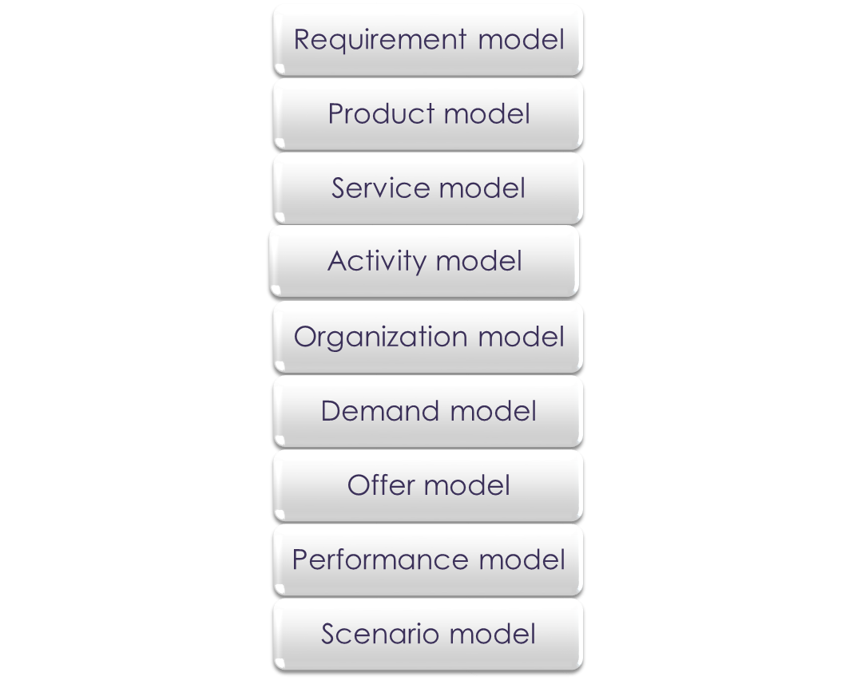
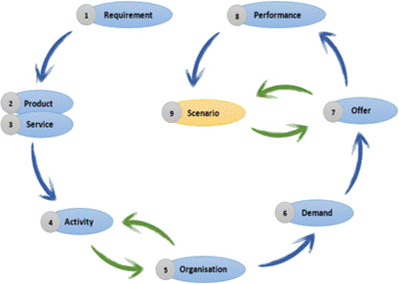
Presentation of PS3M Modelling Approach
APPLICATION OF THE MODELLING PROCEDURE

Slide 8
Presentation of PS3M Modelling Approach
Step 1. Requirement Model
E.U.R.
Technical function
Service function
Autonomous floor cleaning
Autonomous displacement
Facilitate position & navigation
Support
Inspection
Predictive / preventive maintenance
Requirement fulfillment
Contracting
Tele-service
Knowledge feedback
Performance monitoring
Consumption behavior monitoring
1. Requirement View in PS3M
8
Notes:
The PSS modelling process starts by The Requirement Model. It serves to represent the End User Requirements (E.U.R.) and the proposed solution to meet them. For this case, an E.U.R. could be: “an autonomous floor cleaning”.
An E.U.R. can be identified at various levels of abstraction and frequently expressed as two types of functions: first type, functions performed by a physical product that an example can be: “an autonomous displacement”; and second type, functions realized through a service, for instance, “facilitate the position and navigation of the automaton agent”.
The functions take a central place in this model since they connect between the E.U.R.s and the structural elements of the proposed solution. Hence, this model provides a hierarchical representation: E.U.R.s, functions and structural elements, allowing to have a clear idea about the product which should be designed, physical part of the solution which would be the automaton agent; and a first reflection on the associated services, intangible part of the solution which could be the introduction in the automaton agent of the area drawings to be cleaned.
Then, some values are associated to either the general E.U.R. or to be more specific to each sub-E.U.R. identified. For this particular case, a value is: “a professional and effective cleaning process”.
After that, we can go further by specifying the main goal of a function. Regardless the nature of a function, the function’s goal can be divided into three main categories:
First, “support function”: it ensures the effective operation of the delivered product. Examples: inspection, predictive or preventive maintenance.
Second, “requirements fulfillment function”: it enhances the delivered product’s operation trough complementary offers, for instance, contracting and tele-service; and…
Third, “knowledge feedback function”: it provides the manufacturer with customer information from the product use such as: performance monitoring of the product and / or consumption behaviors of customers.
Finally, all the structural elements required to realize each function are deducted as result of this requirement model. After getting a broader vision about the physical part of the offered solution, some service opportunities can be identified.

Slide 9
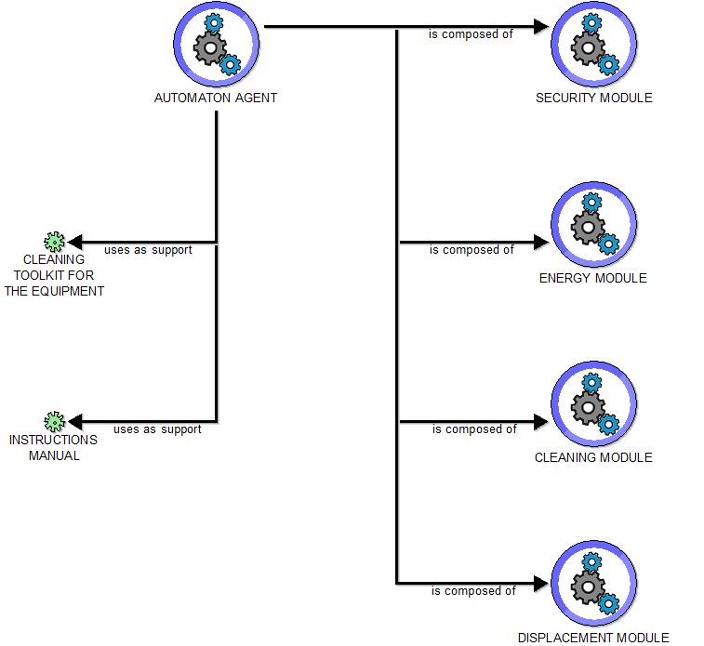
Presentation of PS3M Modelling Approach
Step 2. Product Model
Product families
Composite products
Components
Peripheric products
Another autonomous cleaning solution
Energy module
Batteries system
Operation manual, cleaning kit…
2. Product View in PS3M
9
Notes:
Step 2. Product Model: it represents in more detail the acquired knowledge about the tangible part of the offer, being for this case study, the automaton agent as the core product.
Besides, this representation allows to specify the following items:
families’ product that an example could be another autonomous cleaning solution;
composite products like its energy module;
their components such as its batteries system; and...
the periphery products, for instance, a support equipment like an operation manual, a tool as a cleaning kit, an infrastructure (example: vehicles road network) or an execution system (fraud control system).
Each one of those items contain several attributes distributed in various notebooks, including qualitative and quantitative aspects. Some aspects such as “capacity” and “lifetime” have a significant impact on the proposed offer, since they can influence the delivered product quantity. Therefore, this model captures different qualitative and quantitative information related to the physical elements structuring the proposed solution, being useful throughout the design process and influencing the decisions to make regarding the offer parameters.
Finally, we can define the amount required for each component to obtain a composite product via the link: “is composed of”.

Slide 10
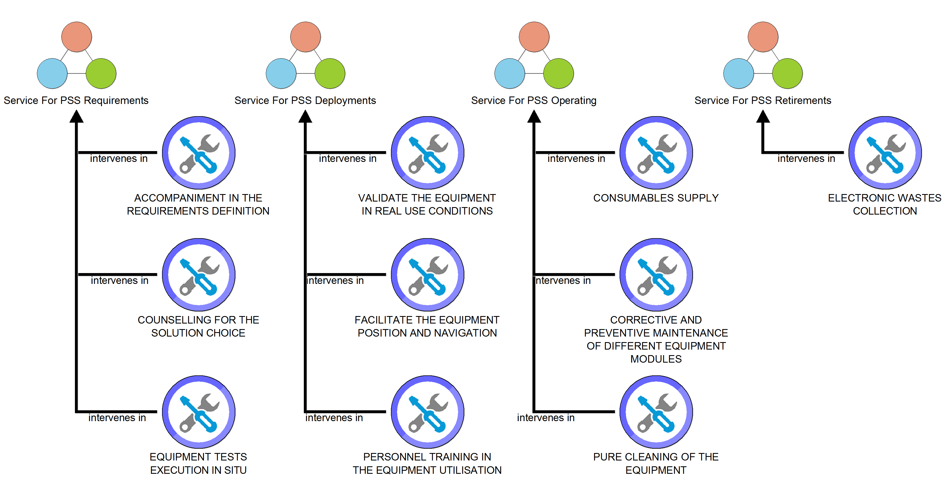
Presentation of PS3M Modelling Approach
Step 3. Service Model
Stage of the PSS lifecycle
Service items in the PSS offer
PSS requirement
PSS deployment
PSS operation
PSS retirement
Needs ident. and definition
Training services
Maintenance services
Collection of waste
3. Service View in PS3M
10
Notes:
Step 3. Service Model: It specifies the intangible part of the offer, particularly the services which can be provided, and organizes them according to several types. Each type is associated to a particular stage of the PSS lifecycle which are:
First stage, PSS requirement: it could contain services of customers’ support in the identification and definition of their requisites.
Second, PSS deployment: for the present case, training services to workers in the utilization of the automaton agent.
Third, PSS operating: maintenance services to the core product in this case study; and…
Fourth, PSS retirement: it would be the collection of electronic wastes of the energy module, that is its batteries.
Those service items contain notebooks that allow capturing information such as the different levels of a service quality or economic information related to costs.
Lastly, this model also provides a gathering structured process of different qualitative and quantitative information related to the intangible elements that compose the offer. Some of this information will be useful throughout the design process and can strongly influence the decisions which will have to make regarding the offer parameters, for instance, the delivered service frequency.

Slide 11
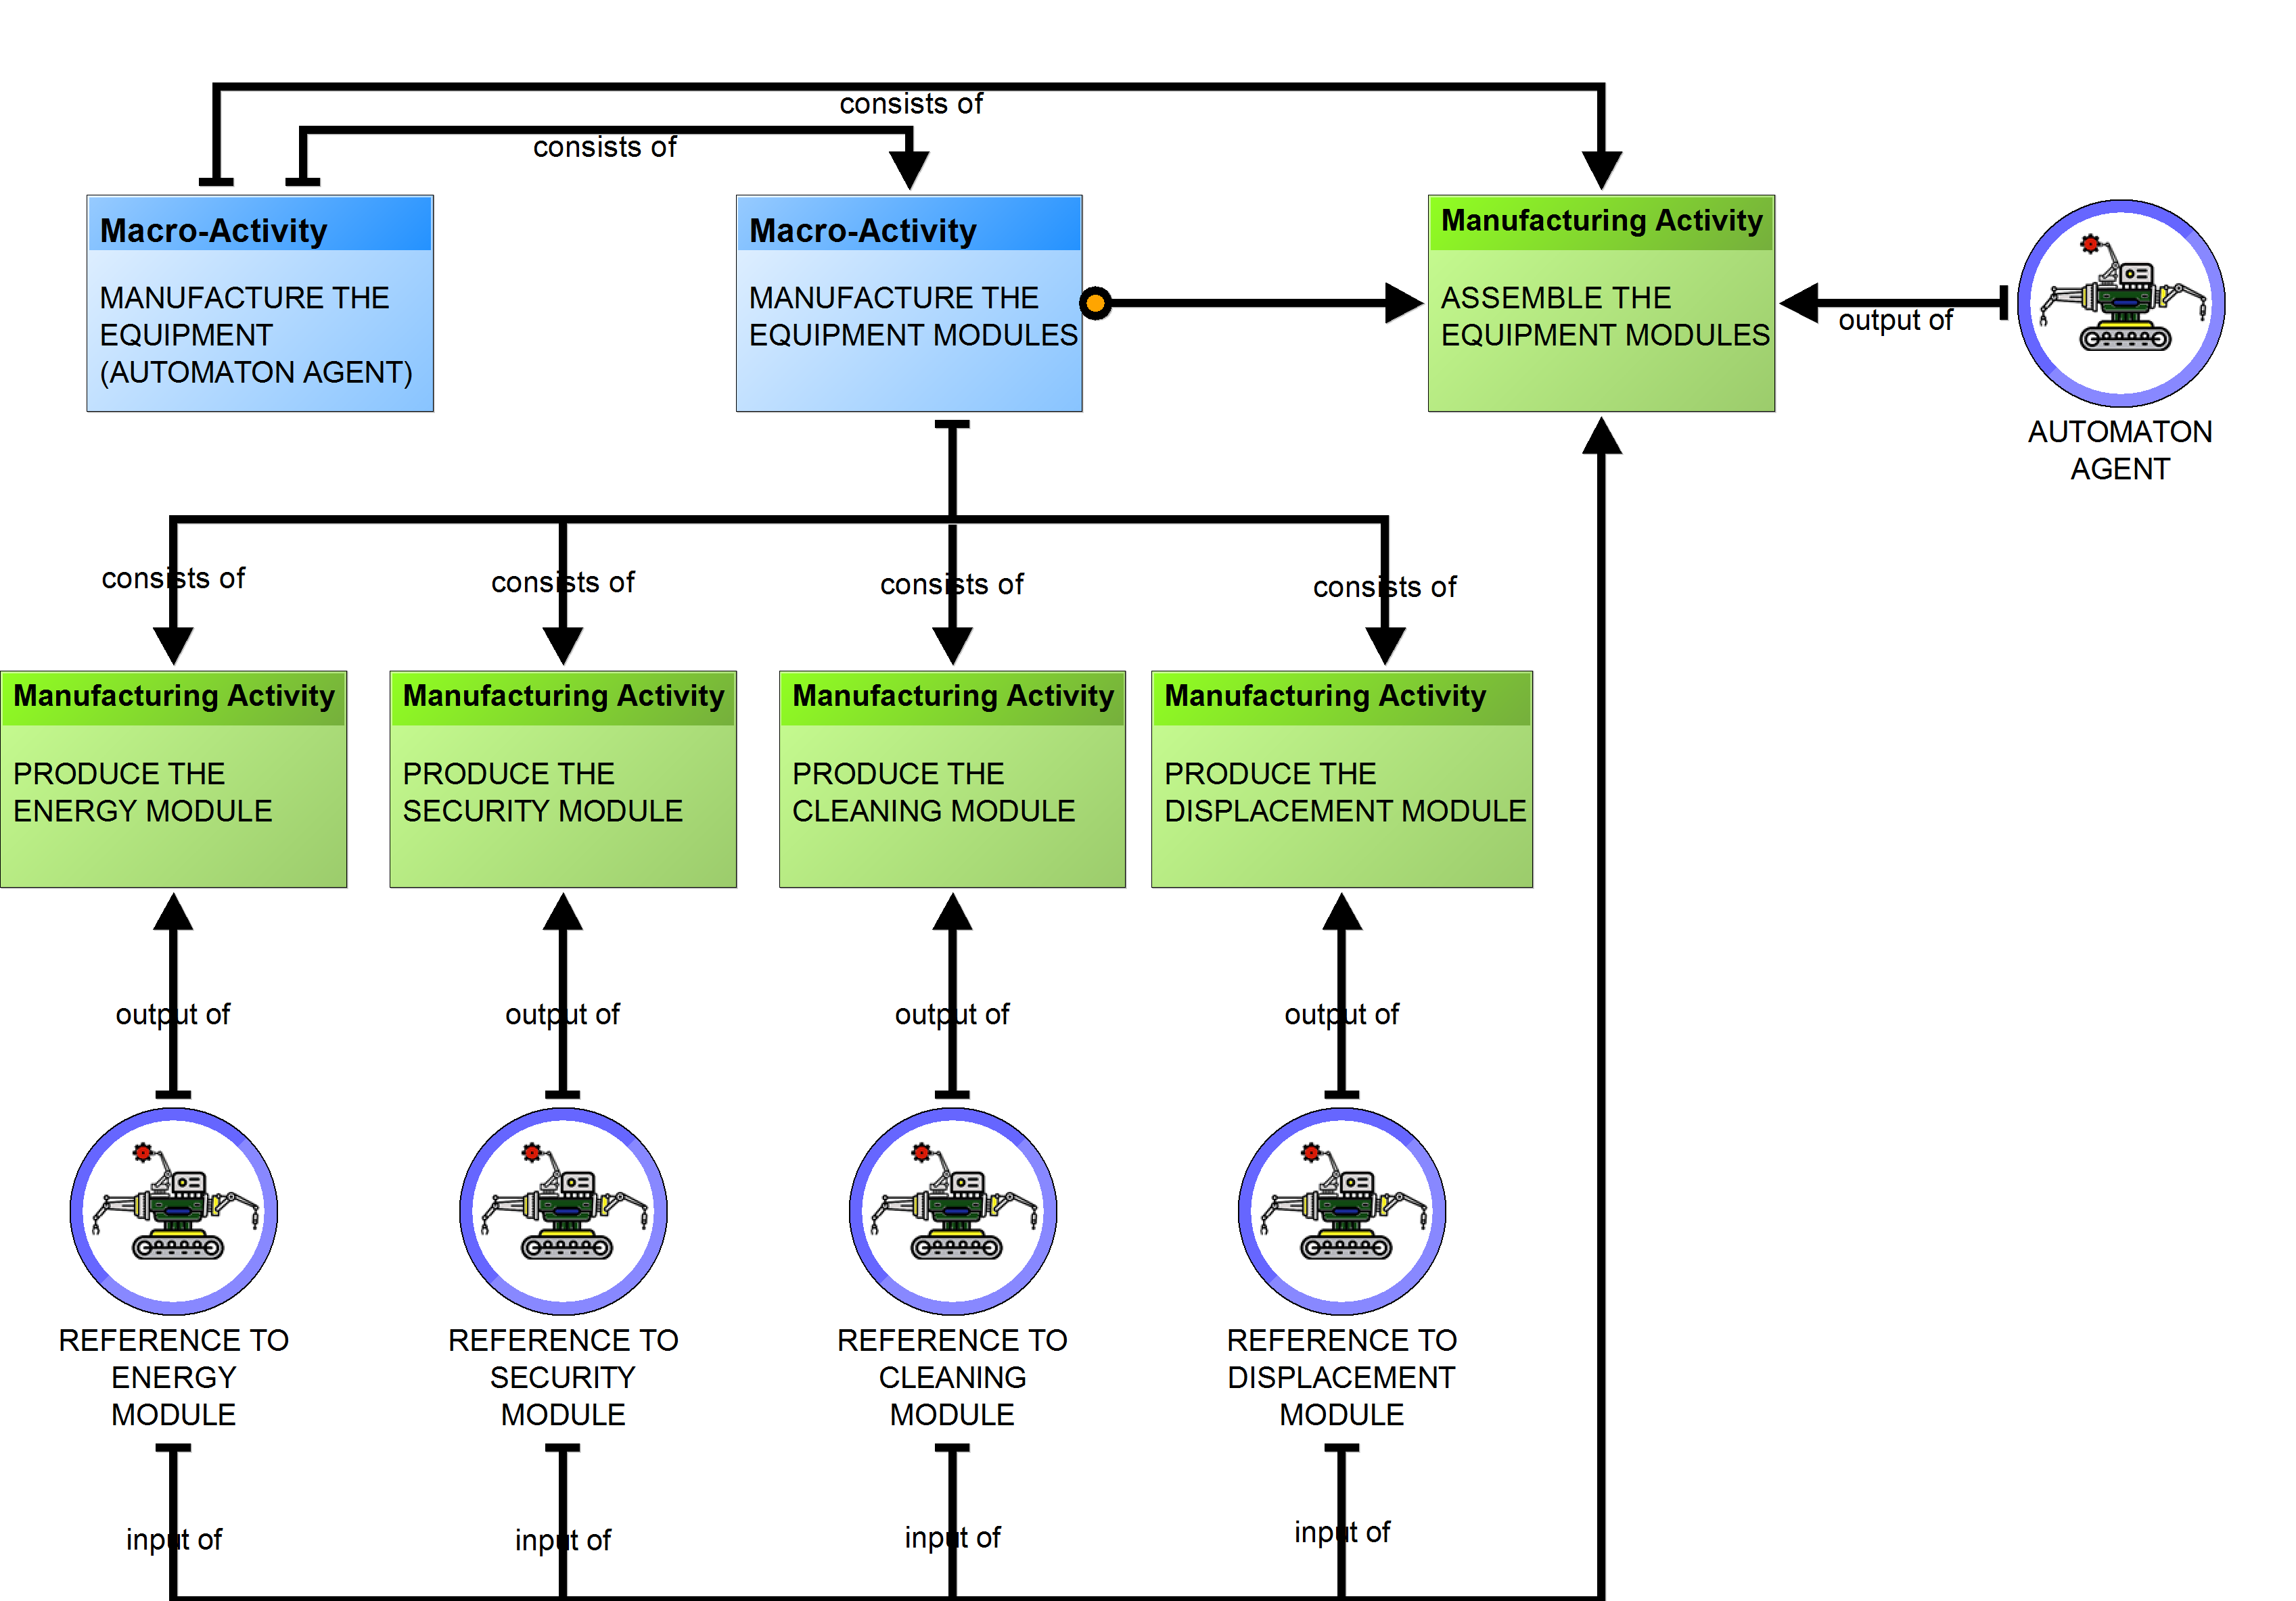
Presentation of PS3M Modelling Approach
Step 4. Activity Model
Macro activity types
Design
Manufacturing
Manufacture of modules for the Automaton Agent
Design of the area plans
Transport of technical staff
Logistic
Back / front office
Usage
Accompaniment to clients
Execution in situ
Assembly of batteries
4.1 Activity View – Manufacturing in PS3M
11
Notes:
Given that the goal of this method is to evaluate the potential specific configurations of a value creation network; it is important to identify the value creation activities through this activity model, step 4.
This model represents the processes required to deliver a PSS offer which are called in this approach: “Macro-Activities” (M.A.). After defining the involved processes and organizing them according to their added value dimensions, we can model each process among with the activities it involves. For the present case, a M.A. can be: manufacture of the modules that compose the automaton agent.
Likewise, it is entirely possible that a M.A. consists of different types of activities, such as:
Design, for instance, design of the area plans to be cleaned.
Manufacturing like assembly of the batteries system.
Logistic: example, transport of technical staff.
Back - front office service as accompaniment to clients in the requirements definition. And…
Usage: execution of the automaton agent in situ.
In the same way, those activities can refer to another models. The latter models are used to have a more detailed description of each activity, allowing to get strategic and operational knowledge as well as information about their:
objectives;
organizational actors involved in their execution;
resources like consumed energy;
capacity;
expected input data; and…
costs.

Slide 12
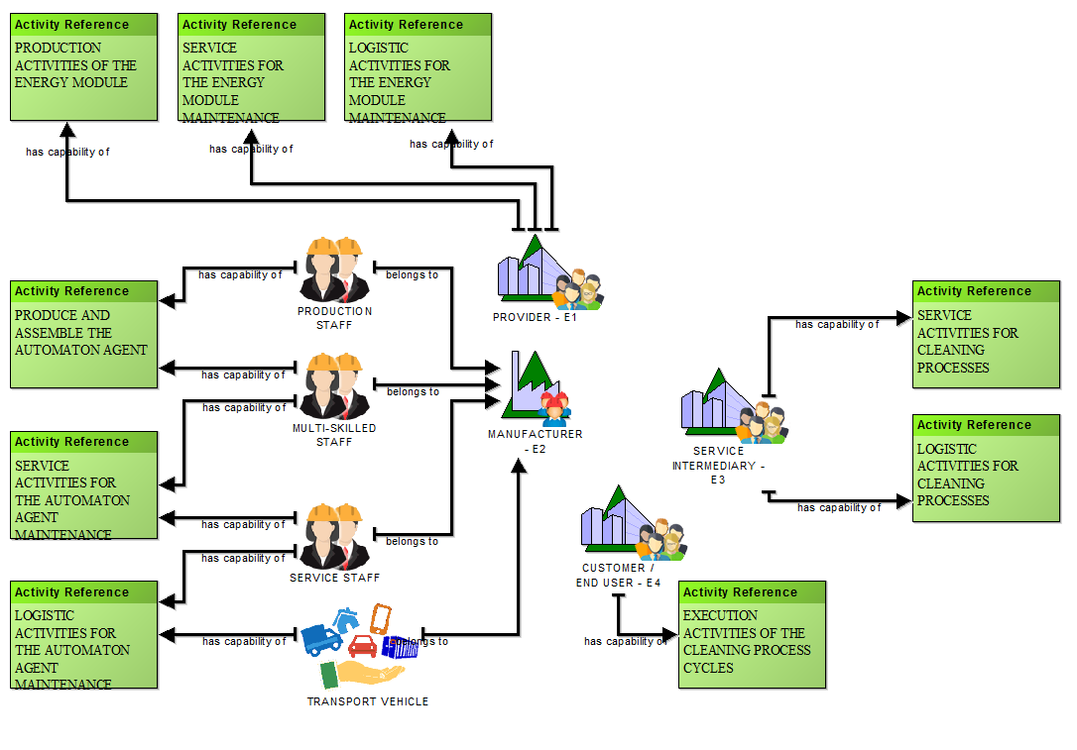
Presentation of PS3M Modelling Approach
Step 5. Organization Model
Actors
Internal
Producer of the automaton agent
External
Batteries system provider
Resources
Physical
Human
Transport vehicles
Specific software
Intangible
Production operators
Examples
5.1 Organisation View – Configuration 1 in PS3M
12
Notes:
After identifying value creation activities, it is now easy to define which actor can undertake which activities. This is carried out through the Organization Model, step 5.
This stage of the currently available modelling method helps to identify the actors that are involved in the execution of those activities. Nevertheless, the purpose of this model is not to define who does what, but rather, to define who is able to do what. Accordingly, in order to define who is able to do what, an “Activity Reference” must be declared with the purpose of referring one or more activities created in the earlier step. In this way, we can generate later several scenarios which represent different possible configurations of the affectation of those actors to the activities.
In addition, this representation is characterized by two types of organizational actors:
the internal, who would be the enterprise that produces the automaton agent; and…
the external, for instance, the provider of the batteries system.
In the same way, an organizational actor is characterized by its capability to take in charge one or more activities and also, it can have one or more resources such as:
physicals: for this case in particular could be transport vehicles;
humans as production operators; and…
intangibles like an specific software or user interaction with an internet platform: being for this case study an example, the design tool to create the area maps to be cleaned.
Globally, those resources are modelled to give details about the internal organizational actors, namely the primary factory which delivers PSS offer.
Finally, it is possible during the affectation to realize that the Organizational Model generated is not accurate. This is due to the granularity degree of the activities declared before. The higher the granularity degree gets, the more allocation in the model will be accurate. Therefore, both models, of activity and of organization, are progressively created with several iterations, which contribute to their refinement.

Slide 13
Presentation of PS3M Modelling Approach
Step 6. Demand Model
Customer class
Meat transformation firms
Demand
Intensive cleaning process
User profile
50 m² to be cleaned daily
6. Demand View in PS3M
13
Notes:
Step 6: The demand model. In this stage, the demand and the segmentation of the market are defined. Modelling these aspects is fairly simple, we start by defining the customer class and his profile, then we specify the demand either as an overall or per period.
The market segmentation is performed through the identification of the customers having the same commercial and use profile. Accordingly, in this case study the automaton agent solution is addressed, for instance, to industrial firms belonging to the meat transformation sector.
Lastly, the use profile is an important parameter since it affects directly the delivered product and consequently the offer, for example: an intensive cleaning process will reduce the automaton agent components lifecycle and, as consequence, it will increase its maintenance frequency.

Slide 14
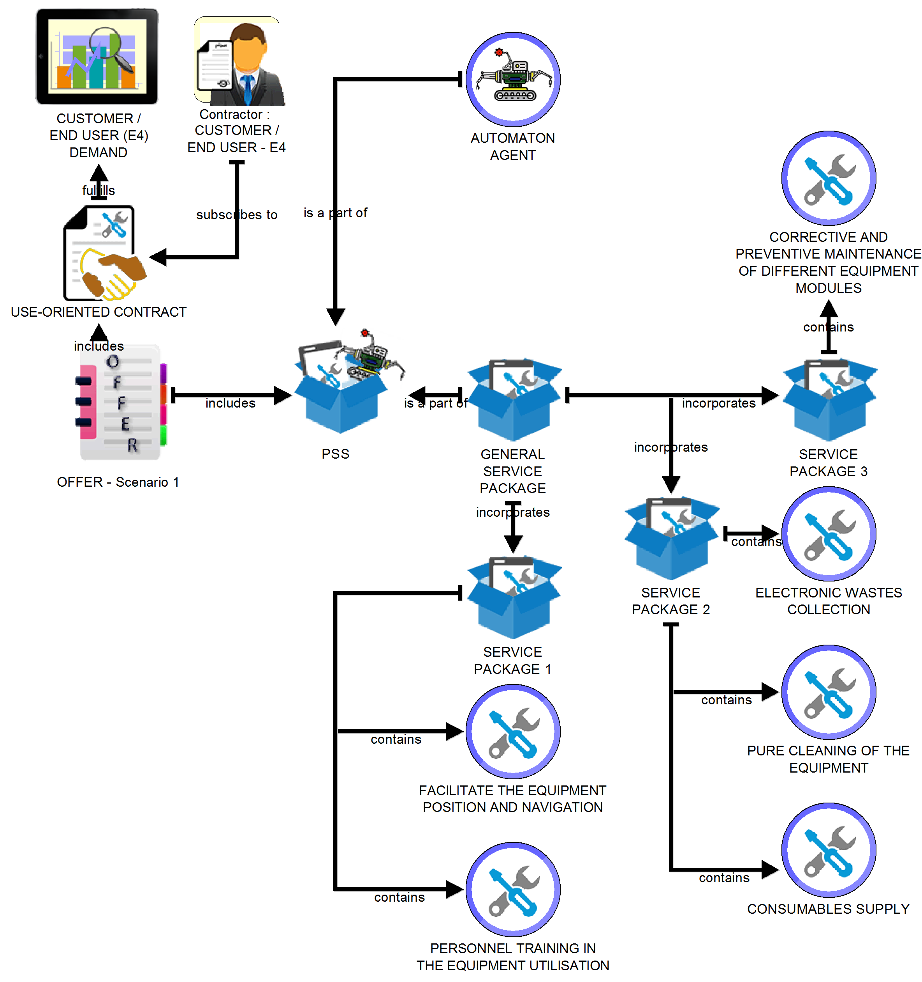
Presentation of PS3M Modelling Approach
Step 7. Offer Model
Contract
Product oriented
Use oriented
Result oriented
1000 m² cleaned per month
500 hours of cleaning per month
Cleaning equipment
Product
Service packages
PSS elements
Autonomous cleaning device
Waste collection
Supply of consumables
7.1 Offer View – Scenario 1 in PS3M
14
Notes:
Step 7: The Offer Model. It specifies the offer which fulfils the demand stated in the previous step. This model connects, the contract and the PSS, as well as, the product and the defined packages, which contains the associated services.
The first important aspect in this model type, is the contract. It is possible to define three kinds of contract and each one represents a particular business model adopted by the PSS supplier.
"Product-Oriented Contract": consists in the direct-sale of products, providing services according to the customer's request. For instance: offering an autonomous cleaning equipment.
"Use-Oriented Contract: consists in selling the functions of the product and providing services according to the customer's request. For instance: offering a certain amount of cleaning hours per month.
"Result-Oriented Contract": consists in the provision of a global solution including all necessary products and services to provide the final agreed outcome. For instance: offering the result of a certain area cleaned per month.
The second aspect is composed by the PSS elements, namely the product and the service packages. The latter allows to organize the services chosen by the customer according to their revenue mechanism. An example of two services belonging to the same service package could be: the collection of waste, and the supply of consumables.
The notion of service package is relevant for the product-oriented and the use-oriented contract where the customer chooses, not only what he needs as services, but also the payment model (For instance, monthly subscription to a service or a direct payment per intervention). However, it is less relevant for the result-oriented one because the supplier offers an agreed outcome, and should choose himself the adequate services to deliver it.
Lastly, the service package can also give an overview of the offer’s integration level; the fewer the packages’ number, the higher the integration level of the PSS offer. In short, the result-oriented contract stands as the most integrated offer between the three.

Slide 15
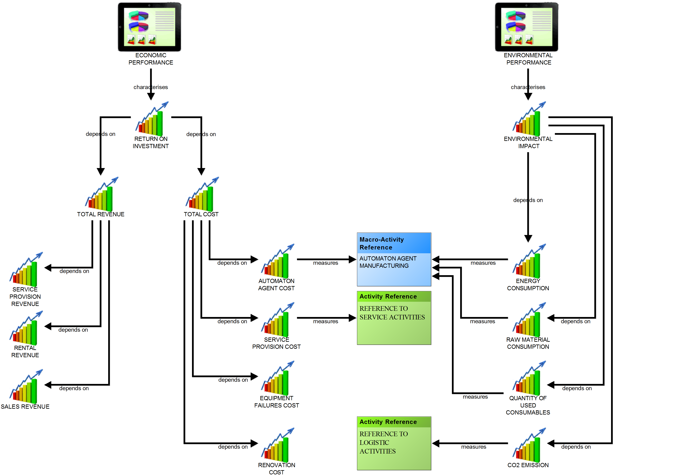
Presentation of PS3M Modelling Approach
Step 8. Performance Model
ECONOMIC
TECHNOLOGICAL
ENVIRONMENTAL
Training return on investment
SOCIAL AND HUMAN
Revenue growth rate
Overall Equipment Effectiveness (OEE)
Energy consumption
Waste reduction
MACRO ACTIVITY REFERENCE
Fabrication of robot
ACTIVITY REFERENCE
Assembly of battery system
ACTIVITY REFERENCE
Transport of robot
8. Performance View in PS3M
15
Notes:
Step 8. Performance Model. It structures the performance dimensions and the indicators that will be used to measure value creation performance.
Performance indicators can be grouped as dimensions such as: environmental, social and human, economic, and, technological. Some examples of indicators of these dimensions could be: energy consumption and waste reduction; training return on investment; revenue growth rate; and, overall equipment effectiveness.
These indicators can be then assigned to activities or macro activities. In this case, a macro activity could be the fabrication of the robot, and some activities could be the assembly of the battery system and the transportation of the robot.
To support decision-making, it is necessary to define indicators that would measure performance of activities in several configurations (that is scenarios). A performance indicator can be characterized by a name, a unit, a formula and a value. From one scenario to the next, the value of the performance indicator is compared to identify the most relevant scenarios.

Slide 16
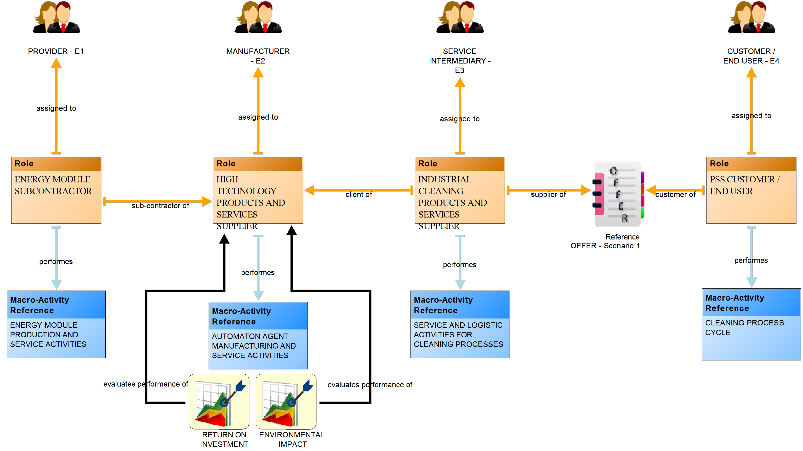
Presentation of PS3M Modelling Approach
Step 9. Scenario Model
Offer
Contract
PSS elements
Assignment of roles
Roles
To organizational actors
To activities and macro-activities
Performance indicators
9.1 Scenario View – Configuration 1 in PS3M
16
Notes:
Step 9. Scenario Model. This is the last and most important step in the modelling procedure, since it allows to link all the PSS concepts. A scenario constitutes a specific configuration of a value creation network and it is based on the combination of elements from other model types to provide a broad vision about a PSS.
Each scenario is characterized mainly by three aspects:
First, a specific business model which is detailed in the Offer Model. Different potential usages will lead to consider several offer configurations and their associated contracts. However, in a scenario model, we evaluate only one offer per scenario.
Second, a specific description of the different roles involved in the value creation network. A role represents the responsibility of an organizational actor, such as: manufacturer, designer, client, provider, and so on.
Third, a specific assignment between organizational actors and roles, then, between roles and the set of the Macro Activities. Each role can be assigned to only one organizational actor and can undertake one or more macro-activities. Therefore, we should refer to the organizational actors through performer items and, to the macro-activities through the macro-activity reference items.
The configuration’s change of these aspects generates different organizational scenarios. It is possible to change the responsibilities of the actors, the assignment of Macro Activities to roles, and, to add or remove roles, or change the offer’s nature (in terms of the contract or the content).
Besides it is possible to stablish a set of indicators. The Scenario Model relates indicators directly with roles. Contrary to the Performance Model, where they are linked directly with the activities and macro-activities.
Once all this information is entered, a specific configuration model is generated. Afterwards, the different scenarios are evaluated to support decision-making.

Slide 17
Back to the case study
INDUSTRIAL AND TECHNOLOGICAL:
- Automation of cleaning processes and hygiene functionalities.
- Hygiene and quality are two key objectives.
- Potential of high-added value solutions coupling robotics with service.
ENVIRONMENTAL:
- Benefits from innovative solutions to increase the efficiency of cleaning process.
- Optimization of resources (water and energy) and responsible use of chemical substances.
LEGAL:
- Hygiene standards are evolving, requiring innovative methods and technologies to keep up with new requisites.
- Overcome with sanitary controls.
- Compliance with safety and occupational health laws.
SOCIAL AND HUMAN:
- Food safety is one of the main concerns of consumers in this field.
- Preserve the quality of life of the work force through the improvement of its work places.
Requirements and needs….for a creativity session
17
Notes:
We continue in the subsection 1.2, A Case Study, in order to describe its requirements, needs and context…
From a LEGAL point of view:
Hygiene standards are evolving, requiring innovative methods and technologies to keep up with new requisites.
Overcome with sanitary controls; and
Compliance with safety and occupational health laws.
From a SOCIAL AND HUMAN point of view:
Food safety is one of the main concerns of consumers in this field; and
Preserve the quality of life of the work-force through the improvement of its work places.
From an INDUSTRIAL AND TECHNOLOGICAL point of view:
Automation of cleaning processes and hygiene functionalities.
Hygiene and quality are two key objectives; and
Potential of high-added value solutions coupling robotics with service.
From an ENVIRONMENTAL point of view:
Benefits from innovative solutions to increase the efficiency of cleaning process; and
Optimization of resources, water and energy, and responsible use of chemical substances.

Slide 18
Exercice : Part 1

Slide 19
Exercice : Part 2 & 3

Slide 20
Exercice : Part 4

