Slide 1

EMSE_05
Circular Economy and Product-Service System
Elaheh Maleki

Slide 2
Objective
Objective: To make students familiar with sustainable solution providing
1
Unsustainability & Circular Economy
2
Strategies to reach sustainability
3
Sustainable
Product-Service System

Slide 3
1. Unsustainability & Circular Economy
Objective: To make students familiar with sustainable solution providing
1
Unsustainability & Circular Economy
2
Strategies to reach sustainability
3
Sustainable
Product-Service System

Slide 4
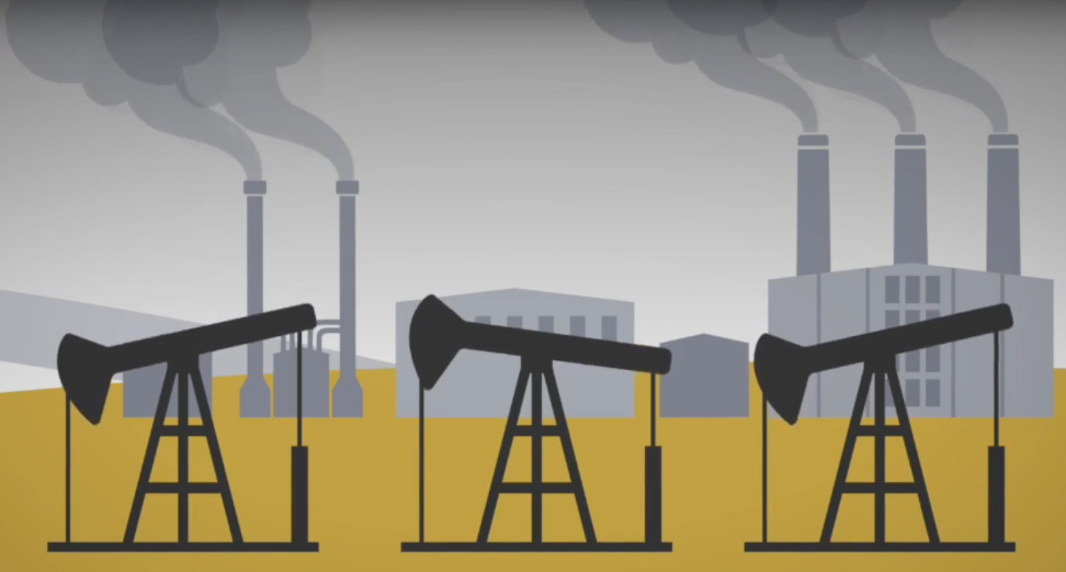
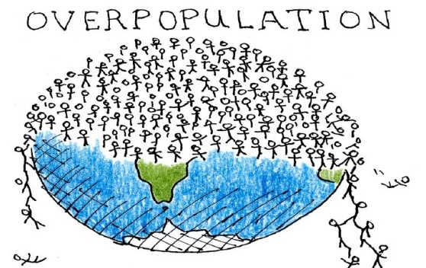
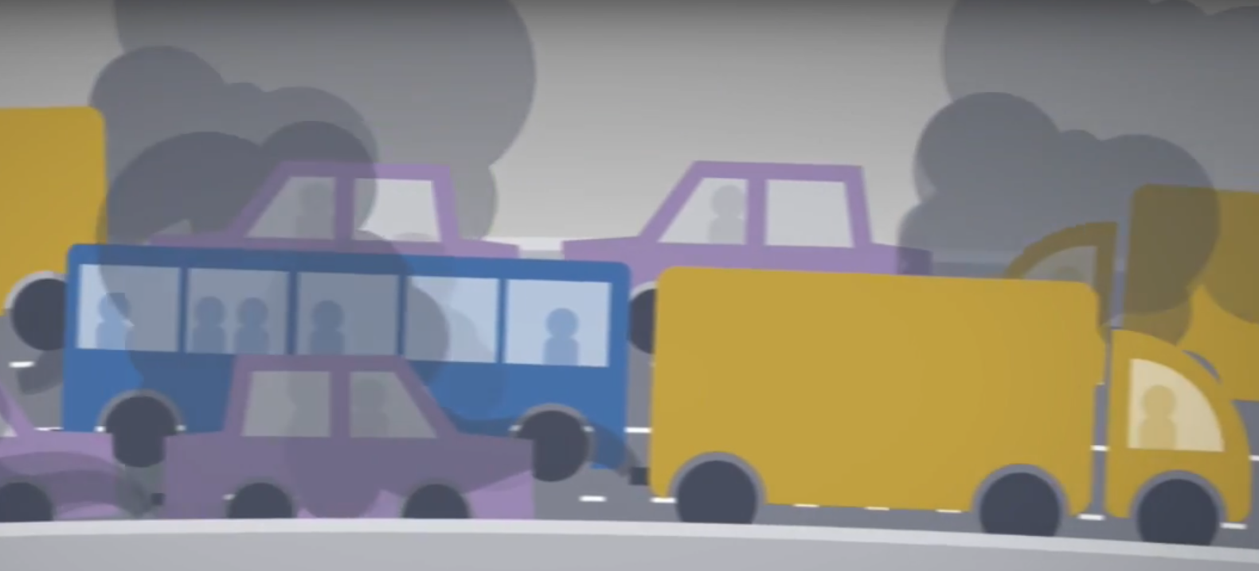
Unsustainability
Critical trends that characterize the unsustainability of the current global situation
Overpopulation
Resource exploitation and increasing pollution
Over-consumption
How to deal with unsustainability?
[Mont, 2000]

Slide 5

Seeing the Bigger Picture
The Linear Economy:
We can’t sustain this ‘take-make-dispose’ model –what’s the solution?
Recycling?
What would have to change to make recycling work better?
Use Less?
What would have to change to allow for using less to be ok?
Last Longer?
Could longer lasting products work? How?
More Efficient?
What would we have to change to make efficiency really helpful?
Green?
Although many green products are moving in the right direction, what does the destination look like?
Fewer People?
How can we change things to make our newest members of the human race welcome on our planet?
How Do Other Species Live?
What are the rules [for benign production]?
Notes:
The Ellen MacArthur Foundation was launched in 2010 to accelerate the transition to a Circular Economy.

Slide 6
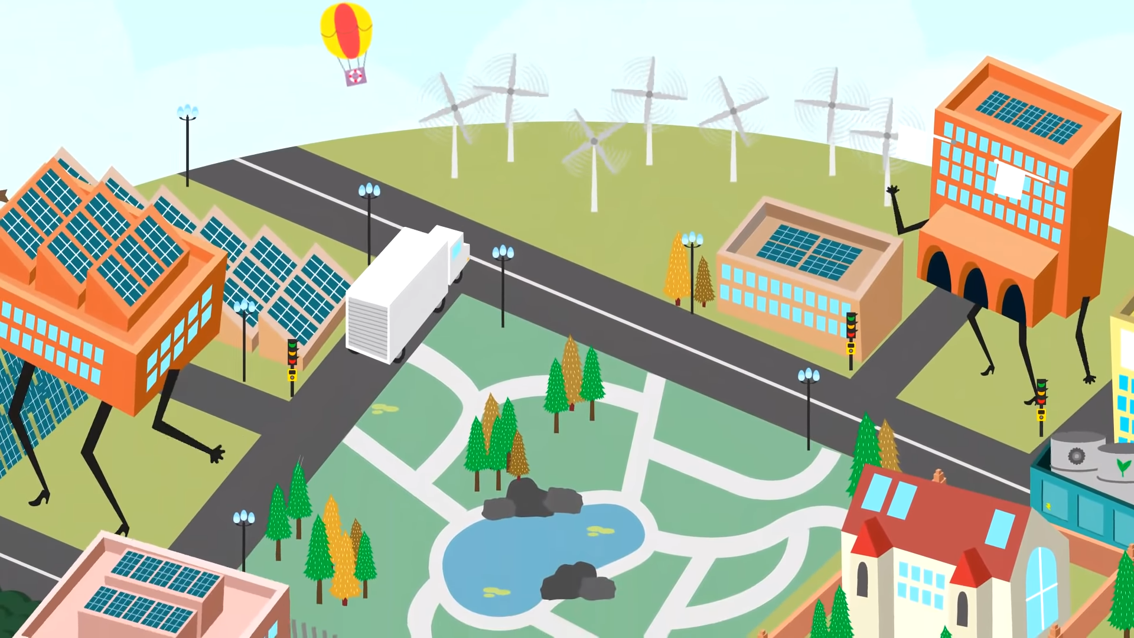
Circular Economy
https://www.youtube.com/watch?v=zCRKvDyyHmI

Slide 7
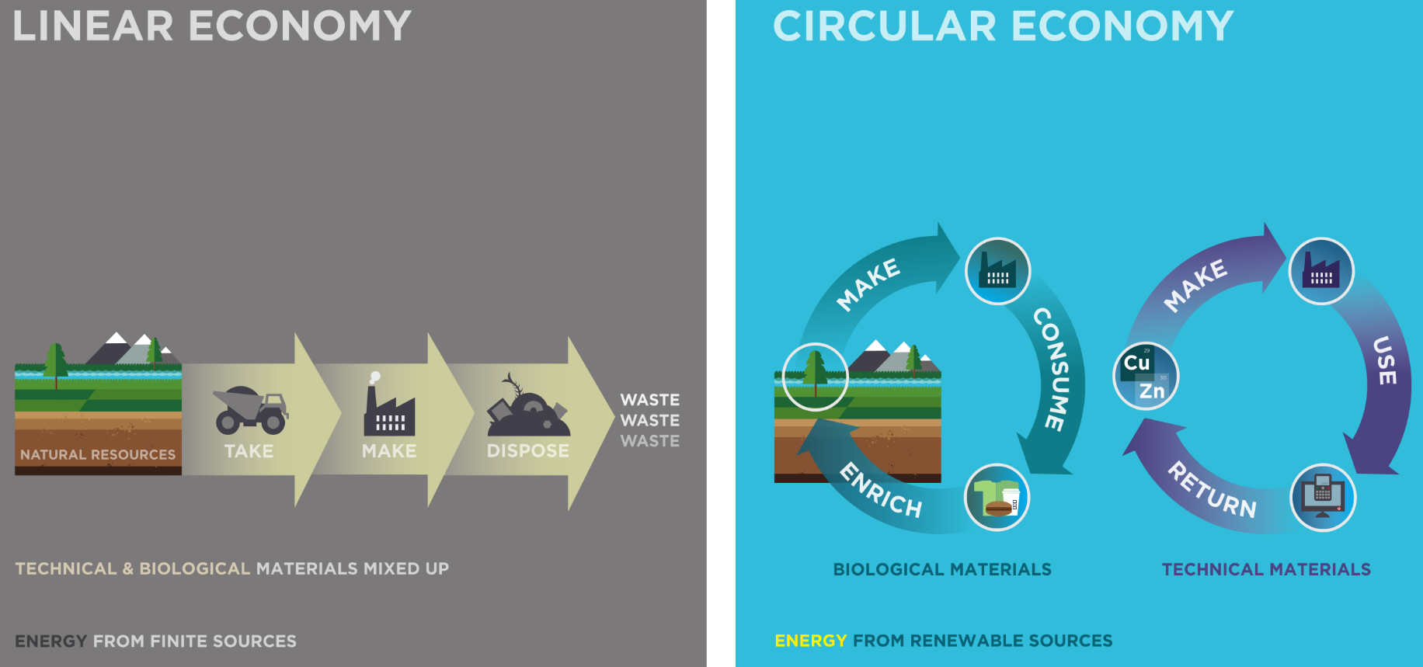
Circular Economy
The circular economy offers the opportunity to move away from our "take - make - dispose" model, by ensuring, through careful design and innovative business models, that technical and biological materials continuously flow, safeguarding valuable resources and restoring natural capital.

Slide 8
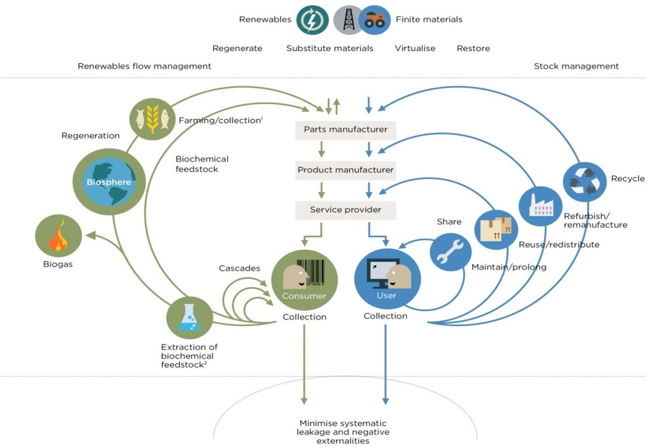
Possible solutions for a Circular Economy
The Ellen MacArthur Foundation was launched in 2010 to accelerate the transition to a Circular Economy.

Slide 9
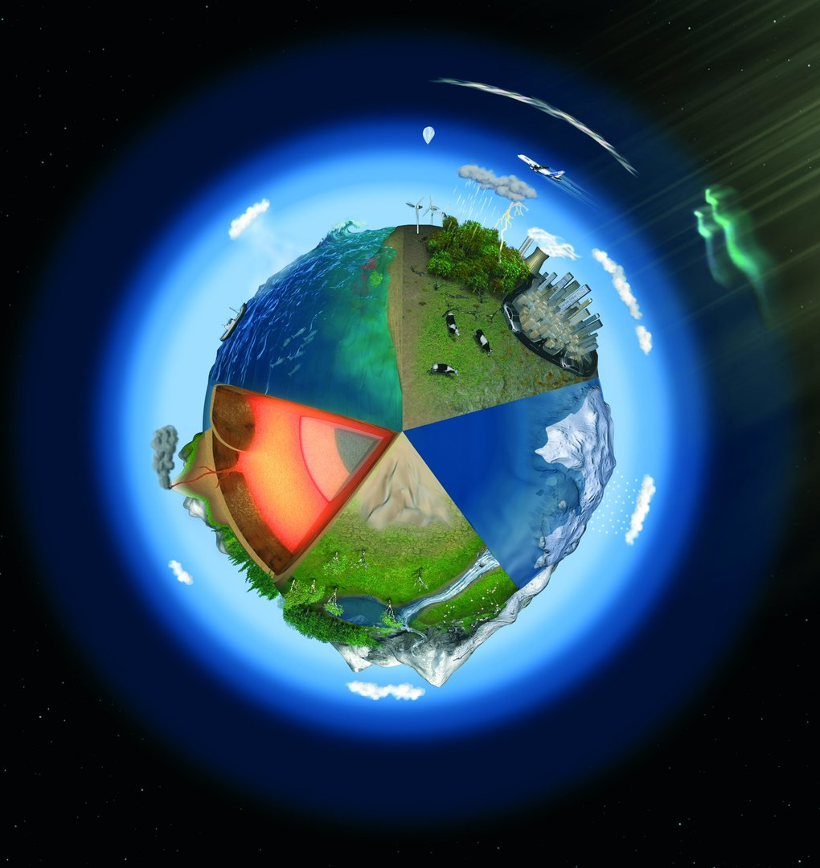
A new perspective: Rethink everything
https://www.youtube.com/watch?v=KIp7Bjexf3Y&list=PLD2C43638C526D33F&index=9

Slide 10
Objective: To make students familiar with sustainable solution providing
1
Unsustainability & Circular Economy
2
Strategies to reach sustainability
3
Sustainable
Product-Service System

Slide 11
Strategies to operationalize the circular approach
Product side of reaching sustainability:
Extending the lifespan of the product [Blomsma and Brennan, 2017] e.g. Reducing requirement for product
Production side of reaching sustainability:
Closing the loop of material flow [Blomsma and Brennan, 2017] & replacing the “end-of-life concept with restoration” [Macarthur, 2013] e.g. Reducing the amount of materials in products and services (dematerialisation), Recycling and claiming the product material back
Consumption side of reaching sustainability:
“To have a utility instead of ownership” [Mont, 2000] e.g. Eco-efficiency, Increasing efficiency of the product usage phase
“Solution-besed approach” can fulfills these strategies.
[Mont, 2000]

Slide 12
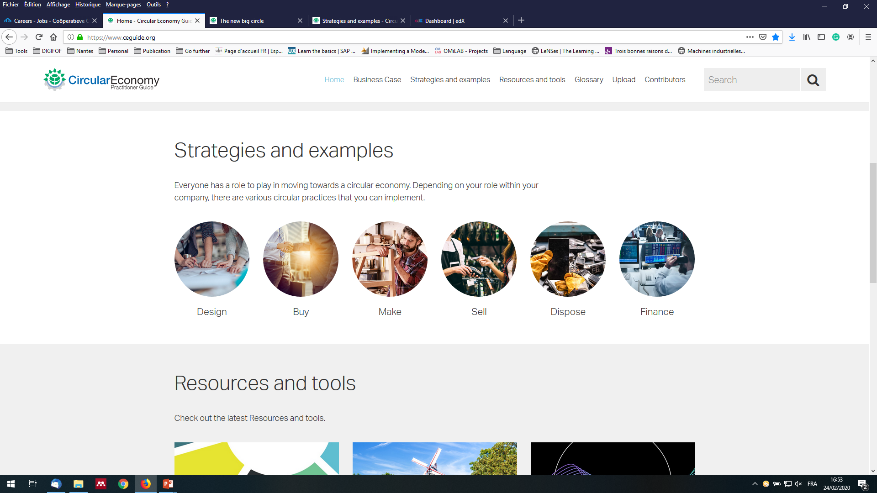
Strategies & examples for moving towards Circular Solution
Depending on your role in company, there are various practices to implement circular solution.
Research, Innovation, Design
Procurement
Production & Manufacturing
Sales and Marketing
Waste Management
Investment & Accounting
https://www.ceguide.org/

Slide 13
DESIGN
If you work within the Research, Innovation or Design departments, consider these practices to move your company towards the circular economy.
Regenerative design
Green chemistry
Integrated design process
Cradle to Cradle®
Standardization
Design for flexibility
Biomimicry
Design for the environment (eco-design)
Life cycle thinking
Design for disassembly/deconstruction
Design for recoverability/recyclability
Systems thinking
Design for maintainability/reparability
Lifetime extension & durability
https://www.ceguide.org/

Slide 14
Unsustainability
BUY
If you work within the Procurement department, consider these practices to move your company towards the circular economy.
Critical raw material substitutes
Services (not products)
Bio-based resources
Reclaimed resources
Compostable resources
Renewable resources
Rare earth metal substitutes
Safe chemicals
Recycled resources
Biodegradable resources
Reused/ reusable resources
https://www.ceguide.org/

Slide 15
MAKE
If you work within the Production and Manufacturing departments, consider these practices to move your company towards the circular economy.
Kaizen (continuous improvement)
Resource efficiency
Additive manufacturing
Remanufacturing
Dematerialization
Prefabrication
Jidoka (autonomation)
Refurbishing
Kanban (just-in-time)
Six Sigma
Poka Yoke (error-proofing)
Lean manufacturing
https://www.ceguide.org/

Slide 16
SALE
If you work within the Sales and Marketing departments, consider these practices to move your company towards the circular economy.
Digitization and virtualization
Pay-per-service unit
Co-branded services
Sharing platforms
Leasing
https://www.ceguide.org/

Slide 17
DISPOSE
If you work within the Waste Management department, consider these practices to move your company towards the circular economy.
Deconstruction and disassembly
Cascading
Composting
Compatibilizers
Energy recovery
Feedstock recycling
Industrial symbiosis
Recycling
Repurposing
Reverse logistics
Selective extraction
Take-back program
Waste to Energy
Secondary material marketplaces
https://www.ceguide.org/

Slide 18
FINANCE
If you work within the Finance and Accounting departments, consider these practices to move your company towards the circular economy.
Integrate circular value in models
Assess ESG risk
Impact loan
Crowdfunding
Factoring
Prioritize cash flow
Green bonds
Assess linear risk
Purchase order finance
Supply chain financing
Natural capital valuation
Stranded asset management
Assess creditworthiness risk
Integrated client approach
Incentivize end-of-life returns
Extend investment time horizon
Emphasize relationship-based financing
https://www.ceguide.org/

Slide 19
Objective: To make students familiar with sustainable solution providing
1
Unsustainability & Circular Economy
2
Strategies to reach sustainability
3
Sustainable
Product-Service System

Slide 20
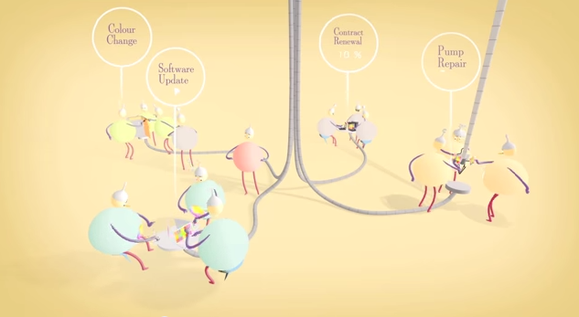
Sustainable Solution-based approach
https://www.youtube.com/watch?v=Cd_isKtGaf8

Slide 21
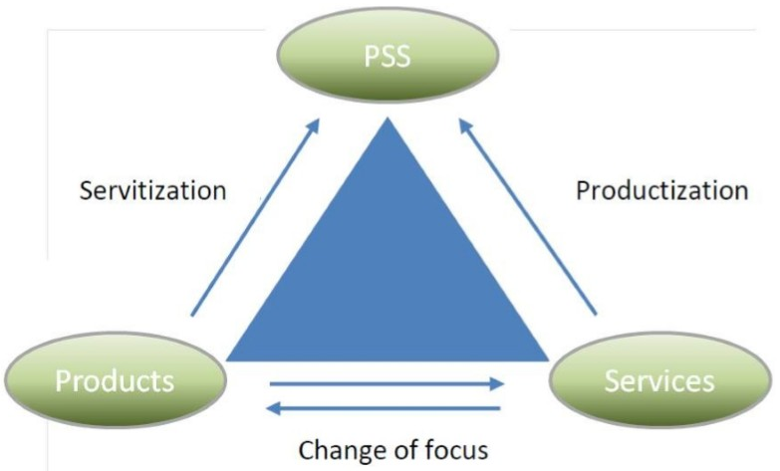
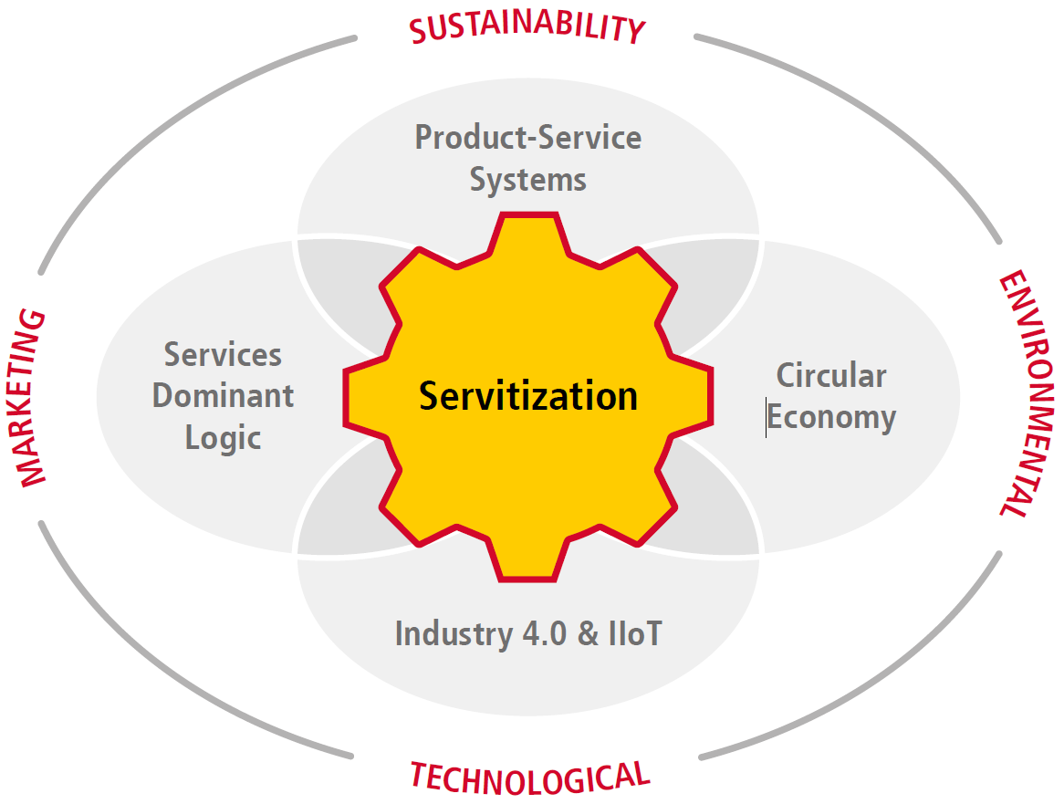
Dematerialization And Service Economy
Product-service systems is a possible answer to sustainability challenges.
Various aspects of the full transformation picture
https://www.logistics.dhl/content/dam/dhl/global/core/documents/pdf/glo-core-servitization-white-paper.PDF

Slide 22
Bike Sharing Case
Notes:
Eco-efficiency is a management strategy of doing more with less (Glavič et al., 2012).
•A ratio between economic performance and environmental impact
Eco-efficiency is achieved through three objectives:
•Increasing product or service values
•Optimizing the usages of resources
•Reducing environmental impacts (Government of Canada, 2013)
Design for Disassembly (DFD)

Slide 23
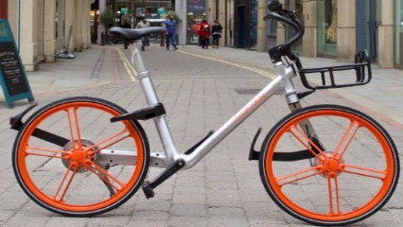
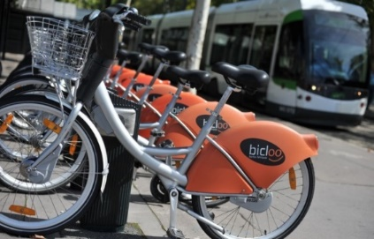

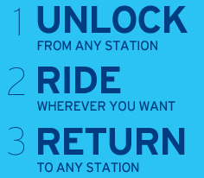

Bike Sharing Case
Paying to OWN the product
Paying to USE the product: Bike Sharing Systems
Sustainability issues
Competitive market
Shift the focus from selling a product to providing a solution

Slide 24

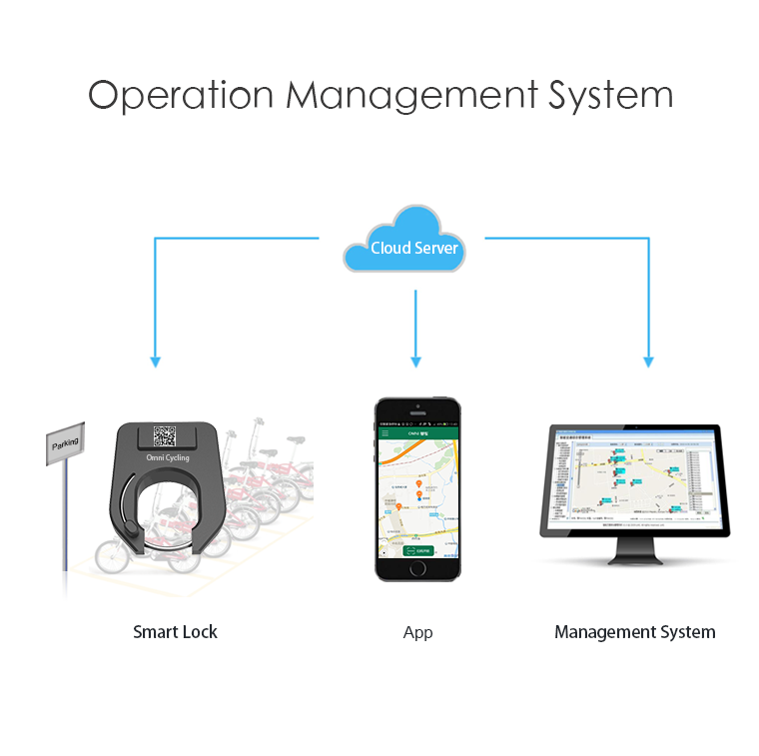

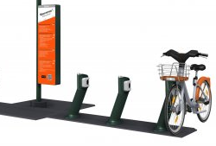
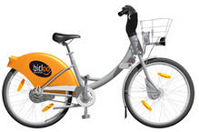

Bike Sharing Case
Product-Service System (PSS)
Integrated as a system
Bike station
Customized Bike
Smart lock
Mobile
Application
Management
System
Payment system
Notes:
Explain it as an example

Slide 25
Industrial Machinery Case:
Gear grinding machine

Slide 26
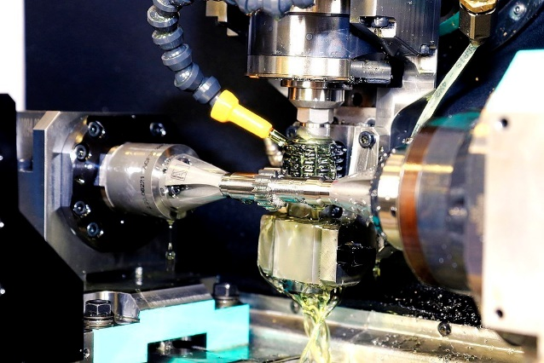
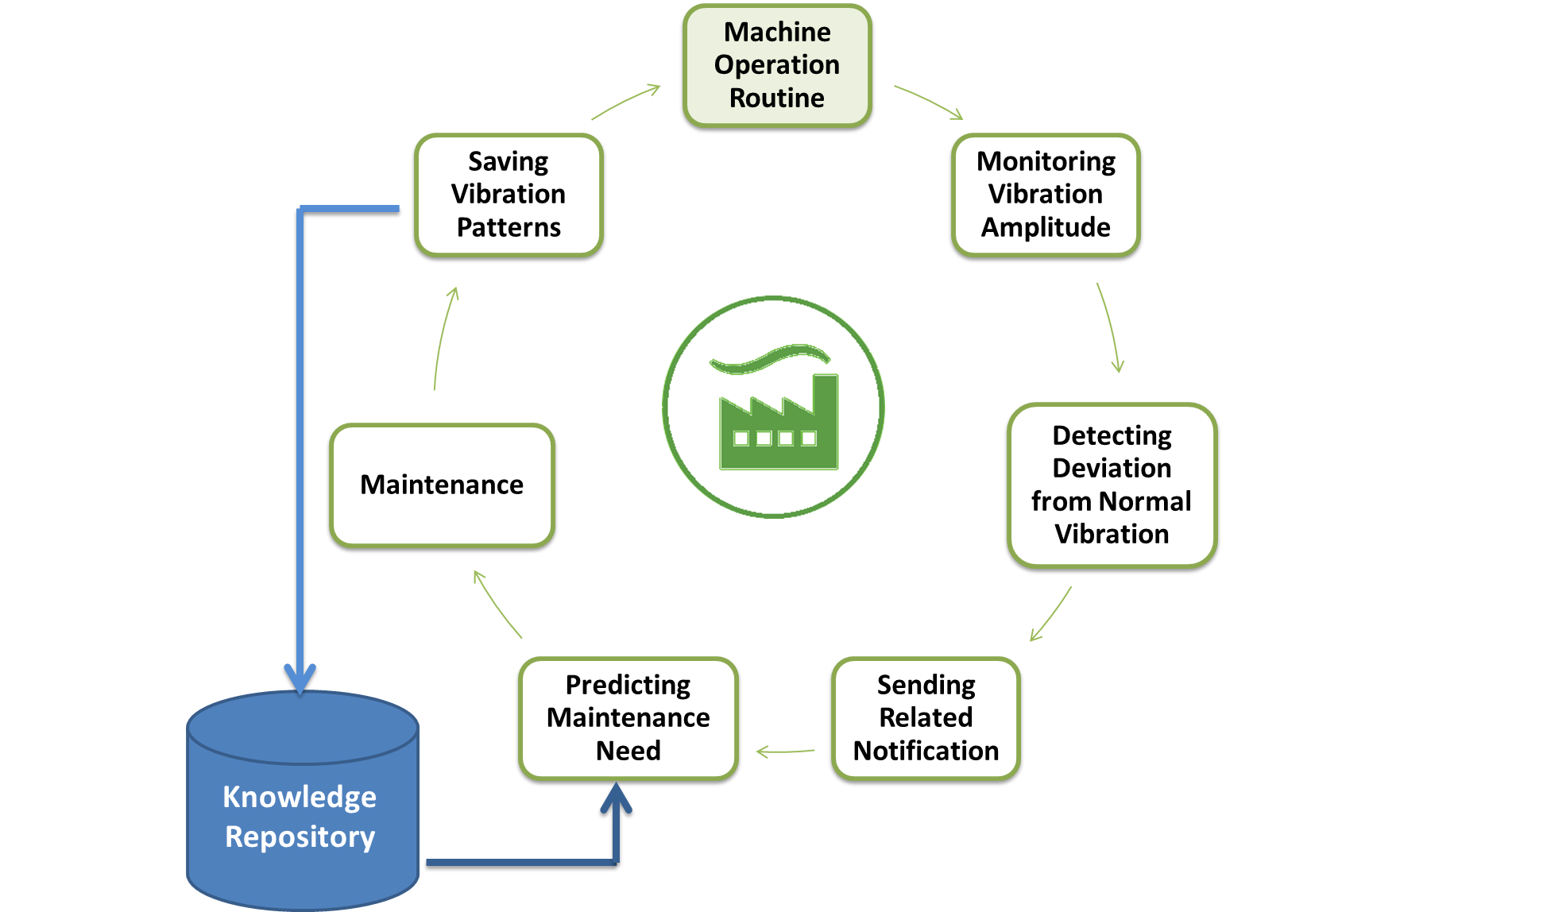
Gear grinding machine
The scenario:
Industrial machine with Health Monitoring Services to increase the machine performance and reduce the waste
↓
1- Relies on Vibration monitoring and predictive maintenance
↓
2- Integrating sensors with machine to acquire data from the machine life stages

Slide 27
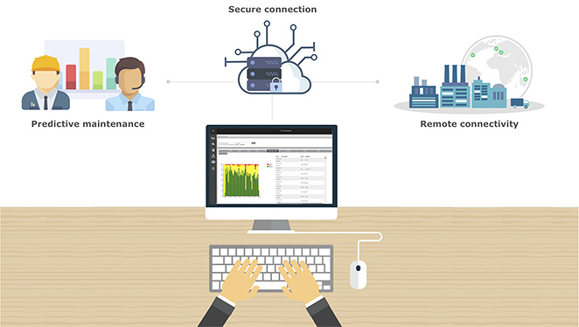
Industrial Machinery Case
Product
Service
Gear grinding Machine
Service Processing: Vibration monitoring (vibration of the machine moving components and condition of the machine)
Embedded System: The vibration sensing system
Software: The HMS software, collaborative platform

Slide 28



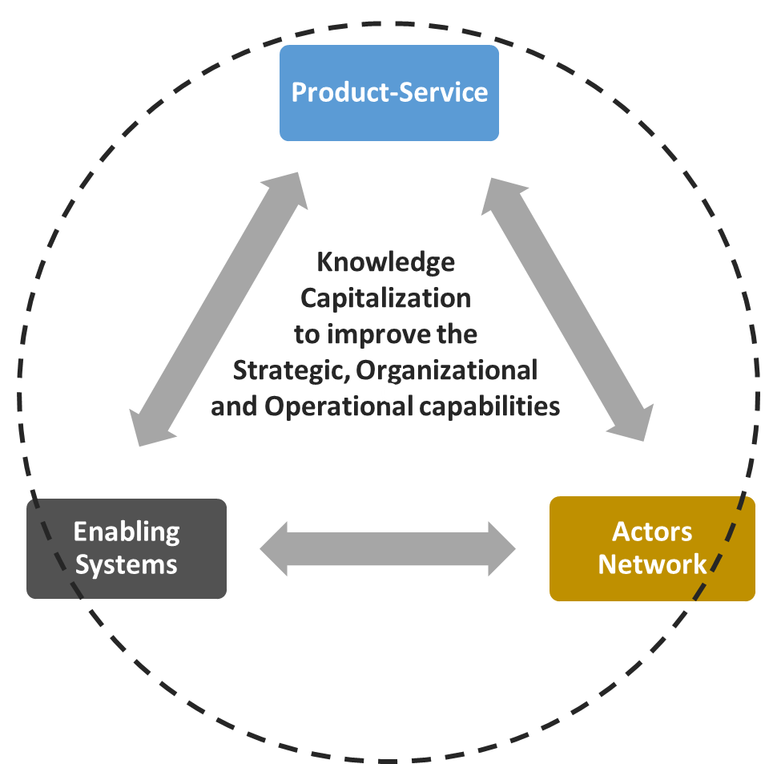





Industrial Machinery Case
Enabling Systems
Actors
Organizational Capabilities
Human Resources: maintenance engineers
Business processes:
Service delivery, knowledge management
Immaterial Resources: Shared and saved ‘know-how’ knowledge
Actors from production, service and support system interacting with each other and with customers
Physical infrastructure Maintenance tools and spare parts
Digital infrastructure
Communication system, Software and cloud

Slide 29
To go further
Circular economy: educational resources
https://kumu.io/ellenmacarthurfoundation/educational-resources#ce-general-resources-map/key-for-general-resources-map
The surprising thing I learned sailing solo around the world | Dame Ellen MacArthur
https://www.youtube.com/watch?v=ooIxHVXgLbc
The Disruptive Innovation Festival (DIF)
https://www.thinkdif.co/topics
Case Studies
https://www.ellenmacarthurfoundation.org/case-studies
A Good Disruption
https://youtu.be/uT66CRYkSM8
New Plastics Economy
https://vimeo.com/168011130
Make Fashion Circular
https://www.ellenmacarthurfoundation.org/our-work/activities/make-fashion-circular

Slide 30
References
Kim, Yong Se (2012), A Product-Service Systems Design Method with Integration of Product Elements and Service Elements Using Affordances, ServDes.2012 Third Nordic Conference on Service Design and Service Innovation
Mont O. Clarifying the concept of product – service system. J Clean Prod. 2002;10:237-245. doi:10.1016/S0959-6526(01)00039-7
F. Blomsma, L. Kjaer, D. Pigosso, T. McAloone, and S. Lloyd, “Exploring Circular Strategy Combinations - Towards Understanding the Role of PSS,” Procedia CIRP, vol. 69, no. May, pp. 752–757, 2018.
Blomsma F, Brennan G. The Emergence of Circular Economy: A New Framing Around Prolonging Resource Productivity. J Ind Ecol. 2017;21(3):603-614. doi:10.1111/jiec.12603
Macarthur E. Towards the Circular Economy. J Ind Ecol. 2013;2:23-44. doi:10.1162/108819806775545321
Weyrauch, T., & Herstatt, C. (2017). What is frugal innovation? Three defining criteria. Journal of frugal innovation, 2(1), 1.
Trevisan, L. & Brissaud, D., 2017. A system-based conceptual framework for product-service integration in product-service system engineering. Journal of Engineering Design, 28(10–12), pp.627–653.
Baines, T.S. et al., 2007. State-of-the-art in product-service systems. Proceedings of the Institution of Mechanical Engineers, Part B: Journal of Engineering Manufacture, 221(10), pp.1543–1552. Available at: http://sdj.sagepub.com/lookup/10.1243/09544054JEM858.
Meier, H., Roy, R. & Seliger, G., 2010. Industrial Product-Service systems-IPS2. CIRP Annals - Manufacturing Technology, 59(2), pp.607–627.
Tukker, A., 2004. Eight Types of Product Service Systems. Business Strategy and the Environment, 13, pp.246–260.
Wiesner, S. et al., 2015. Interactions between service and product lifecycle management. Procedia CIRP, 30, pp.36–41. Available at: http://dx.doi.org/10.1016/j.procir.2015.02.018.
Circular Economy: An Introduction (https://courses.edx.org/courses/course-v1:Delftx+CircularX+1T2017/course/)
Ellen MacArthur Foundation (https://www.ellenmacarthurfoundation.org/)

Slide 31
Join DigiFoF network!
www.digifof.org

