Slide 1
Integration of the uses and the design in the company business model
February 2020
Cité du design Saint Etienne

Slide 2
Agenda :
RELIEF’s support
La Cité du design
Considering the uses
Workshop: considering the uses
Concrete examples from companies
Conclusion

Slide 3
Funded by :
Supported by:
In partnership with :

Slide 4
A pool of 6 consultants

Slide 5
RELIEF’s program
Beginning of individual support
Seminar #1
11.02.2020 Saint Etienne
Uses and design
Seminar #2
16.04.2020 Aiguebellette
Financing
Seminar #3
16.06.2020 Lyon
Contract and legal frameworks
Seminar #4
15.09.2020 Annecy
Ecodesign products and services
Seminar #5
19.11.2020 Grenoble
Public procurement
2019
End of 2020
2021
03.12.19
COTECH
RELIEF
Juin 2020
COTECH
RELIEF
Sept 2020
COPIL
RELIEF
Déc 2020
COTECH
RELIEF
Developpment of support and seminars
Validation COTECH au fil de l’eau des entreprises candidates et des changements de modules

Slide 6
Agenda :
RELIEF’s support
La Cité du design
Considering the uses
Workshop: considering the uses
Concrete examples from companies
Conclusion

Slide 8
Saint Etienne, UNESCO city of design

Slide 10
Promoting design

Slide 11
International event : la Biennale du Design

Slide 12
Development by the design (companies and territories)

Slide 13
Agenda :
RELIEF’s support
La Cité du design
Considering the uses
Workshop: considering the uses
Concrete examples from companies
Conclusion

Slide 14
Innovation by the uses…
… uses information from consumers, allowing them to become active participants of innovation activities.

Slide 15
Agenda :
RELIEF’s support
La Cité du design
Considering the uses
Workshop: considering the uses
Concrete examples from companies
Conclusion

Slide 16
Agenda :
RELIEF’s support
La Cité du design
Considering the uses
Workshop: considering the uses
Concrete examples from companies
Conclusion

Slide 17
Concrete examples from companies
Sam Outillage : Integrated industrial design
Ecobel : transforming purchases in hospitals

Slide 24
5 operations in one machine

Slide 25
Ecobel
Product presentation
Ecological shower for the prevention of bacteriological risks
Water and contaminations
hospital-acquired diseases
legionellosis cases
For public and private establishements

Slide 26
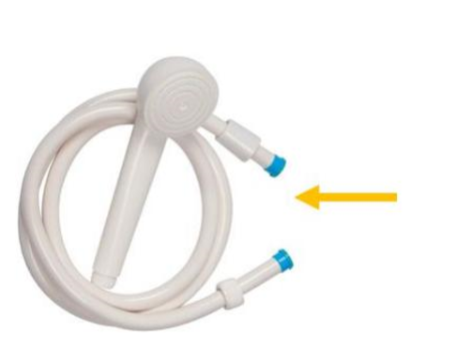
Ecobel
The existing products :
basic and disposable products
mainly destroyed by incinerator
some products without standards
Frome China and Italy…
Price from 1.99€ to 4€
delivered in individual bags
sale by resellers of all sizes

Slide 27
Ecobel
expectations identified :
Security
Hygiene
Environnement
Savings

Slide 28
Ecobel
specifications to the designer
limiting health risks
suitable for sale or service offering
Clean aesthetic signature
special attention paid to the maintenance user
product traceability

Slide 29
Ecobel
specifications to the designer
reduce the amount of material used for manufacturing
Goal -20%
modular construction for the decomposition of the product
suitable for a service offer
make it easier to recycle the product
modular design
Personalization depending on the type of establishment, sale or service

Slide 30
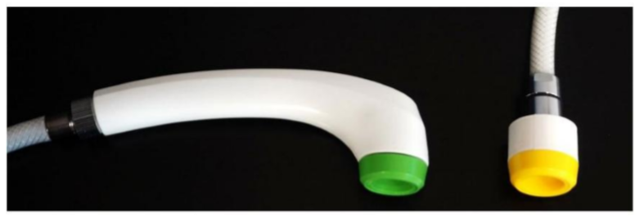
Ecobel
V1 validated 2 arguments :
guarantee of hygiene
efficiency of cleaning and hygienic actions
water saving

Slide 31
Ecobel
Key points :
communicate a high-end image through the adequation between aesthetics, price and service
provide optimal (and obvious) ergonomics for the end user
offer modularity to adapt the offer to different markets and uses

Slide 32
Ecobel
Design study :
adaptation for removal

Slide 33
Ecobel
Design study :
new tube concept directly on the head

Slide 34
Ecobel
Sketch:
style study based on functional study

Slide 35
Ecobel
Design study

Slide 36
Ecobel
validated sketch for 3D manufacturing

Slide 37
Ecobel
Final 3D modeling

Slide 38
Ecobel
Design study

Slide 39
Ecobel
For establishments :
A turnkey procedure
Security for the various players (headmaster, health manager, technical manager, ...)
realizing savings from using the product

Slide 40
Ecobel
For users :
The security of a procedure
Ecological action to meet objectives
Considering the risk for the client or patient

Slide 41
Agenda :
RELIEF’s support
La Cité du design
Considering the uses
Workshop: considering the uses
Concrete examples from companies
Conclusion

