Slide 1
EMSE_02 Product-Service-System Design Pr. Xavier Boucher

Slide 2
Module 3 : Understand PSS design problematics and methodologies
Pr. Xavier Boucher

Slide 3
Agenda
PSS Design problematics
Key concepts and methodologies for PSS design
Introduction to PS3M design approach and modelling toolkit

Slide 4
PSS : a high complexity of system engineering
When designing a PSS, what do we analyse and design ?
A
A societal Environment
A Market
A user population
Which behaviours ?
Usage Delivery
Which interactions between the offer, the clients, the users ?
An integrated offer
{products & services}
Which innovation strategy? Which offer ? Which service packages ? Which customer relationship system ?
A production system and value creation network
Which industrial organisation ? Which interfaces between manufacturing and service delivery ? Etc…

Slide 5
PSS : a high complexity of system engineering
When designing a PSS what do we design ?
Design Value Creation Processes
Specification of the value offer, configuration of the value creation network
Identify/analyse the key value creation factors
Configure and manage distinct business models depending on each contextual situation
Design Economic Models (costs/revenues)
Availability or performance sale ?
Share the added-value amongst all partners of the value creation network
Impacts of obsolescence, Impacts of service contracts on cash flows (mid and long term)….
Design Usages
Ability to anticipate and analyse user behaviours
Anticipate resistances et constraints from consumers ?
Transform usage specifications into adapted service packages? Rapid prototyping of Services ?
Design and manage life-cycles
Information System, PLM, traçeability ?
Environnemental performance ?
Interdependence between product life-cycles et service life-cycles …
… ‘intelligent’ product
….new organisations
….Collaborative Ecosystems
…Interoperable information systems
DIGIFoF Training – EMSE_02_Module3

Slide 6
How to cope with the design of ‘Product-Service-Systems’ ?
Traditional Product Design
Needs and requirements (Cahier des charges)
General functional design of the product (CAD, Bureau d’études)
Detailed Technical design of the system (CAD, validation mock-up , Bureau d’études.)
Product industrialisation (Design of Tools, Production Lines design, Supply Chains design Bureau des méthodes)
Product Manufacturing and Assembly (Production)
Small series
Large series
Quite linear
(even with some feed-back loops)

Slide 7
How to cope with the design of ‘Product-Service-Systems’ ?
i
Integration= to integrate 3 dimensions !
Value
Design
Solution
Design
Solution
Offer
Life Cycles
Value
Offer
Service
Expected
Usage
Product
Organization & Business Model
Design
User
problem
Collectives competencies
Industrial scenarios
& value network
Economic
Models & value sharing
Business
Model

Slide 8
Agenda
PSS Design problematics
Key concepts and methodologies for PSS design
Introduction to PS3M design approach and modelling toolkit

Slide 9
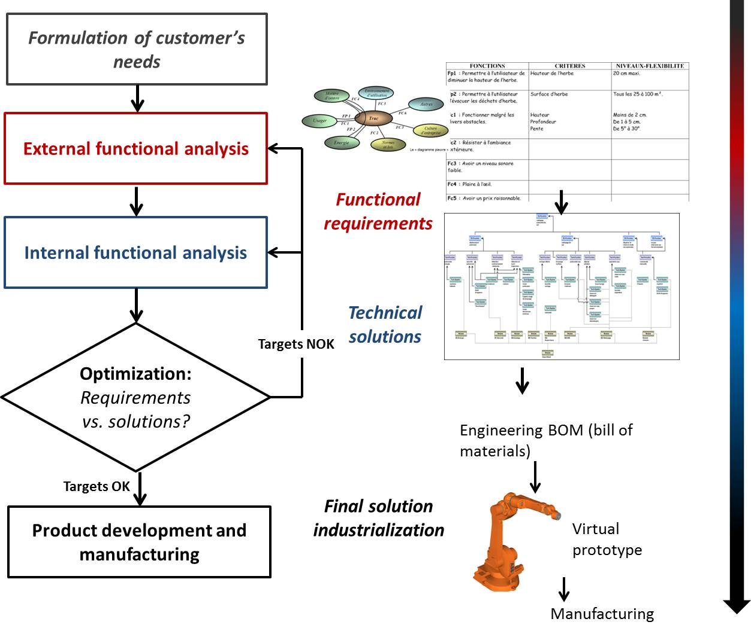
The need to transform current produc-toriented design methods
(Example = Functional Analysis – NF X 50-100)
User problem understanding ?
Usage analysis ?
Service design ?
Network and economic model design and optimisation?
Business model deployment ?

Slide 10
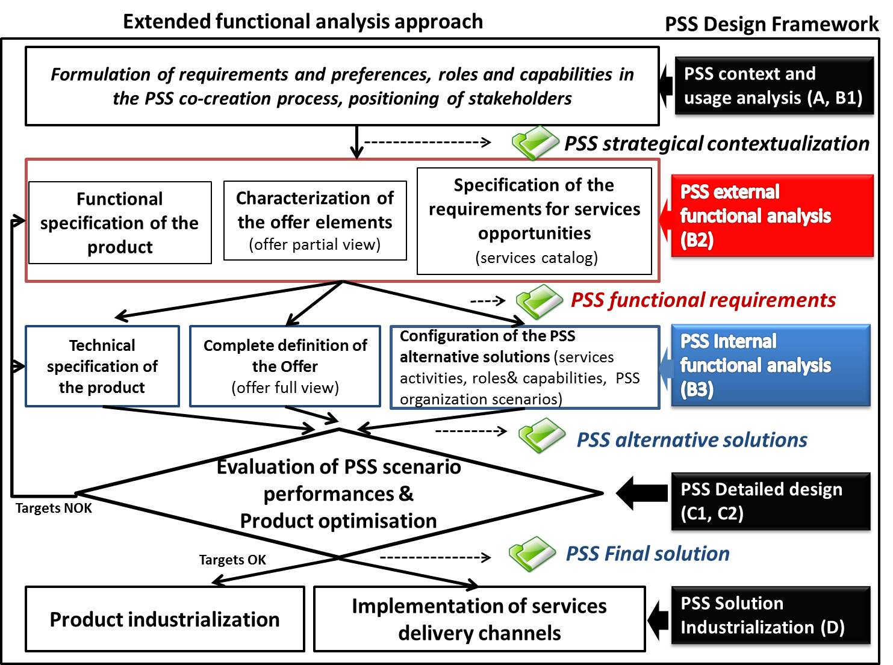
Extended Functional Analysis method (‘EFA method’ = result of collaborative industrial research)

Slide 11
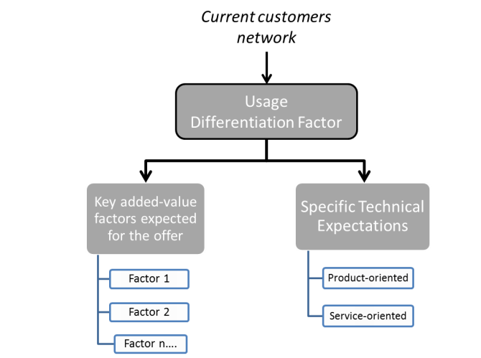
EFA method : context analysis and usage capture
Strategical contextualisation
Usage analysis
General analysis of the current client/user network of the company.
A narrow number of key users are identified, for specific interviews on usage expectations and client/customer
New service opportunities (Client employee training, Solution experimentations, …)
Innovation constraints for the customer (cost, competencies…), thus added-value of usage sale
Openness to collaboration
Internal Environment versus Service Orientation: SWOT Analysis
Internal strong and weak points of the collective competencies.
External Environment versus Service Orientation: PESTEL Analysis
Key external factors : Political, Economical, Social, Technological, Ecological, Legal
Technological context…versus Service Orientation: Technological and Service Innovation factors
First identification of key orientations for pertinent innovations on PSS
Back slide 10

Slide 12
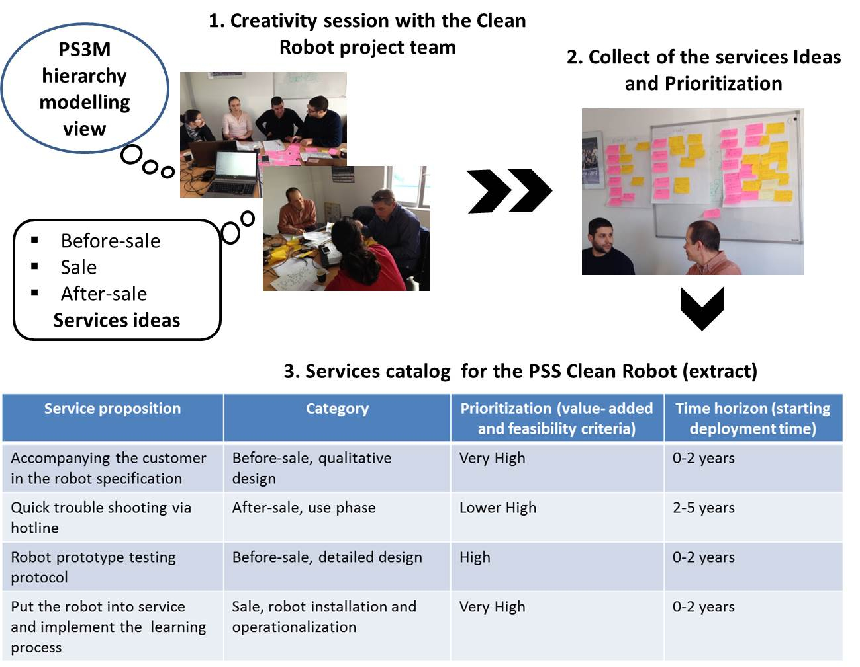
EFA method : study of service opportunities
Back slide 10

Slide 13
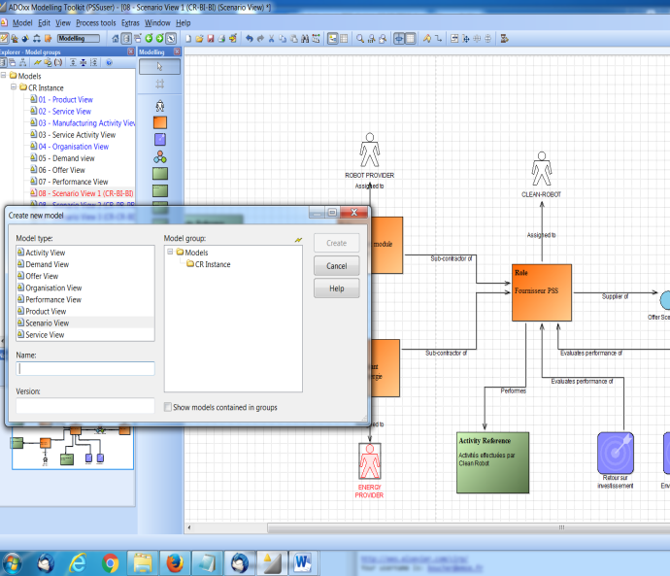
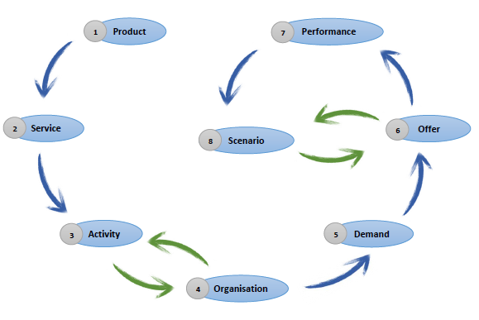
EFA method : study of organisational (industrial) scenarios
Scenarios : alternative PSS Offers (Product-oriented, Use-oriented, Result-oriented) which could be delivered on the market – Distinct actors, processes, economic models)
ADOxx meta-modelling platform
Structured modelling
procedure
+
Back slide 10

Slide 14
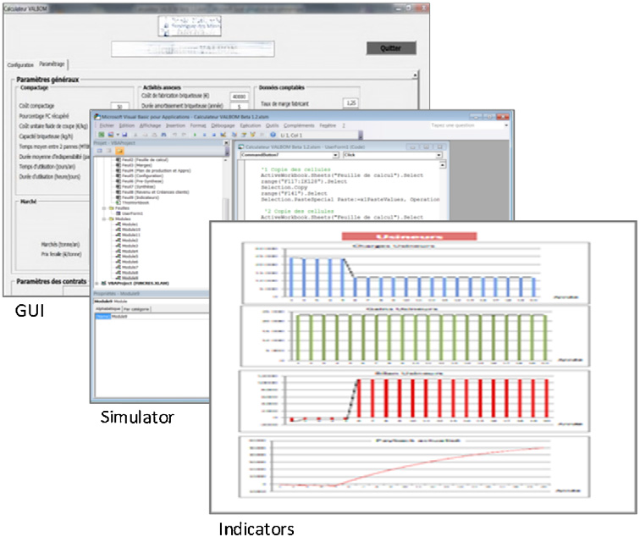
EFA method : assessment of performance and economic models for the organisational scenarios
PSS Decision-Making : add to the traditional CAD product simulation, a simulation of the full value creation network designed for PSS delivery.
PS3A : PSS Scenario Analyser

Slide 15
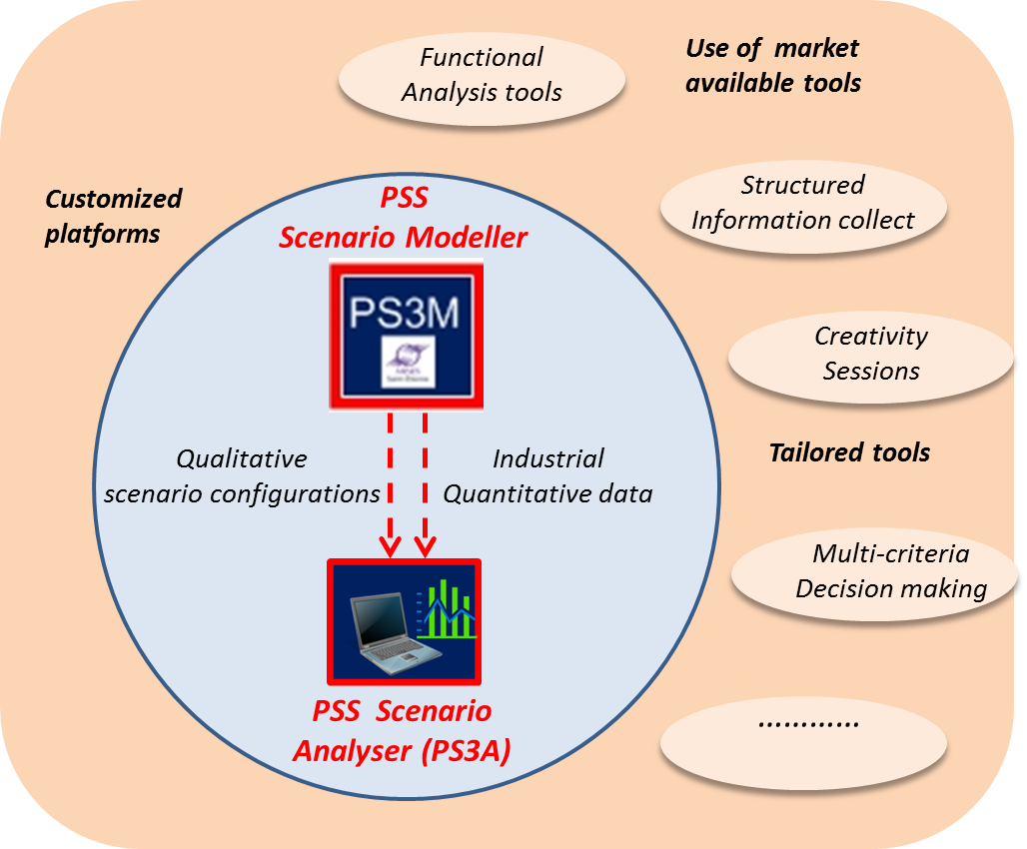
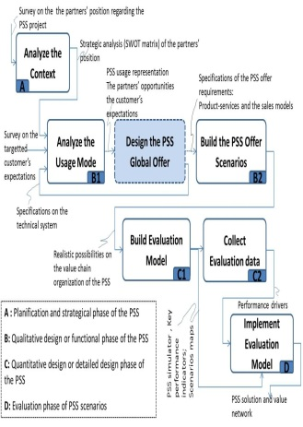
Integrated methodology associating PSS specific tools (PS3M & PS3A) with complementary design tools
TOOLSET
METHODOLOGY
+

Slide 16
Agenda
PSS Design problematics
Key concepts and methodologies for PSS design
Introduction to PS3M design approach and modelling toolkit

Slide 17
Utility of the modelling tool
Qualitative models, to capture and structure key pieces of information
Cognitive support to make explicit all pieces of information required for offer enginering and help interactions among all design actors

Slide 18
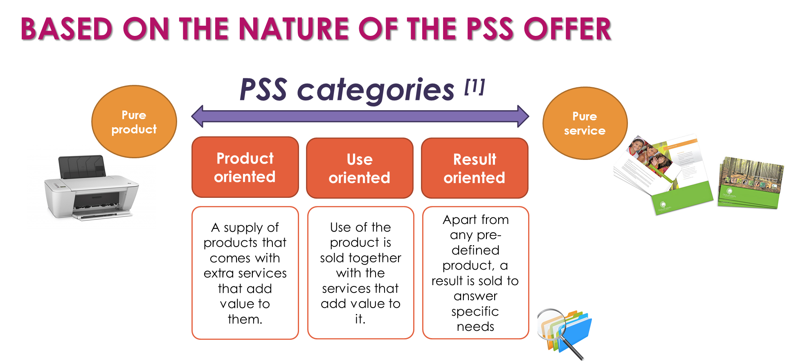
Modelling approach

Slide 19
Overall structure
Requirement
Product
Service
Activity
Organization
Modelling Views
PSS
STRUCTURE
Structural dimension of the PSS required to formalise the PSS offer architecture and its value creation network.
PSS
DYNAMICS
Behavioural dimension of the PSS. Market behaviours linked to the offer and performances factors associated to organisational capabilities.
Demand
Offer
Performance
Scenario

Slide 20
Example : STRUCTURE- « Requirement view »

Slide 21
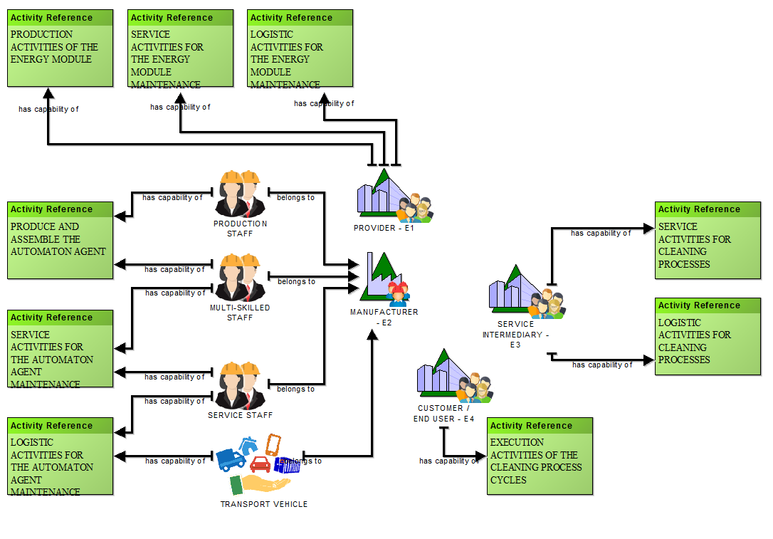
Example : STRUCTURE- « organisation view »

Slide 22
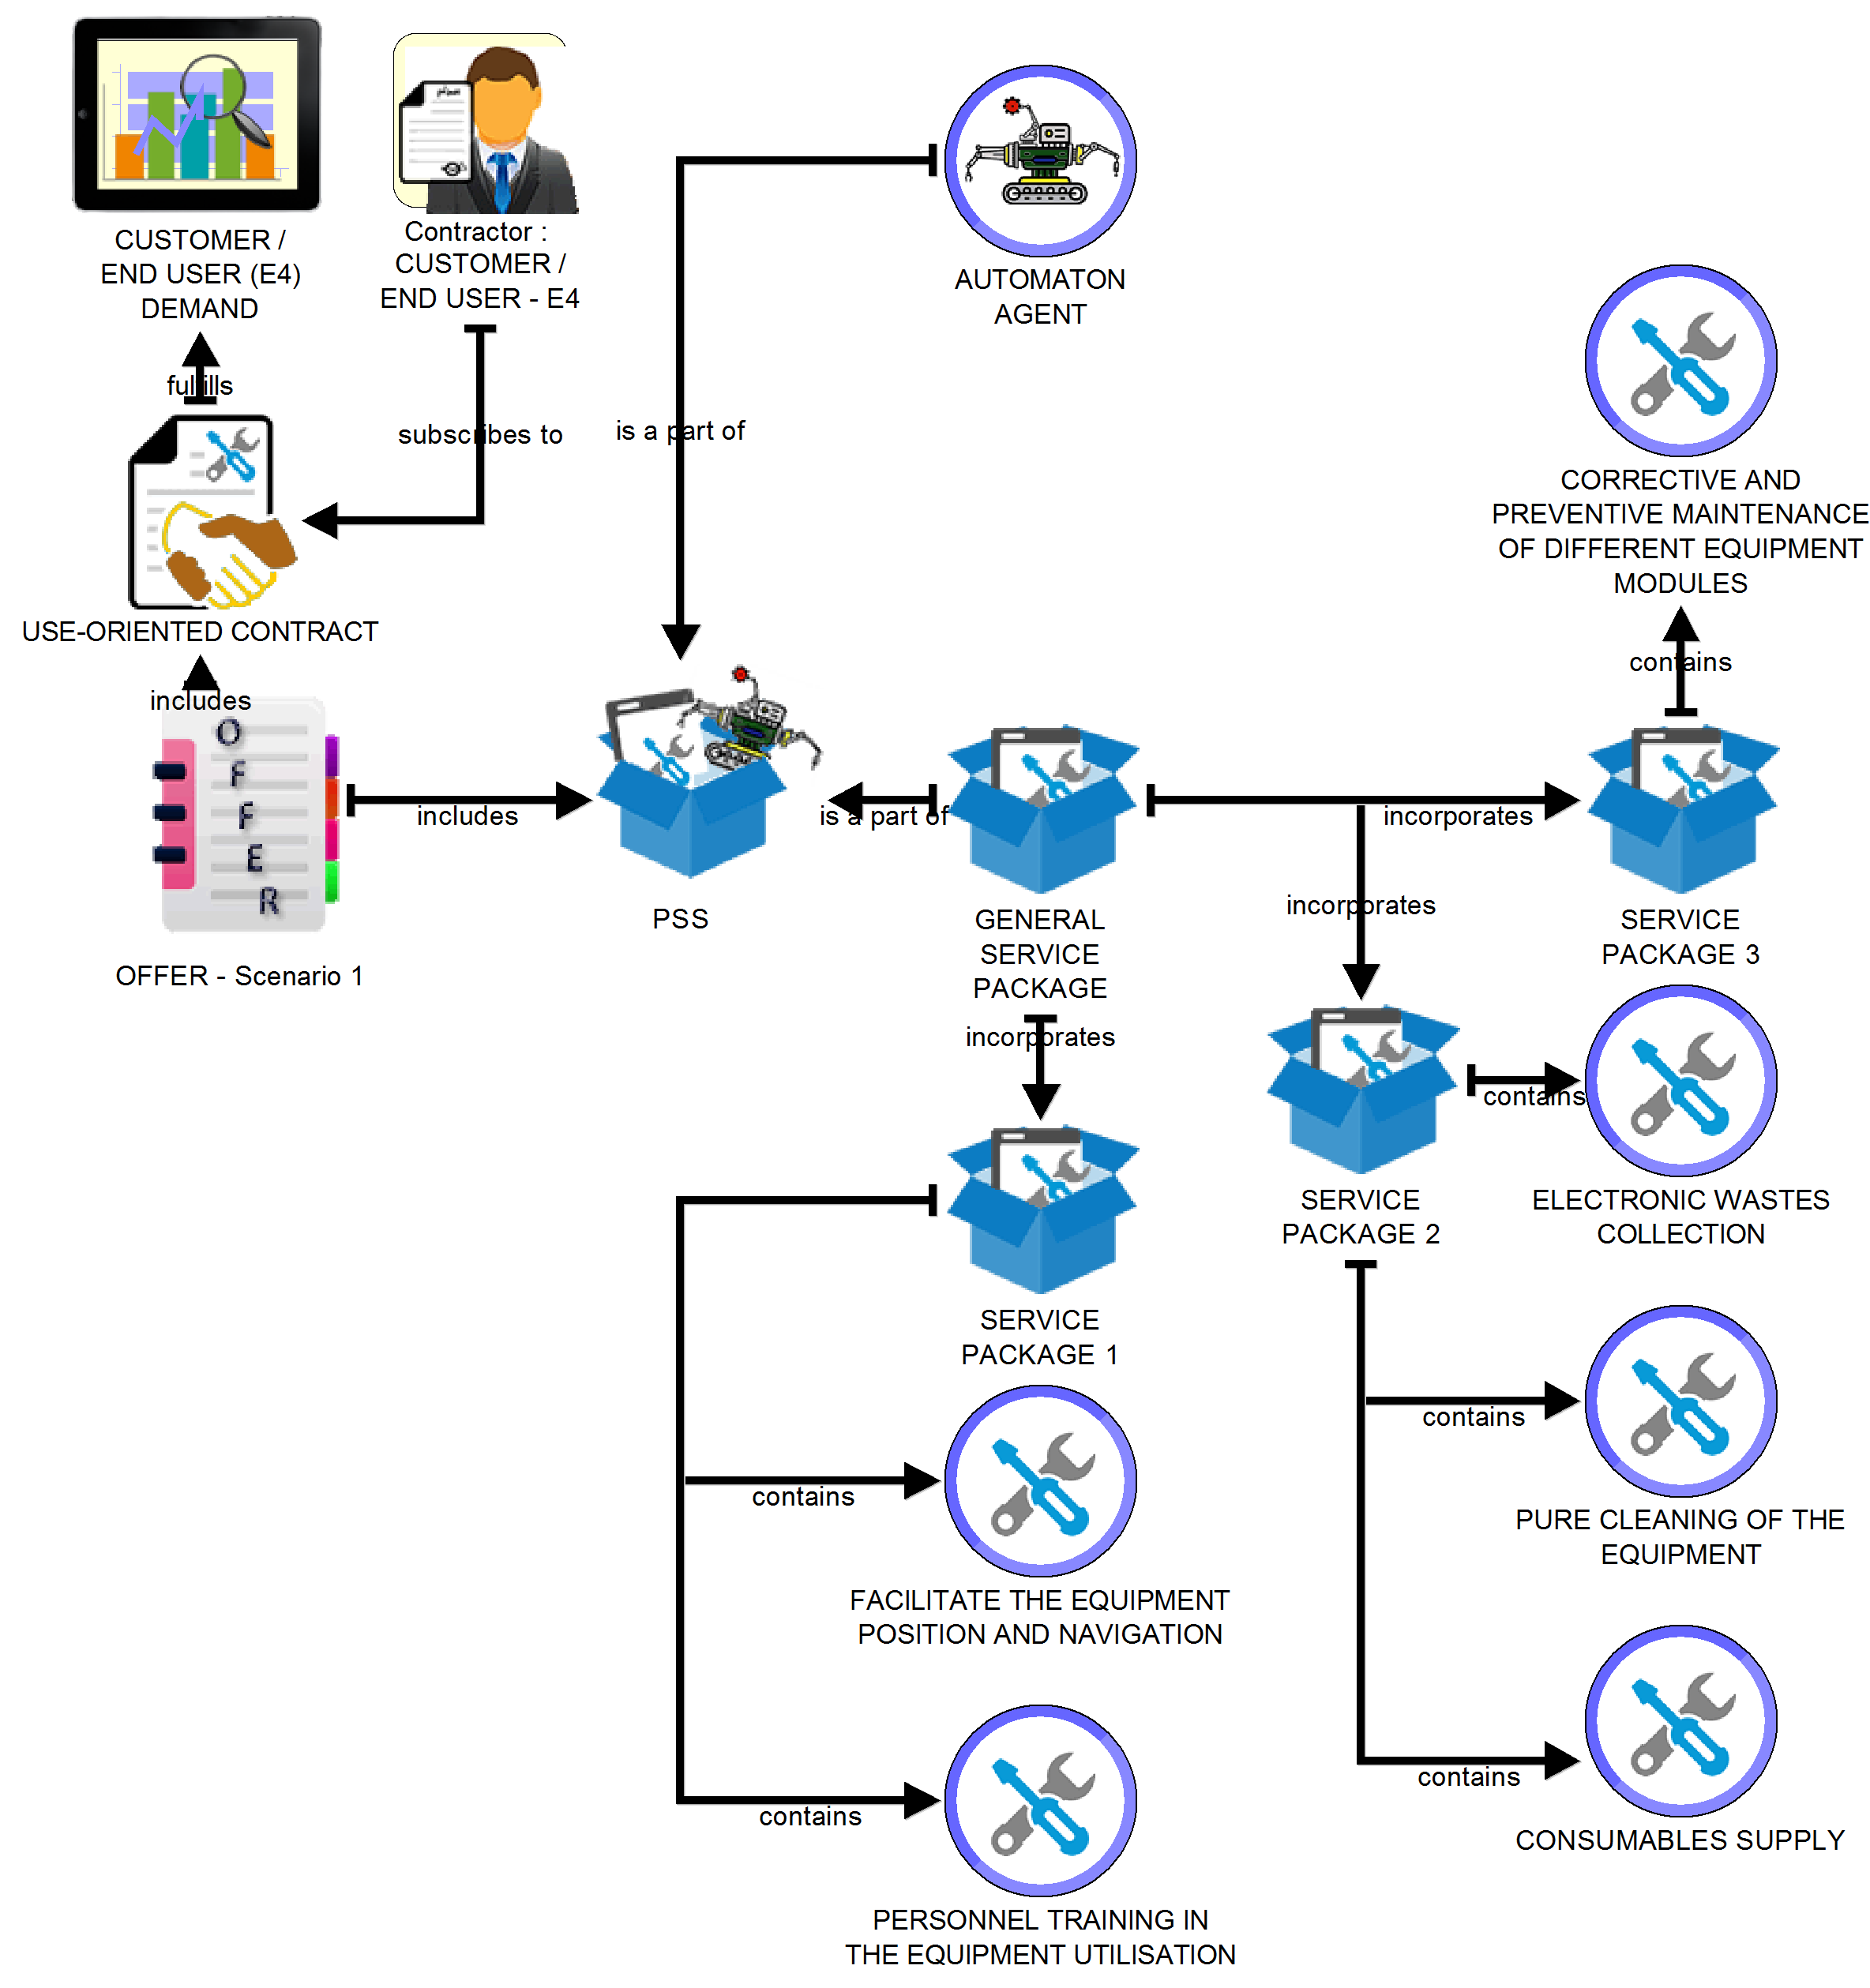
Example : DYNAMICS- « offer view »

Slide 23
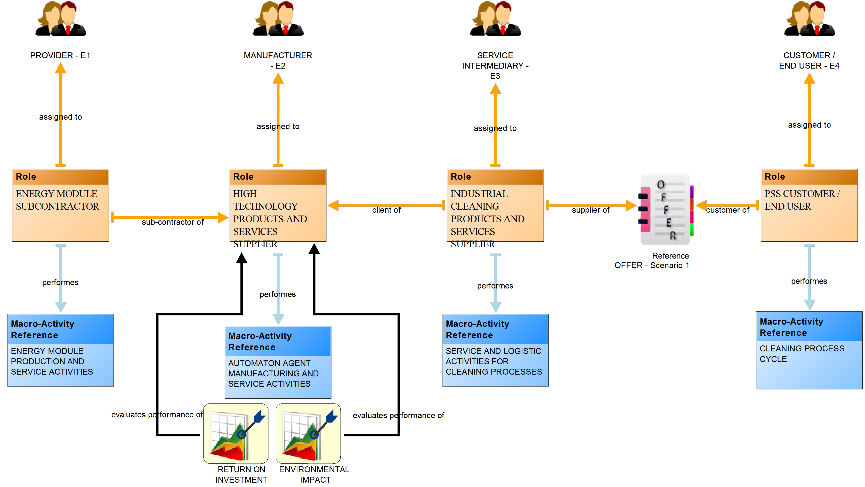
Example : DYNAMICS - « Scenario view »

