Slide 1

EMSE_07
Design Thinking for
Product-Service System Design
Elaheh Maleki

Slide 2
Objective
Objective: Defining a sustainable Product-Sevice System (PSS) using Design Thinking method and tool (OMILAB)
1
Design Thinking
(Basics)
2
Industrial
PSS Case
3
Design Thinking
for PSS
(OMILAB)

Slide 3
1. Design Thinking (Basics)
Objective: Defining a sustainable Product-Sevice System (PSS) using Design Thinking method and tool (OMILAB)
1
Design Thinking
(Basics)
2
Industrial
PSS Case
3
Design Thinking
for PSS
(OMILAB)

Slide 4
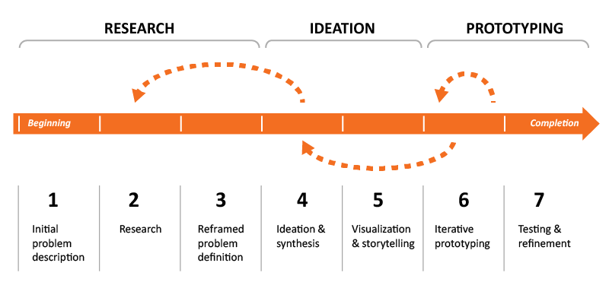
Design Thinking
How to approach problems using Design Thinking:
A user-centered, creative, and collaborative methodology for solving problems.
https://courses.edx.org/dashboard/programs/9b729425-b524-4344-baaa-107abdee62c6/

Slide 5
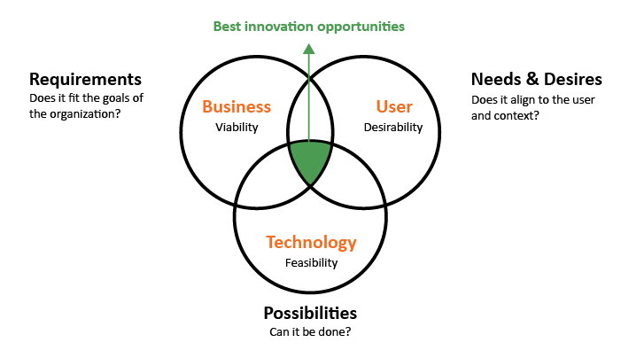
Design Thinking: 1. RESEARCH
User and target market research: provides an understanding of user environments (where the end products or services are intended to be used), practical and aesthetic aspects of potential solutions, and can even predict marketplace trends
Business research: consists of data and statistics related to the organization's interests or focus area such as a product portfolio plan, revenue/profit requirements, establishing geographic interests for product distributions, etc.
Technology research: focuses on assessment to determine strengths, weaknesses, and availability of particular materials or what resources might be relevant for a specific problem area.
https://courses.edx.org/dashboard/programs/9b729425-b524-4344-baaa-107abdee62c6/

Slide 6

Design Thinking: 2. IDEATION
Ideation:
When people talk about design thinking, it's usually the activities associated with ideation that come to mind. This is the stage in which all ideas, no matter how wild, are welcome. All ideas are then assessed against the research done in the preceding stage. Some common tasks are:
Visualization / storytelling
Strategic mapping of solution ideas by theme, such as product categories or timelines
https://courses.edx.org/dashboard/programs/9b729425-b524-4344-baaa-107abdee62c6/
https://www.omilab.org/nodes/design-thinking.html

Slide 7
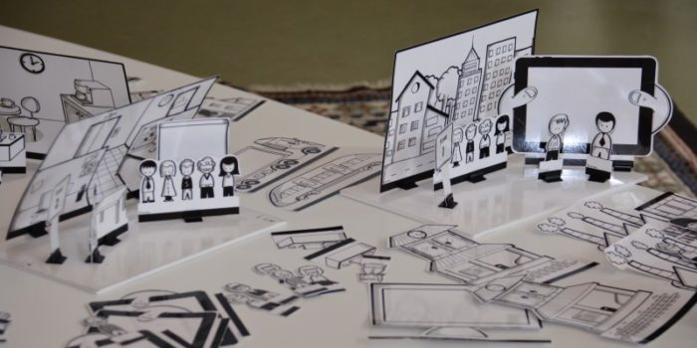
Design Thinking: 3. PROTOTYPING
Prototyping:
Prototypes are an opportunity to make your ideas real, or at least real in model form. Prototypes are a useful way of testing out strong ideas or products with users. Do your solutions really work like you thought they might? What do your users think of them? Prototypes can be used during any stage of the design thinking process.
https://courses.edx.org/dashboard/programs/9b729425-b524-4344-baaa-107abdee62c6/

Slide 8
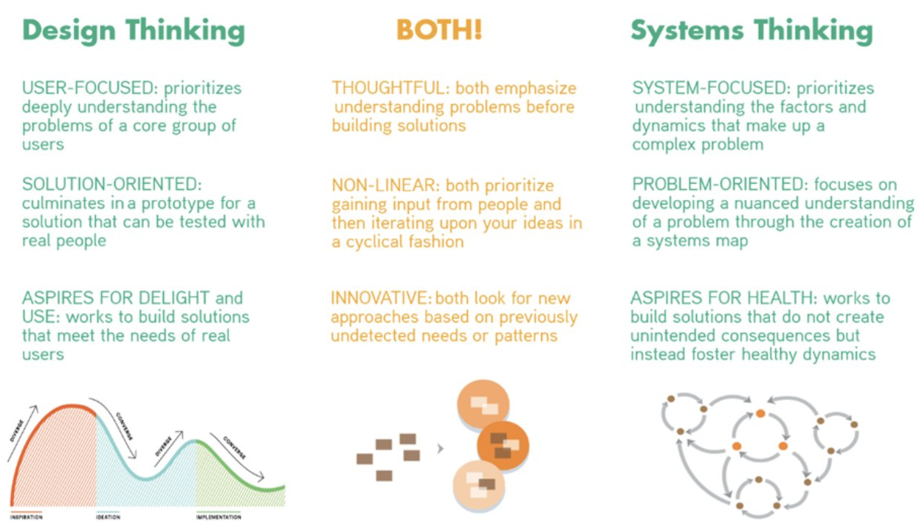
Design Thinking & Systems Thinking
https://medium.com/@conductal/beyond-design-thinking-the-systemic-design-thinking-framework-8d4952271222

Slide 9
Industrial PSS Case
Objective: Defining a sustainable Product-Sevice System (PSS) using Design Thinking method and tool (OMILAB)
1
Design Thinking
(Basics)
2
Industrial
PSS Case
3
Design Thinking
for PSS
(OMILAB)

Slide 10

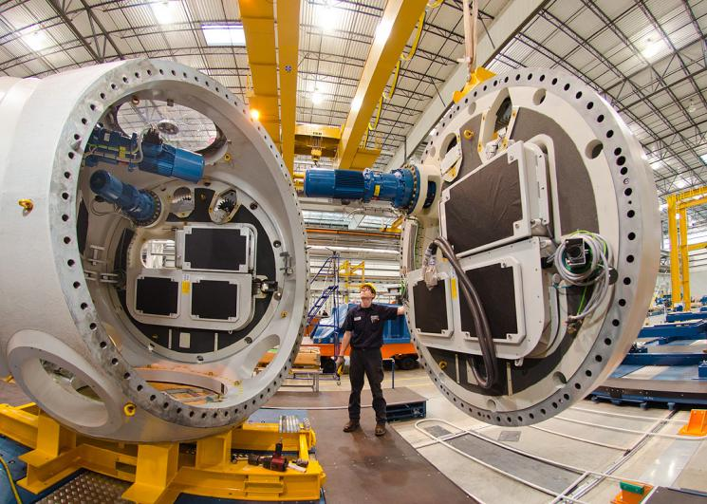
Industrial PSS Case
Green Energy
Manufacturing of wind turbines

Slide 11
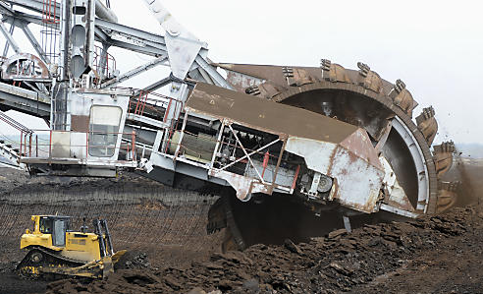
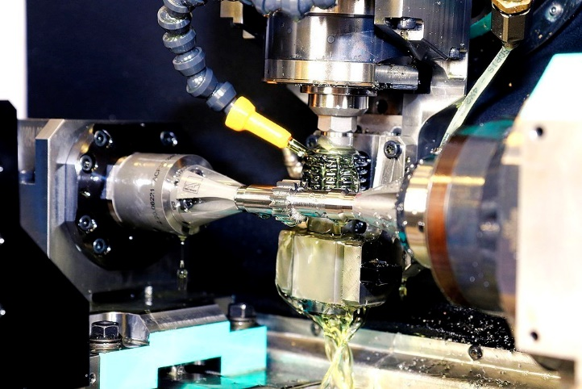
High precision gear grinding process
Manufacturing of Wind Turbines
Heavy Machinery
Gear grinding process
The method of finish grinding gear teeth
The significant step when building high precision gearing

Slide 12
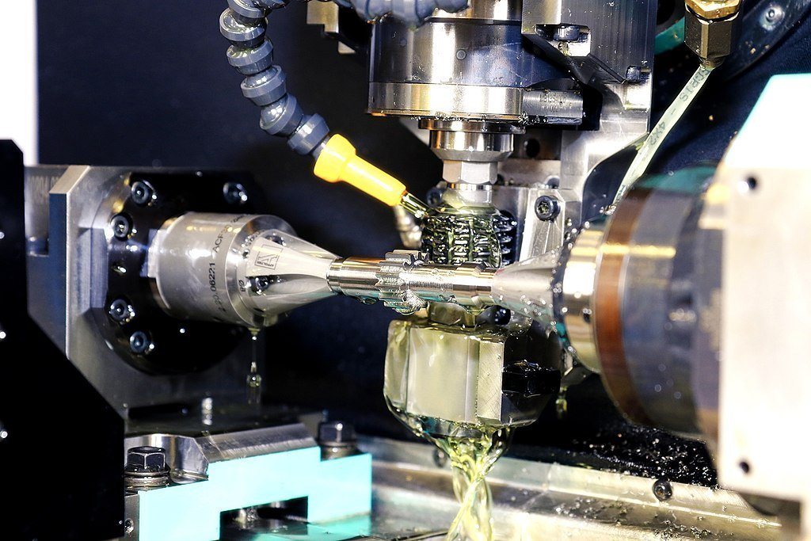
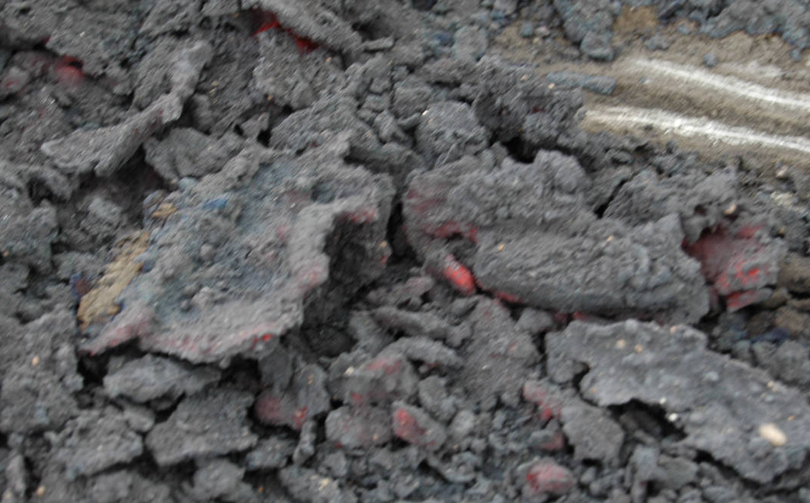
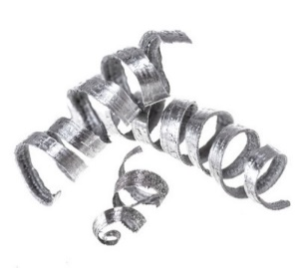
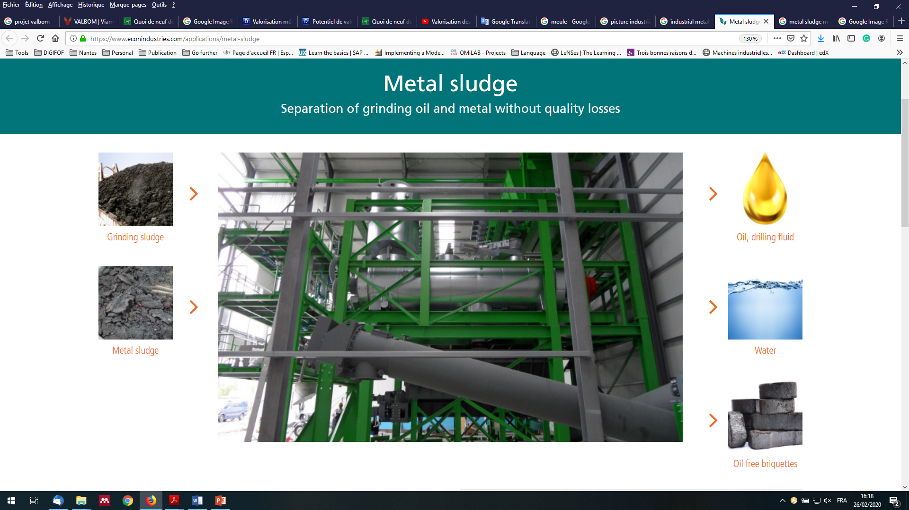
High precision gear grinding process
High precision gear grinding process
Produces Waste
Metal Sludge
Very small metal chips
Water
Grinding oil

Slide 13
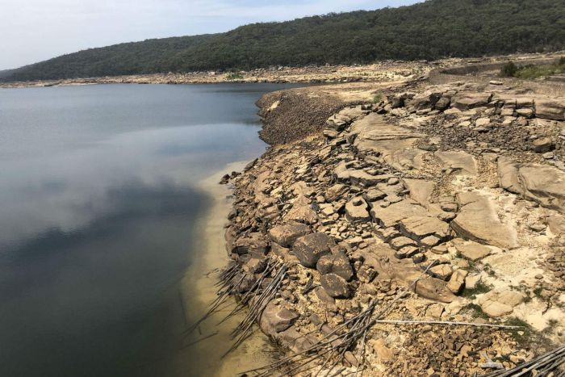
Damage of the metal sludge
Pollution for the field:
The sludge needs a lot of filed to be placed and will sink into the soil with the rain, change the content of the soil and even with heavy metal.
Pollution for the atmosphere:
The placed sludge produces an exothermic reaction which makes harmful gas. It also causes dust pollution with the wind.
Pollution for the water:
The content of CaO and MgO in these sludge will turn into corrosive strong alkaline hydroxide which will be away with water, these materials also turn the nearby water and soil with high PH value.
How to safely and efficiently dispose the grinding sludge produced during manufacturing processes?

Slide 14
Metal sludge:
Separation of grinding oil and metal
https://www.youtube.com/watch?v=4OddlnE7JSE

Slide 15
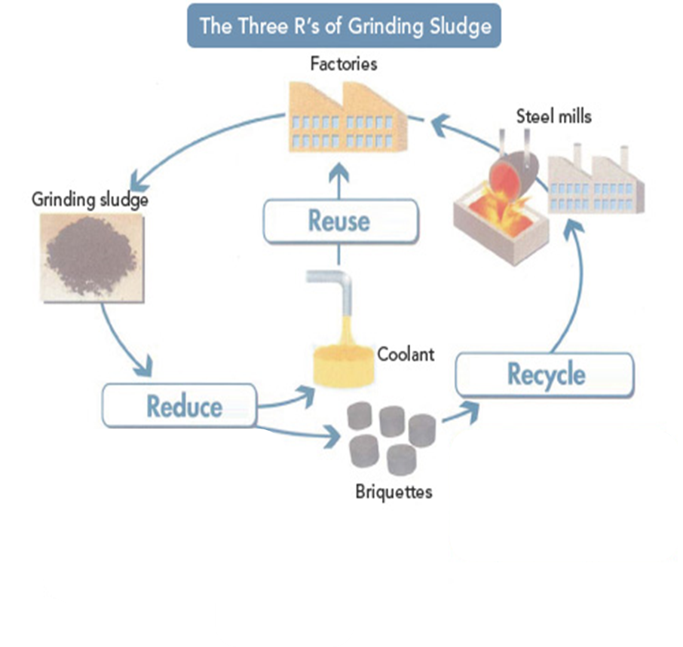
New “products-services” solution
based on circular economy and used sales

Slide 16
Possible scenario
This scenario is based on a service contract between the machinist and the manufacturer. The briquetting machine is at the factory, but the machinist does not own it: the manufacturer of the bricklayer makes it available to the machinist through a service contract. The scenario is based on the assumption of a service contract including preventive maintenance, curative maintenance, and support for the treatment of mud in the event of the briquetting machine being unavailable.

Slide 17

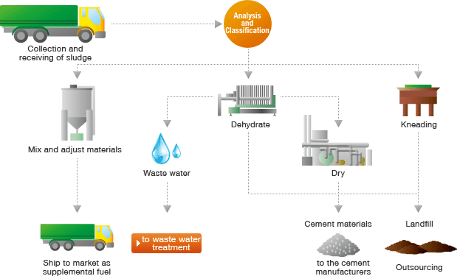
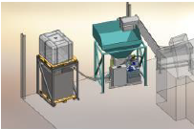
Possible scenario
Machinist reuses Waste water & Drilling fluid
Founder buys the briquettes from the Intermediary
Machinist produce Sludge as waste
Service contract to use the briquetting machine
Intermediary buys the briquettes and resells them to the founder
Sludge is sent to the briquetting machine
Waste water &
Drilling fluid
Briquetting machine extracts
Machinist sales the briquettes to the Intermediary
Briquetting machine belongs to the manufacturer
Briquetting machine is installed in the machinist place
Oil-free briquettes
Briquetting machine produces

Slide 18
3. Design Thinking for PSS (OMILAB)
Objective: Defining a sustainable Product-Sevice System (PSS) using Design Thinking method and tool (OMILAB)
1
Design Thinking
(Basics)
2
Industrial
PSS Case
3
Design Thinking
for PSS
(OMILAB)

Slide 19
OMILAB Downloads
Download and install Scene2Model:
https://austria.omilab.org/psm/content/scene2model/download?view=download
In 2 groups create 2 scenes from the viewpoint of the machinist and the viewpoint of the intermediary (Distribution Scene).
You can use the paper-made characters inside the box. As an exmple some characters are shown in the next slide.

Slide 20
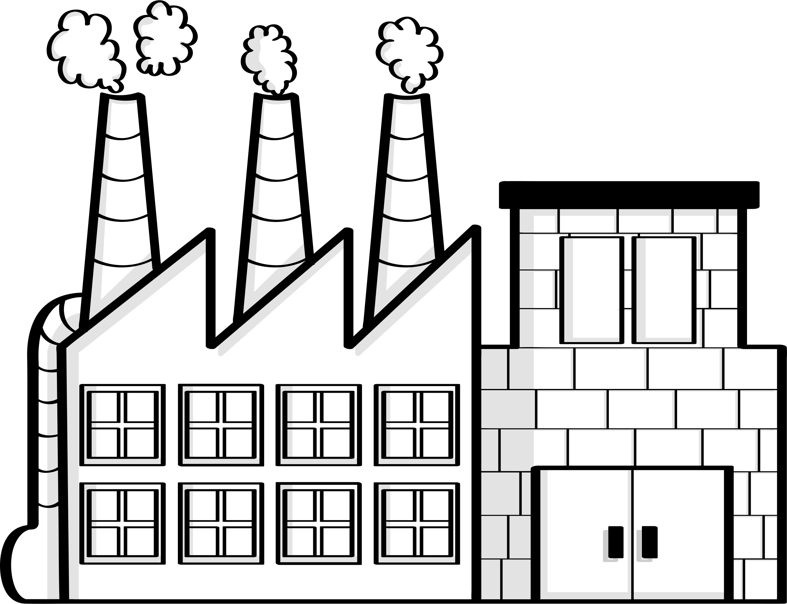




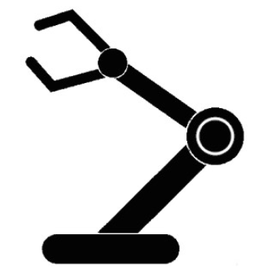


OMILAB Characters
Machinist
Briquetting machine Manufacturer
Founder
Waste water
Drilling fluid
Briquettes
Workers
Customers
Explanations
Discussions
Intermediary
Stock
Briquetting Machine
Service

Slide 21
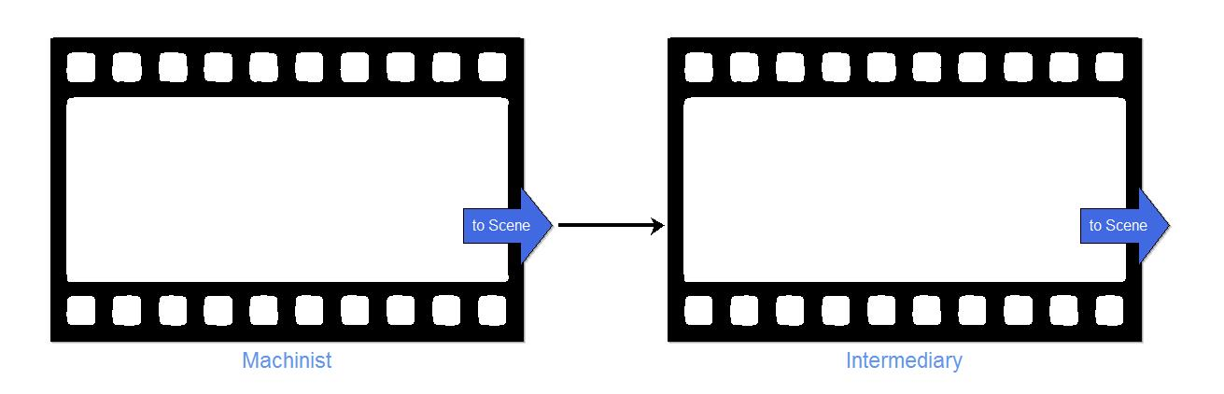
All Scenes

Slide 22
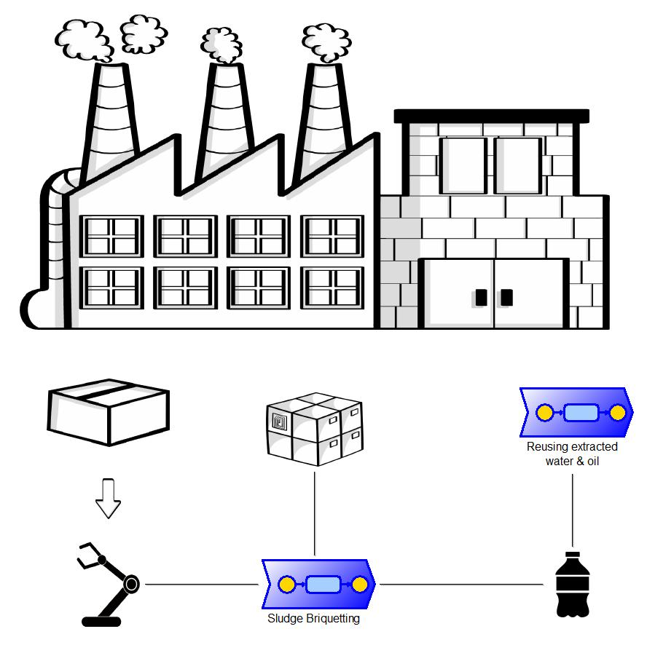
Scene 1: Machinist Scene

Slide 23
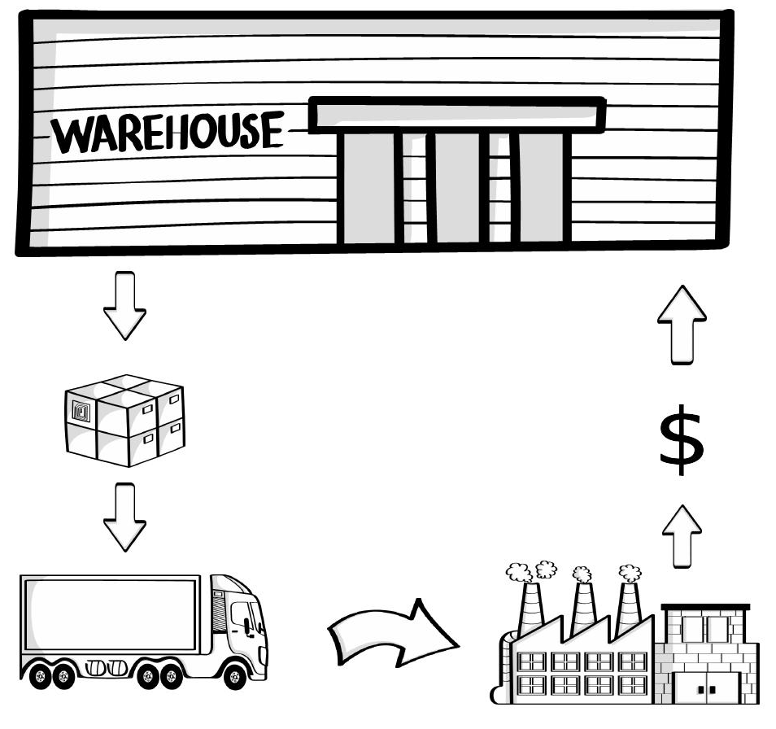
Scene 2: Intermediary (Distribution Scene)

Slide 24
Join DigiFoF network!
www.digifof.org

